Slide 1
Funding outlook for London local government
5 March 2013
Jon Rowney: Head of Fair Funding, Performance & Procurement

Slide 2
“I am keen to move to a radically different system of funding and support for councils that is built on strong incentives, is driven by local decision making and breaks this dependency [on central government grant]…”
Eric Pickles MP – Secretary of State CLG

Slide 3
Strong Incentives
Business Rates Retention
New Homes Bonus
Localisation of Council Tax Support
Public Health

Slide 4
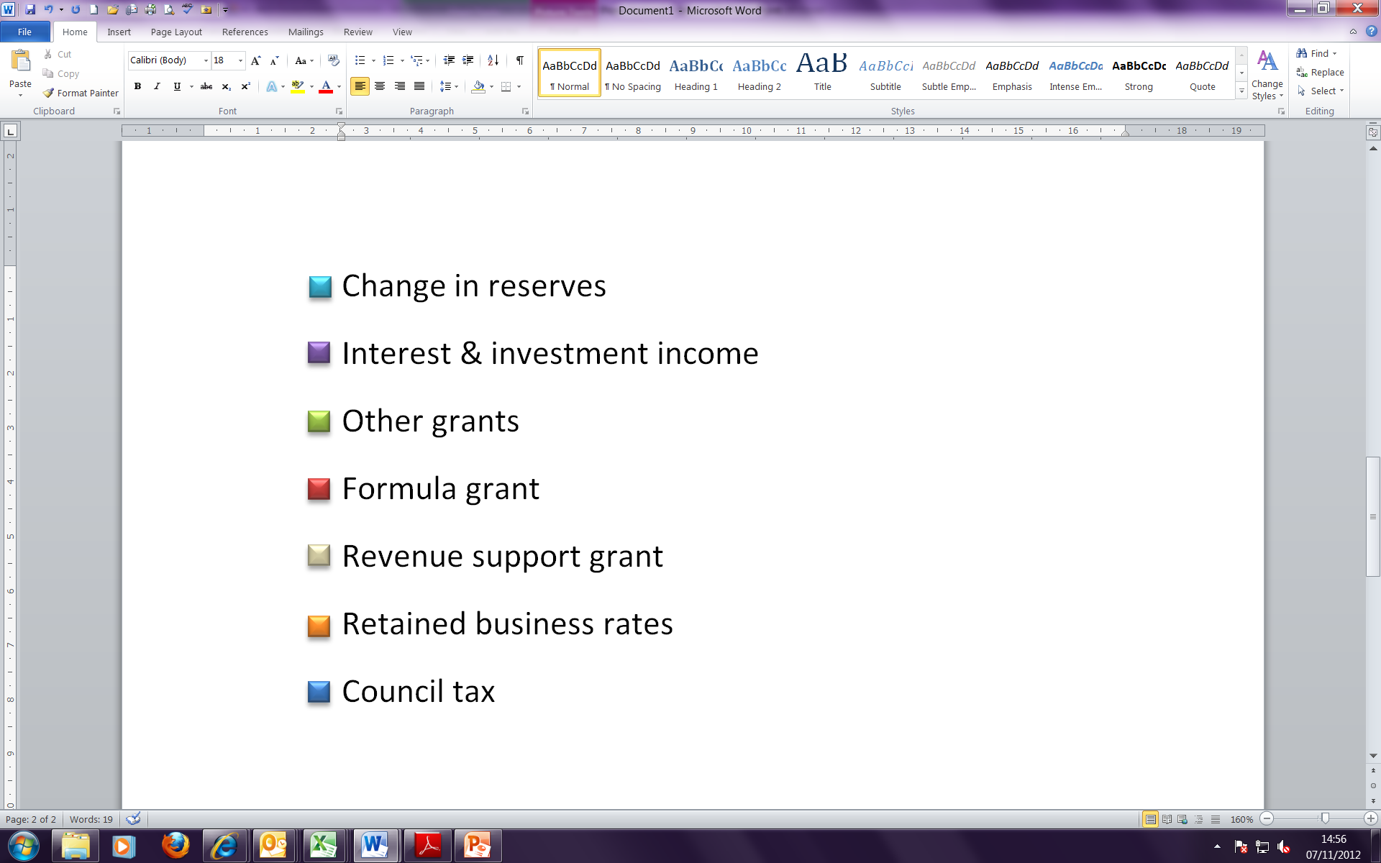
*

Slide 5
Spending Review 2010
Public Sector expenditure
  -£81 billion by 2014/15
Local Government core funding
  -£5.6 billion -19 % in cash terms
  -28% in real terms
Further 0.9% reduction in 2015/16 and 2016/17

Slide 6
Reflecting on SR 2010
Transparent and Comparable?
Delivery Arm of Central Government
The stretching of the 28% ‘Contribution’
  Is it closer to 33%?

Slide 7
The Cut to Local Government

Slide 8
The changing financial landscape…

Slide 9
‘the local government settlement is built on the principle of fairness, which means councils that deliver for their communities will make more’.
Local Government Minister Brandon Lewis

Slide 10
Local Government Finance: Risk, Reward and Competition
Can you build more homes?
Is your local economy thriving?
Is unemployment dropping?
New Homes Bonus Grant
Funding Topslice
More local business rates
Less local business rates
Lower council tax support costs
Higher council tax support costs

Slide 11
Pro-growth services are being cut hardest
Notes:
Source: Department for Communities and Local Government
Note: housing excludes housing revenue account.

