Slide 1
Local health impact of physical inactivity: a new JSNA toolkit
Dr Chris Payne

Slide 2
Physical inactivity - important part of obesity challenge
Energy in
Meals
Snacks and treats
Energy out
Metabolic rate
Physical activity – daily life
Physical activity - sport

Slide 3
Health impact much more than just obesity
Heart disease
Diabetes
Obesity
Physical inactivity

Slide 4
We all know smoking is a big killer
Smoking kills more people each year than the following preventable causes of death combined *
  ^{Obesity (34,100)}
  ^{Alcohol (6,541)}
  ^{Traffic accidents (2,502)}
  ^{Illegal drugs (1,738)}
  ^{HIV infection (529)}
Where does physical inactivity rank?
*ASH factsheet: Smoking statistics: Illness and death
(Alcohol 2009, RTAs 2007)

Slide 5
Population impact at least half as big as smoking
Smoking
  81,400 deaths in England
Physical inactivity
  46,750* deaths in England
Alcohol
  8790 deaths in UK (2010)
Road traffic accidents
  1901 deaths in UK (2011)
  *using Lancet calculations published July 21, 2012, figures yet to be finalised

Slide 6
Quick technical note
Smoking is much more harmful to an individual than physical inactivity
But
  Only 20% of population now smoke
  Over 80% are physically inactive
So population impact is huge

Slide 7
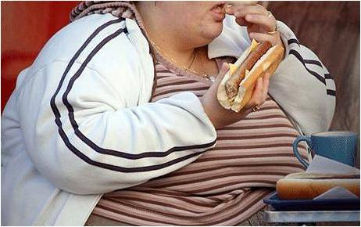
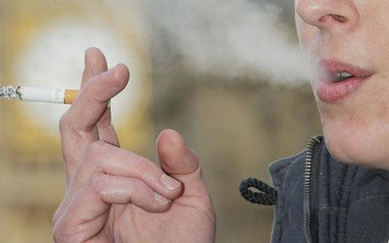

Other risks get more attention

Slide 8
How much of a problem is physical inactivity in my area?
Question for the JSNA
How does the problem compare with smoking, road traffic injuries, pollution, alcohol?
No good source

Slide 9
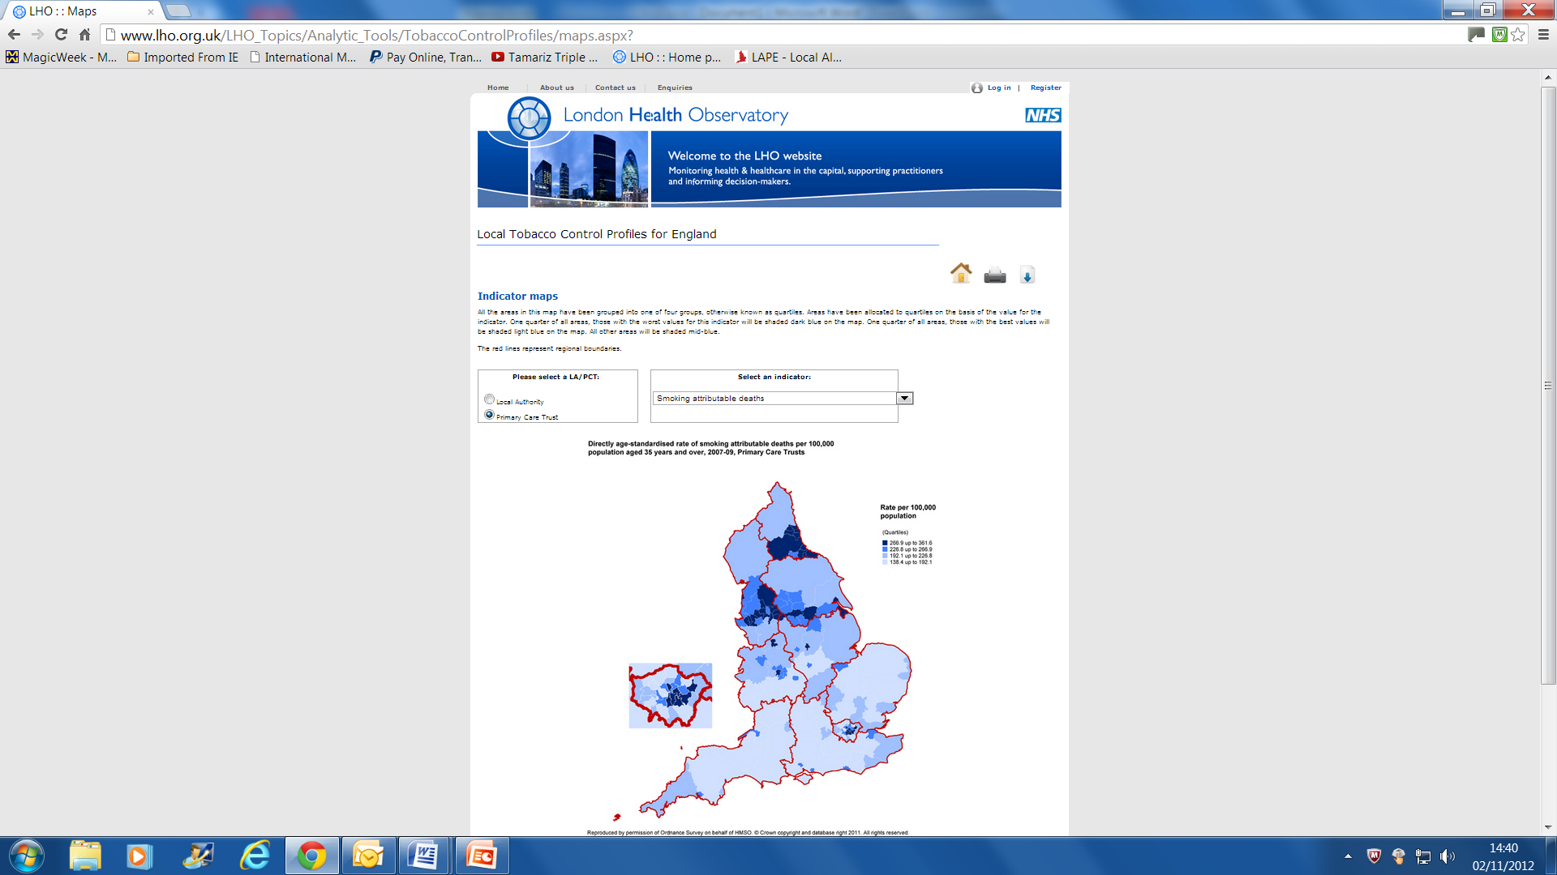

Slide 10
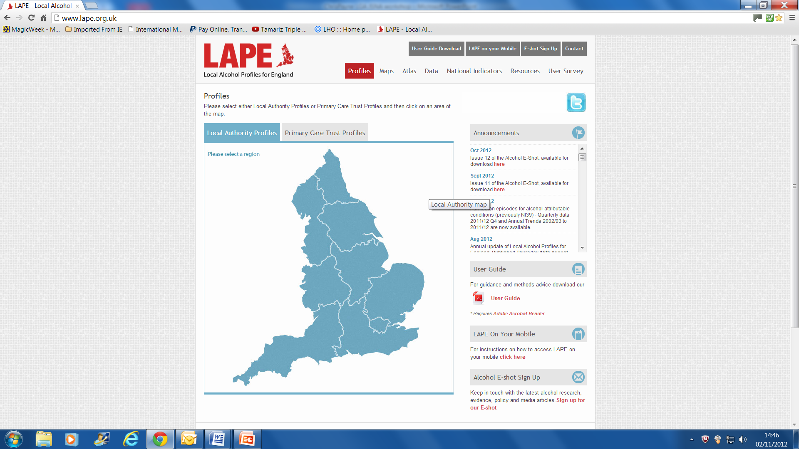

Slide 11
Health impact of Physical Inactivity - HIPI
For each LA in England, shows local impact of physical inactivity on annual preventable
  Premature deaths
  Emergency admissions with Coronary Heart Disease
  New breast cancer cases
  New colorectal cancer cases
  Cases of diabetes

Slide 12
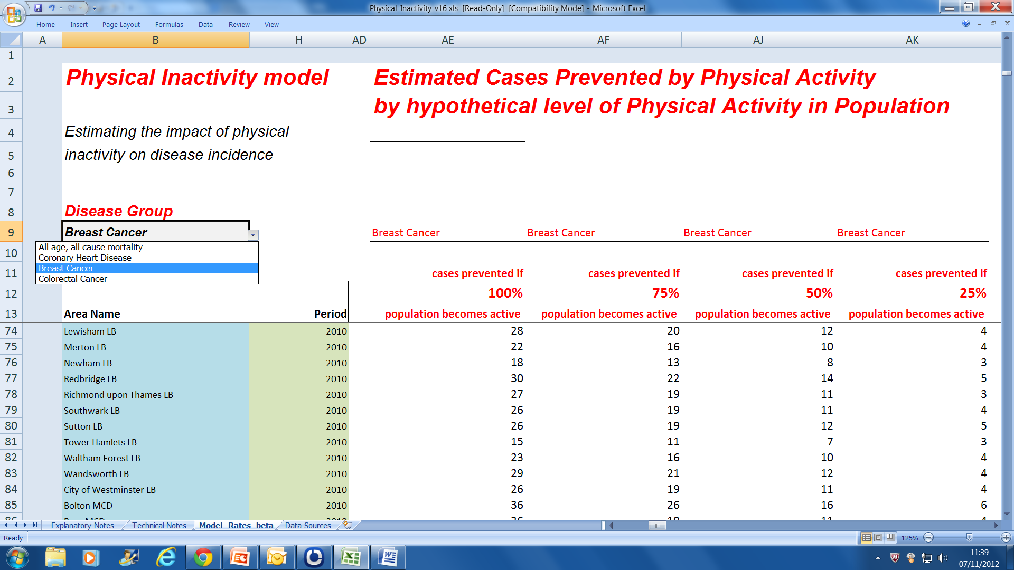

Slide 13
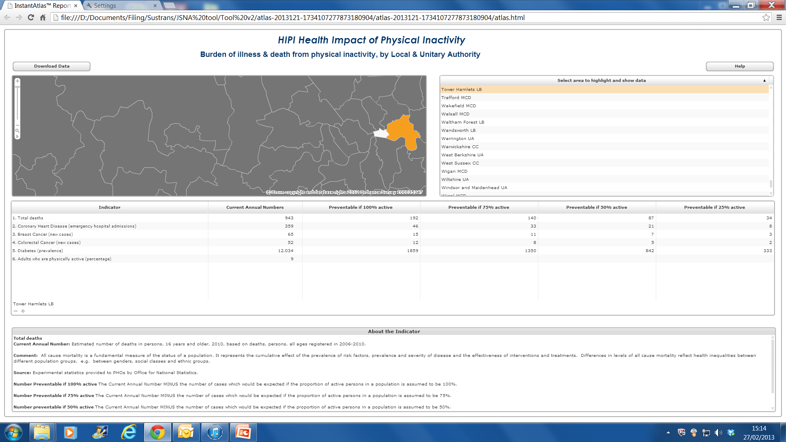

Slide 14
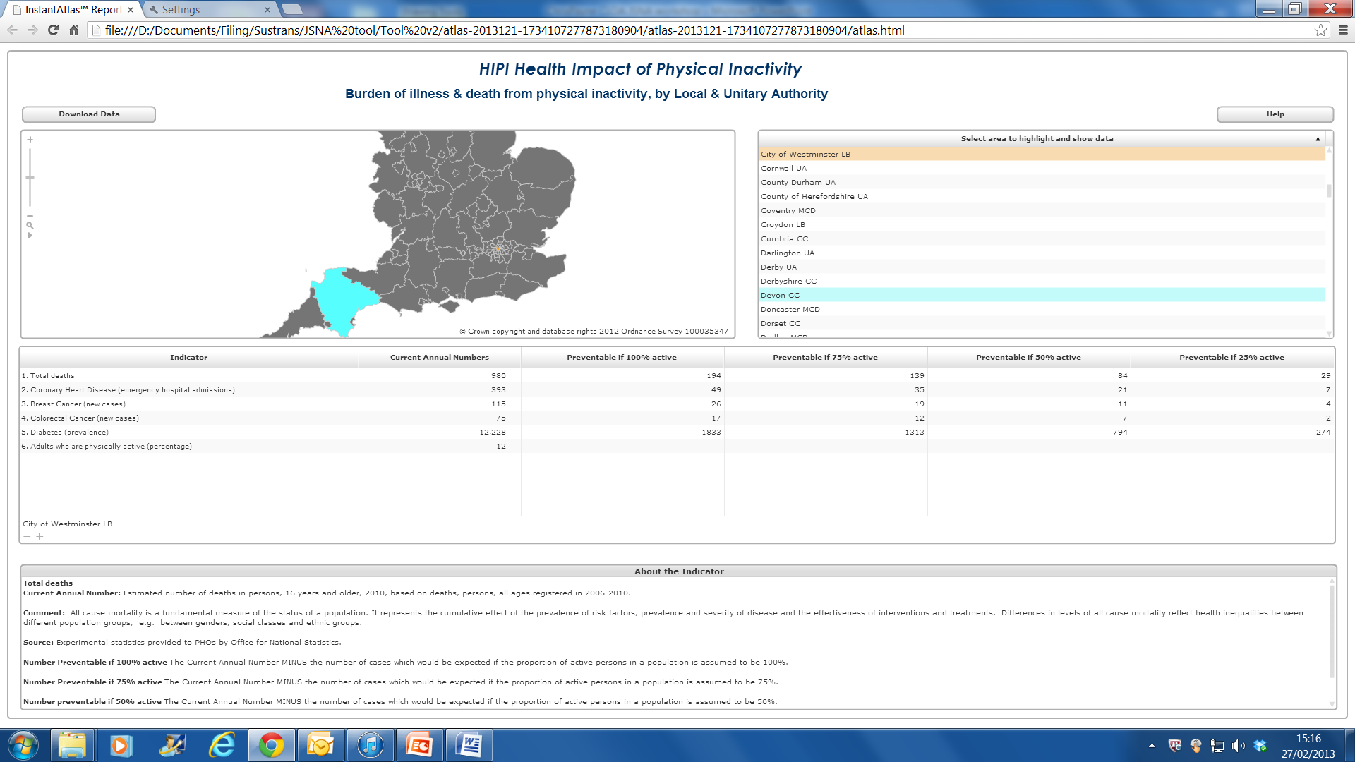

Slide 15
JSNA tool - HIPI
Will be published March 19th 2013
http://www.apho.org.uk/

