Slide 1
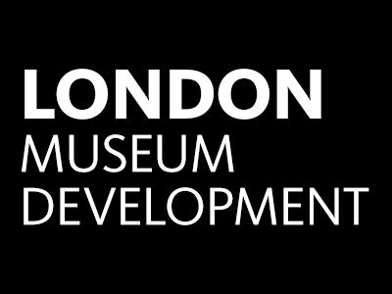
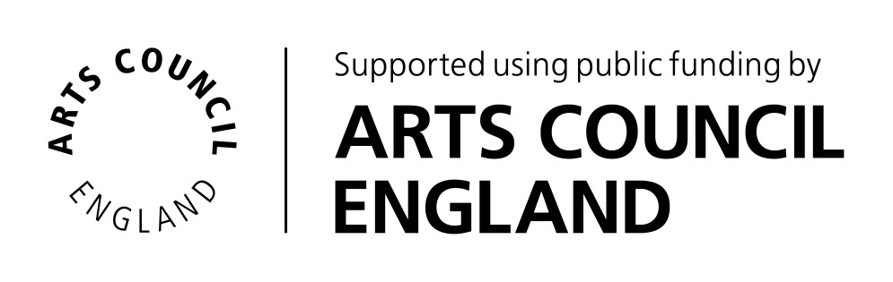
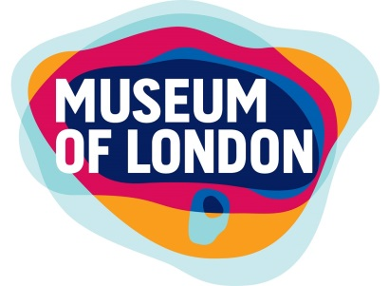
Supporting local authority museums – lessons learnt
Notes:
Intro Museum Development is a national programme funded by ACE and delivered as 9 separate programmes delivered in each of the English regions. It’s usually located at a major regional museum, in our case the programme is hosted by Museum of London.
The current policy context for museums in England is provided by the DCMS Independent Review of Museums (‘Mendoza Review’ Nov 2017). First government sponsored review of museums for 10 years. It has recommendations for ACE, National Lottery, Historic England and for DCMS itself concerning their strategic oversight of museum provision in England.
It also makes a series of ‘suggestions’ for two other key players over whom it doesn’t have direct influence. These key players are local authorities, still a major provider of museum services in this country, and museums themselves. Yvette to take a look in a moment at DCMS’ best practice suggestions for museums, in the context of our experience of running resilience programmes for local authority museums over some years. I will take a look first of all at the suggestions for local authorities, and how far the Review’s recommendations chime with our experience of running our programme in London

Slide 2

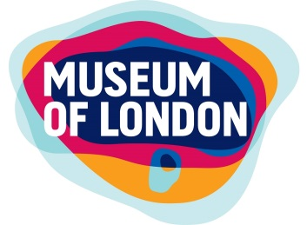

Independent Review of Museums, DCMS
‘Suggestions’ for local authorities:
Making the most of your museum
Bringing down barriers to innovation and enterprise
Challenges around alternative governance models
Appointing effective museum leaders ……and listening to them
Notes:
Making the most of your museum
The headline suggestion is perhaps the obvious one about local authorities making the most of their museums, with their potential for contributing to place-making, economic regeneration, educational attainment and improving health outcomes.
London’s most high profile exemplar in this respect is Waltham Forest’s William Morris Gallery, which won Museum of the Year in 2013 and whose own success has had a transformational impact on Walthamstow and the wider borough. William Morris Gallery has continued this success, with its collections at the heart of a £1.3m awards under the Great Places Scheme this year to further embed culture across Walthamstow.
This really shows what can be achieved when museums are able to form effective partnerships with local businesses, health and education providers. The Review agrees that a key element of this is museum leaders having the evidence of what their museum contributes, as well as the influencing skills to make the case. Evidence, influencing and advocacy skills for museums are something that Yvette’s training programme can help with, and she’ll say a bit more about that in a minute. The Review also talks about that extra little bit of help and brokerage that museum leaders might need from their own bosses to make those relationships with decision-makers.
Bringing down barriers to innovation and enterprise
Another of the Review’s recommendations is about bringing down the barriers to enterprise and innovation which confront local authority museums. A lot of this goes back to the 2015 ACE research piece on the characteristics of successful local authority museums. This report found that a key factor for successful museums was a culture of innovation and enterprise among both museum staff and senior leaders.
This government Review now seems to be taking steps to actively encourage enterprise. DCMS is to explore with DCLG an offer on operational freedoms for museums around retention of commercial profits and managing reserves across financial years. . Greater autonomy around online presence and brand identity are also to be discussed.
We would agree that these are issues which have long needed addressing. Certainly a few museums in London have been allowed their own Facebook or Twitter accounts, but hardly any their own web presence, so the opening up of a discussion on this would also be welcomed
Challenges around alternative governance models
A strong feature of the 2015 ACE report was the way it recognised that a culture of innovation right across a museum and its host authority might be a more important consideration than new governance arrangements. Inevitably, given the financial context, the Review spends quite a bit of time talking about switching to trust models. The risk of this for an authority is a lot more spent looking inwardly on something which doesn’t carry a guarantee of actual improvement.
For local authorities who do decide to try and find alternative arrangements for their museums, there is the usual set of suggestions in the Review about ensuring effective governance arrangements, about support for senior staff involved the process, and about arrangements which ensure appropriate degrees of independence, flexibility and risk. There is a recommendation that by next summer the LGA should have worked with ACE to produce best practice guidance on setting up independent trusts.
We could have a debate on whether or not we need more written guidance on trust models. One thing we do know from the London experience is that new trusts, even the larger ones which cover not just the museum but the whole heritage service, are never likely to be totally self-funding . One or two such as Greenwich and Redbridge have gone well enough for the council to commit continued revenue funding across years. But equally others have recently faltered and have been taken back in house by the council, despite the financial challenges the council itself is facing.
Appointing effective museum leaders……and listening to them
The Review also makes suggestions about museum leaders. It talks about the importance of local authorities appointing museum leaders with skills including business management, fundraising, diversifying audiences, place-making and partnerships - incidentally it will only be possible to appoint people with all those skills if the posts are at the appropriate grade.
Most importantly, the Review suggests that once those people have been appointed, they should be given the freedom to operate, and listened to. This is a point we would concur with from a London perspective. Those Local authorities who have pulled off success with Heritage Lottery Fund over last few years have fully involved museum leaders in the process. As well as Waltham Forest, a good example is Harrow’s HLF-funded re-development of its Headstone Manor & Museum. Moreover it’s fair to say that all museum managers would have good insights into HLF questions about the significance of collections, so it’s always a mistake to exclude your museum staff completely from the HLF process

Slide 3
The London experience – other current issues
Challenges of downsizing
New museum projects
Notes:
It might also be worth taking a minute to consider some issues we have observed from our London experience which are not fully highlighted in the Review
Challenges of downsizing
Whilst we have had few outright closures so far in London, we have certainly had downsizing, and this taking place at museums with already very small staff teams. At the same time, there has been an increased pressure on remaining staff to take on new duties, particularly fundraising. Some of the most energetic museums have taken the challenge head on and have had some success with various grant streams. But there has been quite a bit of burning of midnight oil, and there is a concern about how sustainable this pattern is.
Many of our local authority museums are co-located or co-managed with archive services, so there has often also been a process of merger accompanying the downsizing. Some boroughs such as Barking & Dagenham and Islington have been able to make a virtue of this by skilfully integrating the team that works across the museum and archive. In other cases the loss of skills and reliance on more generic ‘heritage assistant’ job descriptions has led to problems. This particularly relates to management of things behind the scenes – museums and archives have very different collections management practices. The evening networking events which Yvette runs for London museum and archive staff have been case-studying some good approaches to these challenges, and these sessions are always well worth joining in.
New museum projects
Whilst the Review takes quite a bit of space mulling trust models, an equal trend we have noticed over the last couple of years in London is for local authorities to be pursuing brand new museum projects. Most of these have been encouraged by the apparently easy win of the government’s LIBOR banking fines fund – quite a few are military heritage projects, typically ex-RAF airfields dotted around the edge of London. This trend for eye-catching new projects does seem as visible to us here in London as the trend for setting up new trust arrangements.
We do understand that the push for these projects can be political in nature and come from on high, but there are always handy guides around that you can use to explain upwards in simple terms the complexity and challenge of setting up brand new museums. The best of these is the Association of Independent t Museums guide on setting up new museums, and we’re happy to provide this to anybody who needs it.

Slide 4
Ben Travers
Regional Museum Development Manager
btravers@museumoflondon.org.uk
020 7001 9831

