Slide 1

Cityread London 2012
1 book – Oliver Twist
1 month
33 London library services
900+ events

Slide 2
Mission, Vision, Values
Mission
To raise the profile of libraries in London, by helping them bring reading to life for London’s citizens, visitors and students.
Vision
By 2015 Cityread London will become an internationally recognised annual literature festival with libraries at its heart. Cityread will work with partners to engage new and diverse audiences year on year.
Values
Cityread London works collaboratively and openly with libraries and partners. We value teamwork and inclusivity, and are innovative, creative and passionate in our approach.
Notes:
London is a world class city. She deserves a world class library service.
Cityread is the only pan-London libraries project currently running.
Joined up thinking in libraries and more widely in culture.

Slide 3
The programme
Central idea – bringing reading to life
Three key strands allowed libraries to play to their strengths:
  Children & Family
  Local history, family history, archives
  Creating new work
All underpinned by a strong digital offer

Slide 4
Bringing reading to life
Free books for libraries as part of publishing partnership
All library reading groups encouraged to take part
Centrally funded ten one-man Dickens performances by actor Laurence Foster
Hosted tea and Dickens readings in Queen Victoria’s bedroom, Kensington Palace
Threw a very Victorian dinner party in the heart of Artful Dodger’s Clerkenwell

Slide 5
Children & Family
All boroughs had a programme of children’s events - reworked Easter craft sessions/tagged existing events – eg Victorian rhyme times
Cityread funding covered the Dodgy Dickens Family Day at V&A Museum of Childhood
Free cinema screenings
Comic workshops & hip hop Dickens workshops were centrally funded
Printed resource

Slide 6
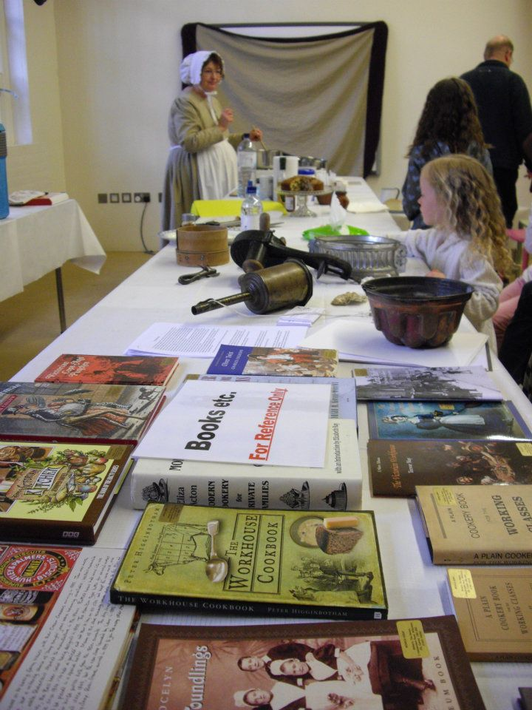
Gruel Lady, Dodgy Dickens Family Day

Slide 7
Local history & archives
All boroughs ran at least one local history event, some hosted walks and pub crawls
Some ran family history workshops – Discover your Victorian Ancestors
Birkbeck lectures
Claire Tomalin author event
Dickens’ London Trails app
Notes:
Birkbeck lectures – standing room only, part of their outreach programme. Also worked with Queen Mary & Holloway, University of Roehampton, University of East London

Slide 8
New writing
Young Writer in Residence at The Charles Dickens Museum
Birkbeck workshop
Hip hop Dickens
Twisted London comic workshops
Children’s short story competitions
Notes:
Attractive to Arts Council

Slide 9
Cityread Digital
Website www.cityreadlondon.org.uk
Facebook www.facebook.com/cityreadlondon
Online book group led by Dr Holly Furneaux
Twitter @cityreadlondon
Cityread blogger Aoife Mannix
Dickens London Trails app
Notes:
Online book group – led by Dr Holly Furneaux
Website – 23,000 hits
Blog – 1500 hits
Twitter – 426 followers
Facebook – 841 likes
Guest blogger – David Nicholls
Tweeted by Stephen Fry

Slide 10
Cityread Marketing
Leaflets
Posters
Launch at St Pancras International
Window displays at Foyles bookshops
Hip hop Dickens part of World Book Night programme at Southbank Centre
MP mailshot
Radisson Edwardian partnership
PR campaign
Notes:
Marketing – all the different ways we tell people about what we’re doing
The ‘product’ is still libraries, the campaign is what we use to sell it, how we take our ‘product’ to new audiences, instead of expecting them to come to us.

Slide 11
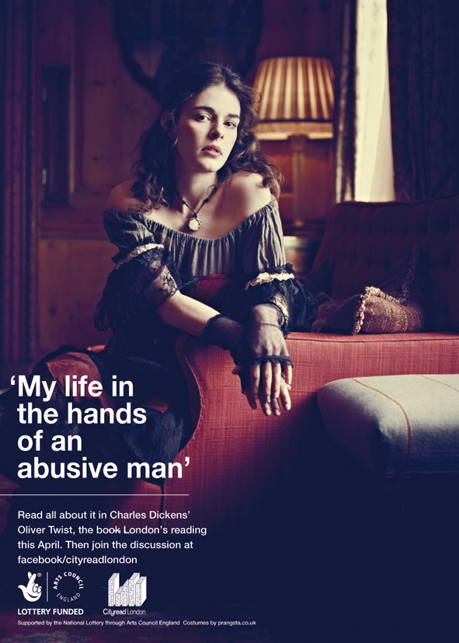
Notes:
Marketing
AMV/Ogilvy
Photographer Jason Bell (Michelle Pfeiffer)
Venue – paid; makeup artist paid
Costumes – at cost from friend’s shop
Models – free/portfolio shots
Also did Dodger one – How I survive living on the streets of London
Logo

Slide 12
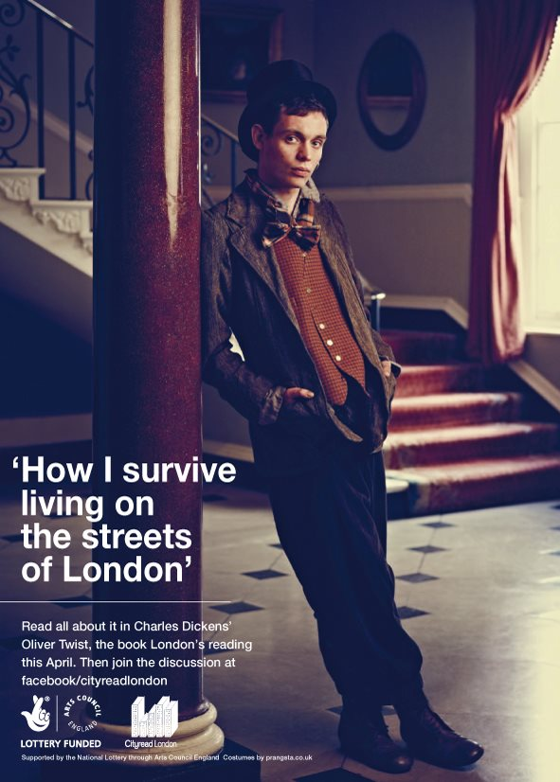

Slide 13
Our audience
Wanted to appeal to as wide an audience as possible
Identified some key groups within that spectrum
  Children and young people
  Prisons
  Developed translation packs with the Asian Librarians Advisory Group (ALAG)
  Encouraged libraries to work on a local level
Notes:
Attractive to Arts Council

Slide 14
Cityread 2012 Finance
£400 contribution per borough = £13,200
£86,000 Arts Council funding for 2012/13
£1,500 contribution – Oliver! The Musical
Final budget £231,000 (in cash and in kind)
Average return £7,000 per borough
Notes:
Finance

Slide 15
What makes it all worthwhile
“I saw all the programmes and adverts about Charles Dickens on the BBC but now I understand what this is all about”
Verbal feedback from the Urdu event at Ealing Road Library (Brent)

Slide 16
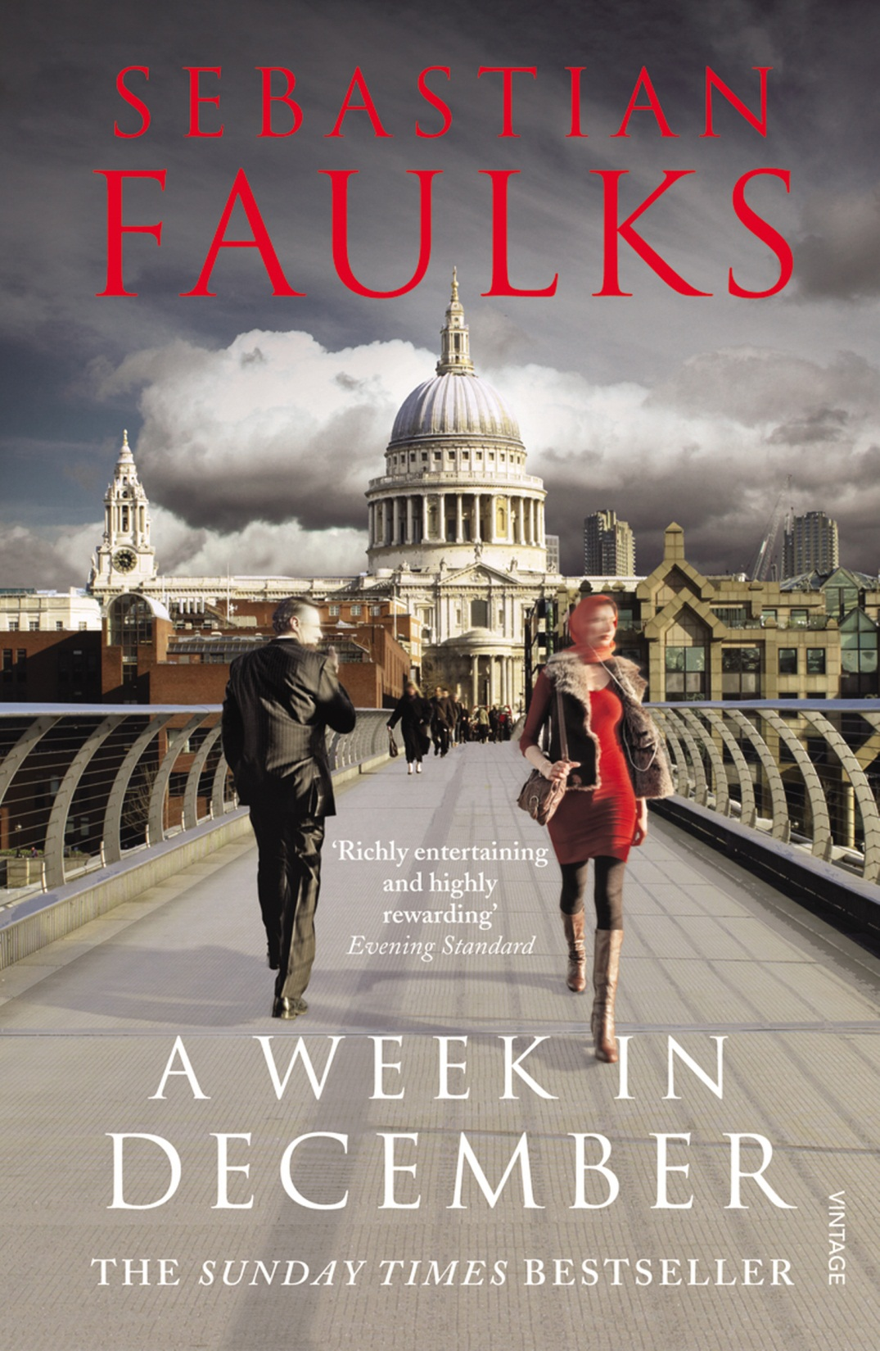
Cityread
London
2013
Notes:
Chosen book – A Week In December
Story arc
Need notes

Slide 17

Thank you
andy.ryan@stellarlibraries.co.uk
07787 431219
Facebook/stellarlibraries
Twitter @stellarlibrary
Andy Ryan, Director
Stellar Libraries CIC
27 Rokeby Road
London SE4 1DE

