Slide 1
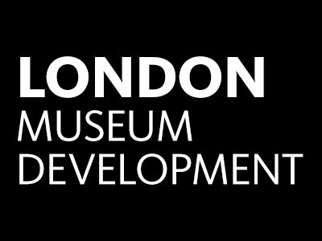

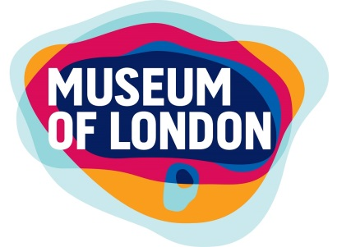
Promoting Resilience for London’s Local Authority supported Museum and Archive Services
Notes:
The Museum Development team in London works with approximately 106 of Accredited museums of which 22 (16%) are Local Authority Museums. A further 4 or 5 are Local Authority supported – either operating as Trusts or as small independents for which small grants and LA premises are vital to their existence.
Most of the LA supported services have undergone significant budget constraints over the past few years and are small to medium in size (average of 4-5 FTEs). London’s Museum Development team works with these services to support their development and to help them to deliver benefits to audiences and communities.
Why do these small museums matter?
community spaces and their relationships to local communities (many people in outer london boroughs don’t venture into the city centre
a source of civic pride – communities view civic collections as a common treasury for all of us
objects tell stories about people, places, the natural world and thought. Encountering real objects really brings an emotional response that connects us to our common ancestry.
Visitor numbers to museums have never been higher; from the DCMS Taking Part survey last year 52% of adults had visited a museum or a gallery

Slide 2

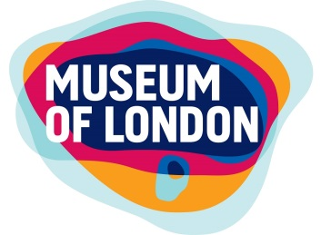

London Museum Development support
Training
Specialist advice
  Audiences
  Digital technologies
  Collections
  Organisational Health
    Survive & Thrive programme
Notes:
London Museum Development exists to support museums with their ongoing development needs.
Our training programmes are open to all staff – paid and unpaid and covers all aspects of service delivery across the three broad areas of Organisational Health, Collections and Users
MDOs offer specialist advice in the areas of Audiences, Digital and Organisational Health
Survive and Thrive programme – Org Health remit
From Culture & Sport Improvement Toolkit – Steve Wood
Adapted to work with a broader range of London’s Museums in 2011-12 since when we’ve worked with 17 museums/museum services to help them to undertake a detailed self-assessment of their current activities which is verified by a process of peer review. The resulting improvement plans have provided these museums with impetus to build on their strengths and address weaknesses.
Success stories: London Borough of Barking & Dagenham – resulting outcomes framework now guides all of the strategic thinking for the service and is embedded into their approach
Gunnersbury Park Museum – undertook S&T processin 2012 -14 prior to applying for major HLF project – highlighted the need for a more effective approach to cross borough working without which the HLF bid might not have been so effective.
Problem = capacity to engage

Slide 3
Priorities for LA supported services
(from the What’s Next conference April 2016)
Advocacy (internal and external)
To share experiences
Networking in and out of the sector
Creating an evidence base
Aligning to outcomes
Flexibility and being nimble!
Notes:
It was against this background and in the light of the 2015 ACE report,
Research to understand the resilience, and challenges to this, of Local Authority museums
For Arts Council England
Prepared by TBR in partnership with Pomegranate Seeds LLP and Scott Dickinson,
that in April 2016 London Museum Development working in partnership with The National Archives invited Councillors, Senior Council Officers, LA museum and archive managers and key stakeholders to a conference event to look at how we could offer more direct support for services supported by Local Authorities:
London’s local authority-funded museums and archives – What Next? held at the Museum of London on 28 April 2016.
A key aim for that conference was to directly consult colleagues as to the key needs for the LA supported museum & archives sector to be addressed through LMD.
These included:
• Advocacy - Internal & external
• Share experience
• Networking in and out of sector
• Evidence base
• Aligning to outcomes
• Flexibility and being nimble!
Further to this event London Museum Development developed the Strong & Safe programme to directly address these needs 1

Slide 4
    Strong & Safe programme
Training
  Practical Influencing & Advocacy
  Developing an Outcomes Framework
  Commissioning
Twilight Networking events
  Personal resilience
  In a spin: Sharing Ideas for effective service delivery
Factsheets
  Evidencing Impact
  Understanding Community Infrastructure Levy
Grants programme
Notes:
Strong&Safe programme was designed to address some of the issues arising from the symposium. The offer was mixed in order to provide options for managers short on time and resources included training, networking, small grants and factsheet. It was aimed at those working at a managerial level in local authority or largely local authority supported services.
2016 – take up of the training opportunities was small but those who came scored it highly – we’ve learned from last year’s experience and in 2017 we’ve offered a programme covering Personal Resilience, Evidence & Outcomes Framework and Workplace Resilence and having more notice and wider gaps between events seems to have helped and we’ve seen an increase in take up.
The Twilight networking events were last year very successful – the evenings started with a ‘training element’ and were followed by an informal get together in the London Wall Bar and Kitchen, with delegates having a chance to continue conversations and deepen contacts.

Slide 5
Case Study: Kingston Museum Service
Project: To look at Options for storage of the Museum and Local Studies collections.
Strong & Safe grant: £5k
Impact:
  helped to think more widely and innovatively
  refined aspirations
  created more cross service, cross authority and community group discussions
Notes:
Project: To look at options for storage of the Museum & Local Studies collections
Consultants (National Conservation Service) also asked to look at potential internal & ext partners
Quickly identified similar need in other services in the authority
Remit of the project expanded to look at whether there was a need for more than just a storage facility – NCS worked to explore needs and liaise with other stakeholders internal and external with an interest in controlled storage, improved access and care of heritage collections (such as the local archaeology group)
Impact: helped to think more widely and innovatively
refined aspirations
created more cross service, cross authority and community group discussions
Result: Strong & Viable case to merge Heritage and Records Management Service and make savings with economies of scale by reducing costs for external storage & retrieval, while at the same time making Council compliant with legislation (reduce risk of financial penalties from the Information Commissioners Office)
Potential savings of £150k per annum for initial expenditure of £3m.

Slide 6
Case Study: The View
Project: To develop The View’s data collection framework and pilot partnership and marketing projects to attract new audiences.
Grant: £5k
Impact:
brought together promotional and planning ideas in the context of an audience profiling framework
created confidence
Notes:
What they did: Bought into Audience Agency framework to collect meaningful visitor data.
Collaborated with a local artist to develop a summer of cultural events in partnership with the William Morris Gallery and the Barbican centre
Piloted a partnership with local Business Stow Brothers Estate Agents to create a mutually beneficial promotion designed to attract new audiences.
Impact:
huge enabler to bring together promotional and planning ideas in the context of an audience profiling framework
timescale and funding were significant in unblocking work priorities and budget concerns in our Visitor Services team
gave confidence in talking about audience and potential audiences to commercial businesses and other cultural organisations
provided a common terminology for external discussion and internally, and allowed The View to make decisions in the light of accepted demographic data and segmentation.
Gave experience of working with other sorts of organisations whereby they can offer mutually beneficial partnerships to offset
Provided a pilot and baseline to build on in the future.

Slide 7
What next?
Continued programme 2018-19
Network Support
Business Diagnostic
Notes:
Continued programme – currently in discussion with TNA. Want to make this small programme effective and to take into account the findings from the 2016 Museum Survey of Heads of Cultural Services which identified the main challenges at Funding and budget pressures, Service provision – new service models as well as opportunities for accessing, increasing and generating more income and developing creative ways to do so, and for increasing partnership and collaborative working within the community and other working bodies and using museums to develop a sense of place. The Mendoza report also gave advice for best practice for museums: 1) clarity of purpose, 2) business planning 3) audience focus 4) governance 5) Leadership 6) workforce 7) effective collections management 8) partnership Our general training programme and specialist advice will continue to deliver relevant training, advice and support in all these areas. Through the Strong & Safe programme we will continue to provide network support to help managers to feel less isolated and to exchange useful experience. We’re also working with other museum development providers around the UK to develop a consistent approach to a business diagnostic which will help services to develop effective forward plans and develop their long term resilience.

Slide 8
CONTACT:
Yvette Shepherd
MDO Organisational Health
Yshepherd@museumoflondon.org.uk
020 7001 9877

