Slide 1








Tola Dabiri
Archive Project Manager

Slide 2
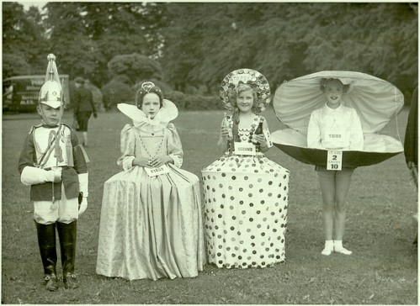
Project intro

Slide 3
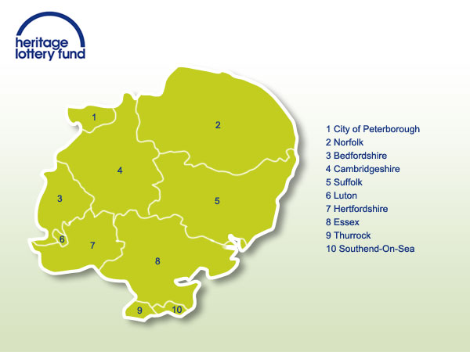
Regional HLF pilot

Slide 4
Main aims

Slide 5
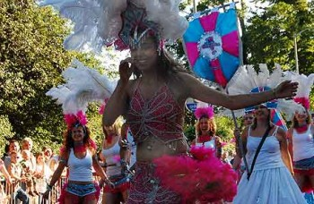
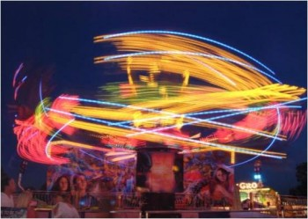
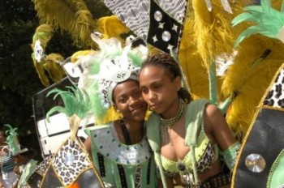
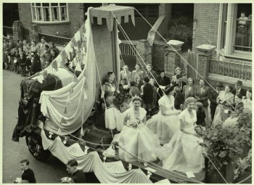
The locations

Slide 6
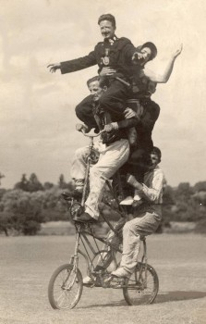
The archive team

Slide 7
Outputs to date

Slide 8
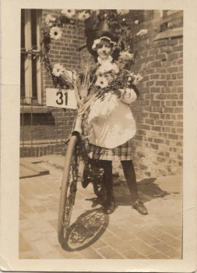
Collecting

Slide 9
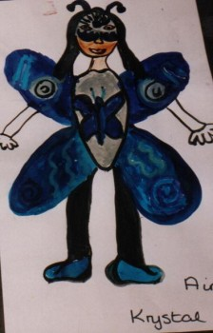
Learning

Slide 10
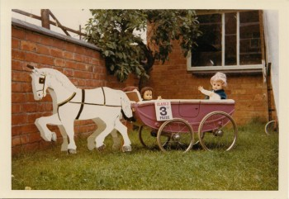
A digital archive
The Ray Heitzman Collection
Photographs of Ray Heitzman's daughter
Lydia in costume ready for the
Northampton Carnival c 1950. There is also a
postcard showing a photograph of Ray's uncle
Bill Bird at the Northampton carnival c1930.
                Cart made by Ray Heitzman for Northampton Carnival c 1950.

Slide 11
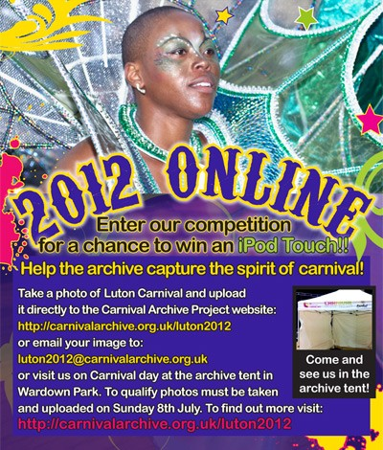
www.carnivalarchve.org.uk

Slide 12
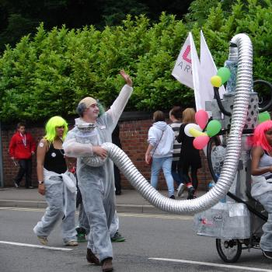
engagement

Slide 13
Our work with local authorities

Slide 14
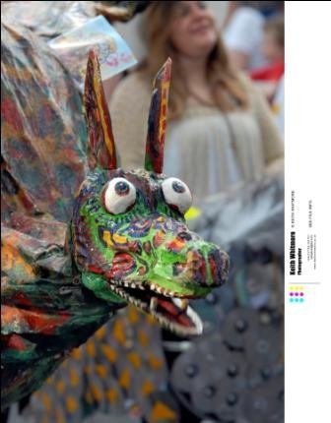
Donations
Photograph of a model of a dragon's head.
Date | 2010
Contributor | Norwich City Council
Rights | Every effort has been made to identify the copyright holder of this item. If you any further information, please contact the archive
Ref | CAP/NNF/1/15
Level | item

Slide 15
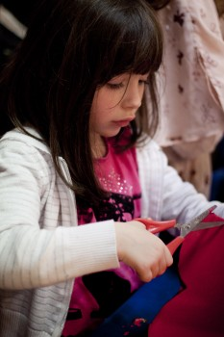
Record offices, museums, schools, libraries

Slide 16
Benefits to local authorities

Slide 17
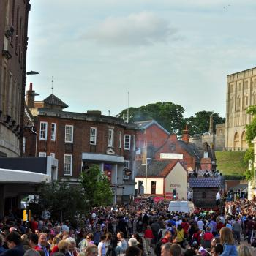
Widening participation in local heritage, culture and the arts

Slide 18
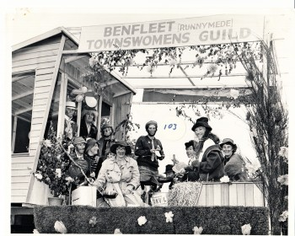
A sense of place

Slide 19
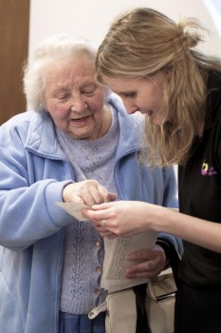
Working with hard to reach communities

Slide 20
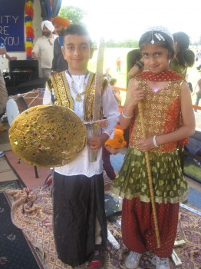

Slide 21
Benefits to the archive project

Slide 22
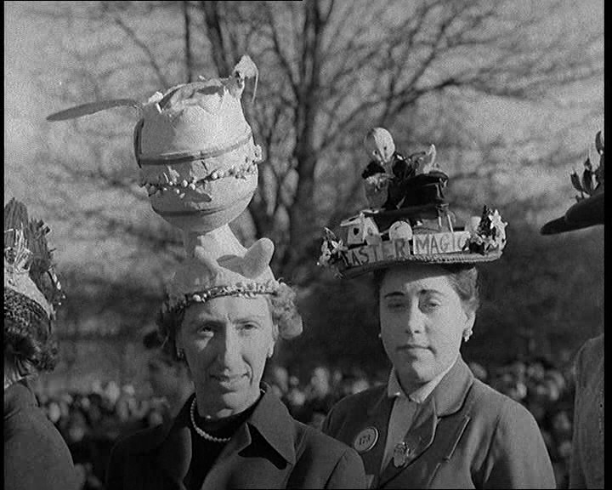
Increasing discovery of archive materials

Slide 23
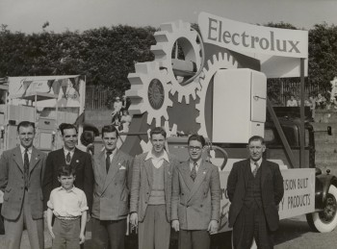
Developing partnerships within the heritage community

Slide 24
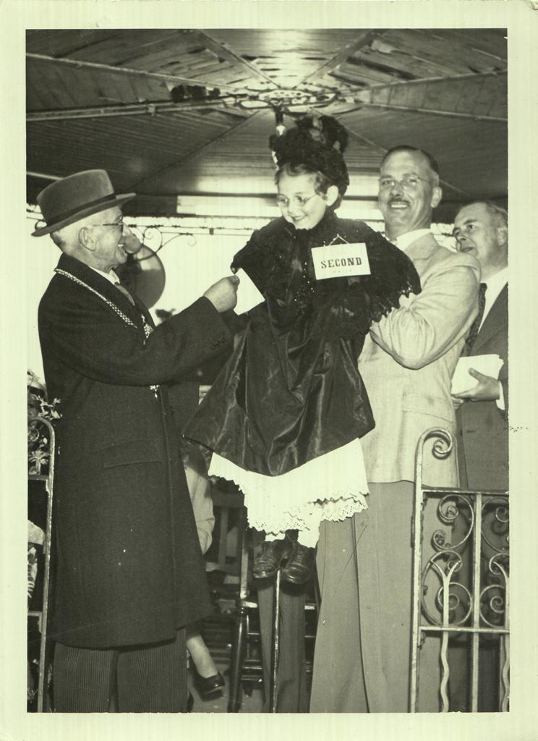
Increased support for the national project funding bid

Slide 25
Next steps

Slide 26
Dates for your diaries
Carnival Film Night – October 13th 2012
The Big Carnival
school engagement programme October 2012 – March 2013

Slide 27
Expressions of interest
Collecting from November 2012

Slide 28
Carnival archive conference –
March 2013
Carnival heritage and project learning,
UKCCA March 2013

Slide 29
Contact details
tola@carnivalarts.org.uk

