Slide 1


Social Media and the Games
Getting ready for the most talked about Olympics...EVER!
Michelle Leavesley
@CitydeskSport

Slide 2
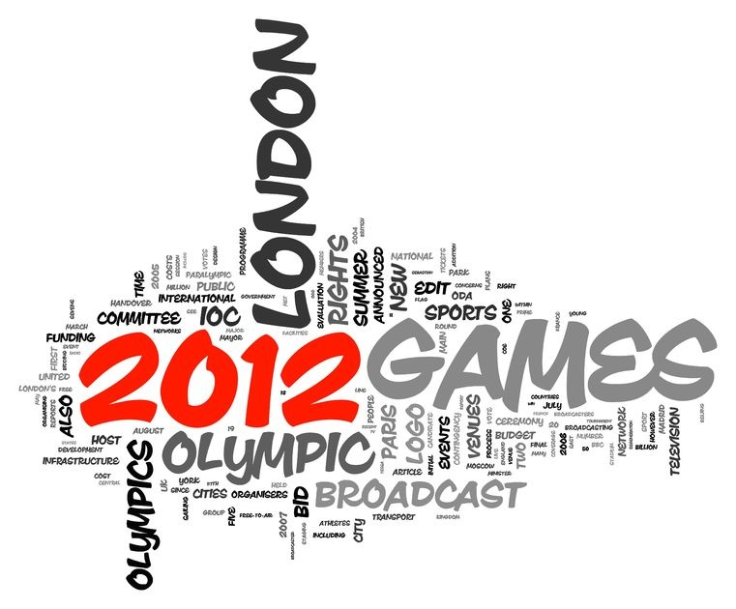
Are we ready?
Notes:
Sports fans worldwide will have unprecedented access to athletes, coaches, medics, workers, volunteers, venues, suppliers, journalists, governing bodies, BOA, IOC & Government.
Are we REALLY ready?
December 2011 Man City first premier club to launch #Bluview during game with Norwich City
Seen to be lagging behind the states

Slide 3
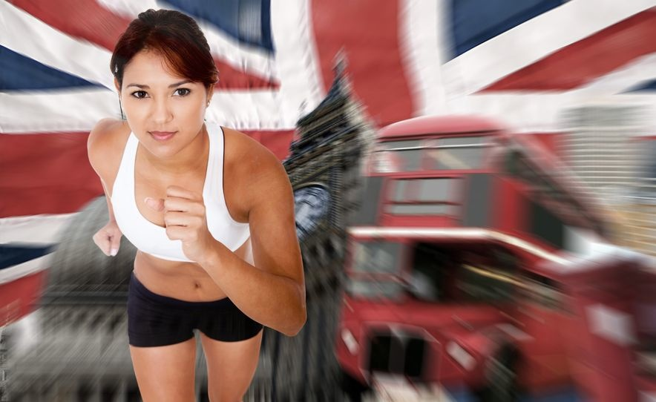
Olympics
So-Me Trends to date
Crowd Funding
Sponsor Auctions
Policies
Athlete brand building
Geotagging
Viral advertising
QR Codes
Notes:
James Ellington 32,500

Slide 4
Julz Adeniran
Notes:
110 m sprinter Sponsume

Slide 5
http://olympics.sociagility.com

Slide 6
Proctor & Gamble
Notes:
700,000 views in 3 days of release

Slide 7
Proctor & Gamble

Slide 8
Cadbury

Slide 9
Cadbury

Slide 10
BMW

Slide 11
BMW
Notes:
21,355 shares from their first three adds beating their all time best of 18,000

Slide 12
Get Fit for Olympic Day Badge
Notes:
Foursquare users can now check-in to Olympics venues around the world — and potentially win a trip to the 2012 London Games by doing so.
The International Olympic Committee (IOC) launched check-in locations around the world and an official Olympics badge on Tuesday. The IOC’s official Foursquare page has details on more than 40 historic sites from past games and venues for the upcoming edition in London.
Fans who check-in to at least two venues and follow the IOC on Foursquare will unlock the “Get Fit for Olympic Day” badge pictured above. They’ll also be entered into a contest for a trip to this summer’s Olympics in London.
“Our integration with Foursquare and the ability to leave location-based tips from the athletes is one more way to serve highly engaged fans of the Olympic Games and to integrate social media directly into the Olympic fan experience,” Alex Huot, the IOC’s social media director, said in a press release. “We wanted to do something fun and thank our fans who make an effort to stay fit by offering them a chance to win a trip to the Olympics.”
The Olympic Day tie-in refers to a holiday taking place June 23 to promote fitness and health in countries around the world. The holiday was first celebrated in 1948.
Foursquare check-ins are just one aspect of what are being hyped by some as “the first social Olympics.” The IOC is heavily promoting social media, and Twitter and other platforms are expected to play a prominent role with fans, athletes and media in London.
Last month the IOC unveiled its Olympics Athletes’ Hub, a digital portal to verified athlete Facebook and Twitter feeds as well as additional digital content. However, a series of stringent restrictions on what fans and athletes can post from where during the Games has some crying foul.

Slide 13
Olympic Athletes’ Hub
“We want the hub to be a platform which can inspire athletes and fans to share the Olympic values of friendship, respect and excellence through their everyday stories.”
Alex Hout
IOC Head of Social Media

Slide 15


Fans
1. 80% of fans interact so-Me while watching sport on TV
2. 60% at live events
3. 86% desk at work
4. 68% love, like or indifferent to athlete mentions of sponsors
GMR

Slide 16

What can we learn?
Need for Strategy
Safeguarding & Customer Service Policies
Robust So-Me Management Platforms
Listening
Engagement

Slide 17
Final thought!
Notes:
Spanish Club Seville selling picture 25 Euro

Slide 18
www.citydesksport.com michelle@citydesksport.com
@Leavesm @CitydeskSport
#Thankyou

