Slide 1


Social and Digital Media in Leisure
Chief Cultural & Leisure Officers Association – June 2012
Presented by
Michelle Leavesley, Catherine Lunt and Chris Phelps

Slide 2
Simplified Social Media Hierarchy

Slide 3
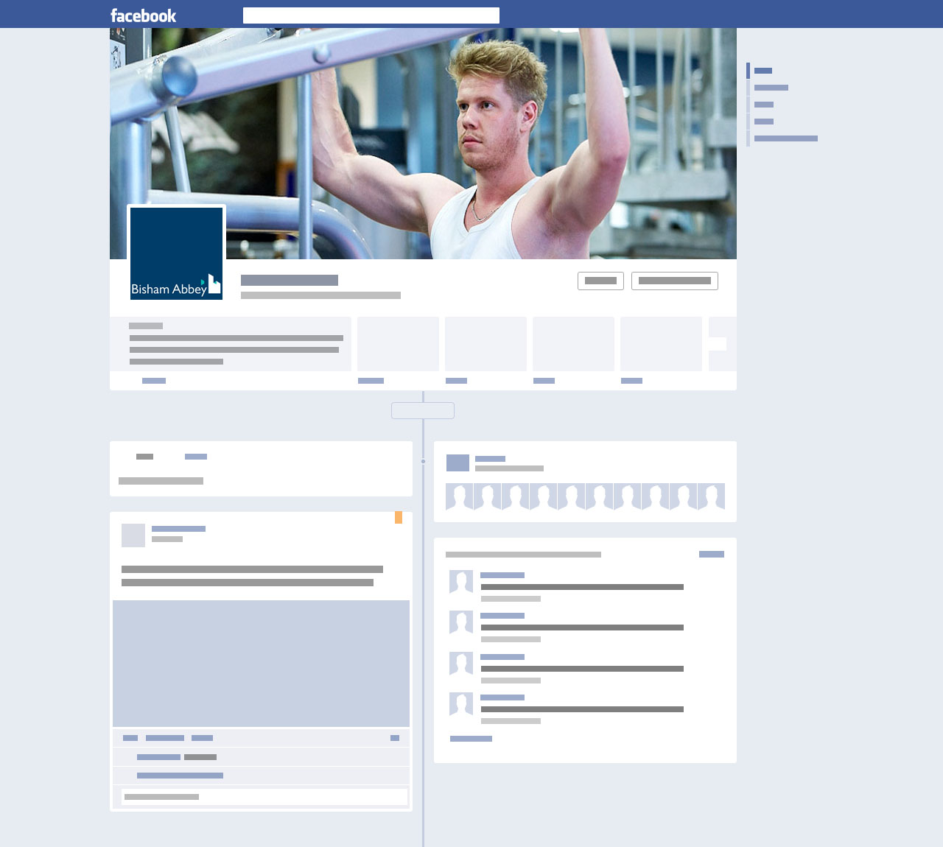
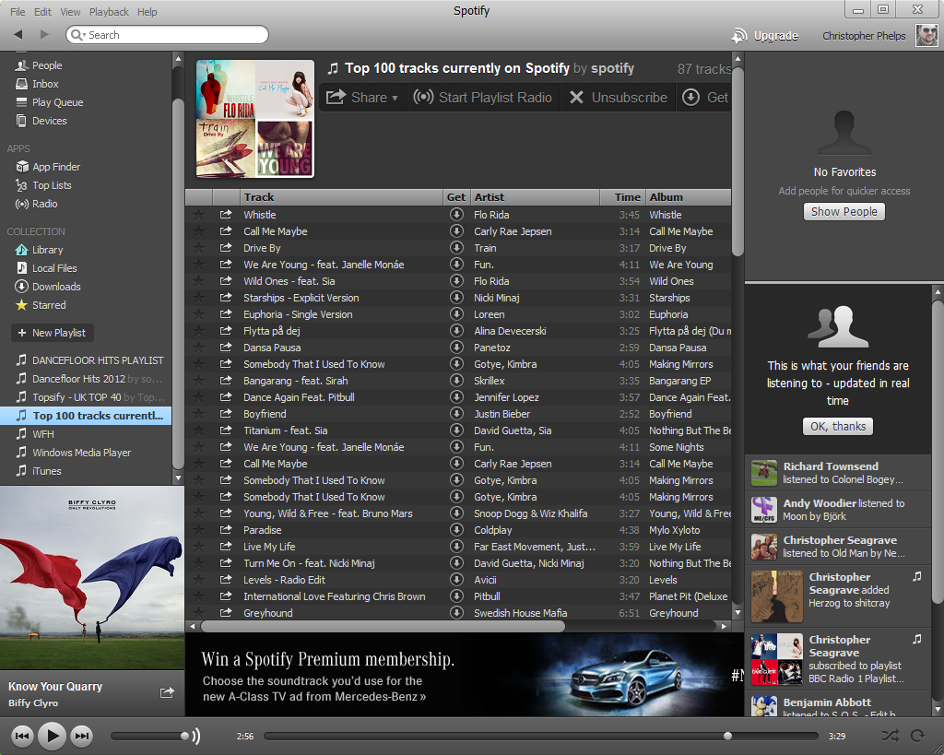




Example of Community Engagement
The Sport England Fitness page shares this post with all of it’s followers.
Sport England – Fitness shared National Fitness’s Post
John Smith
What’s your workout ‘Power Song’?
I’m a fan of “Meat Loaf – Bat out of Hell”
Add your tracks below and we’ll add them to the gym playlist!
Like - Comment - 1 hour ago
John Smith (Marketing Manager)
Puts up a national message about music.
Terry Numan follows the national page and ‘likes’ this post. Terry’s friends can now be aware of this.
Terry Numan Likes this
Brian Jones
Anything by @DaftPunk for me!
Like - Comment - 1 hour ago
Brian follows ‘Sport England Fitness’, but can now comment on the national post.
The post will now have comments from national and multiple local users, reaching large scale participation/engagement.
Brian has also tagged the music group ‘Daft Punk’, spreading our message even further…
The playlist can also be shared on services like Spotify, allowing users to download to their MP3 players

Slide 4
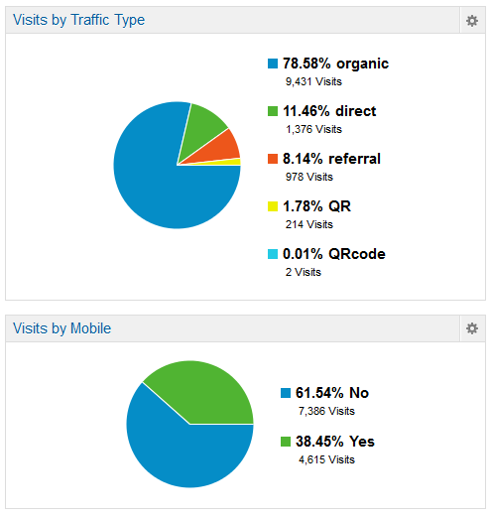
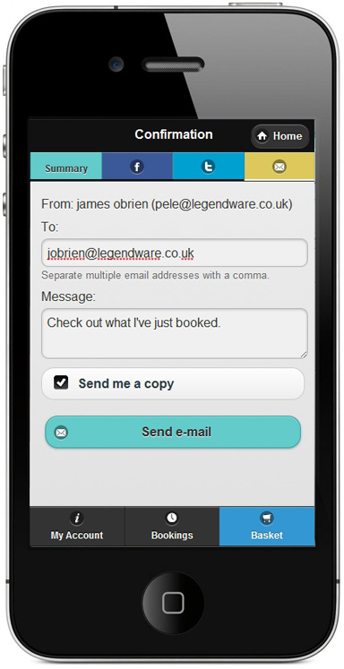
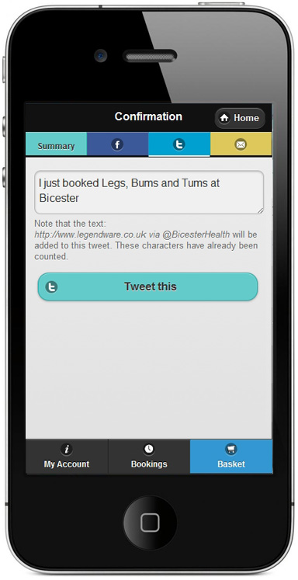
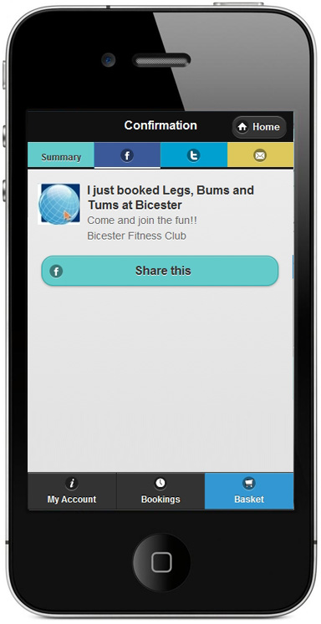
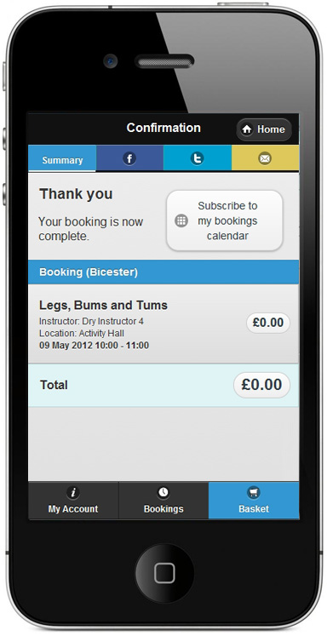
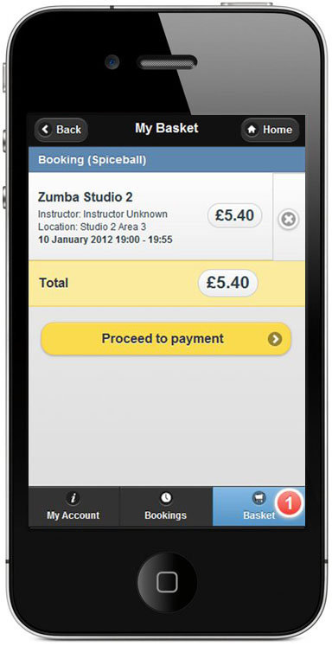
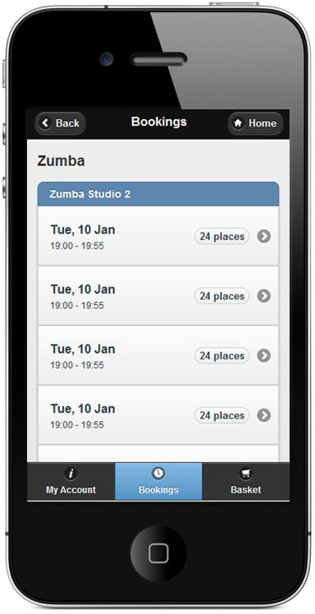
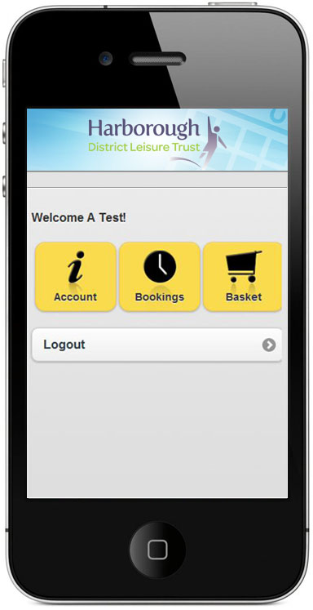
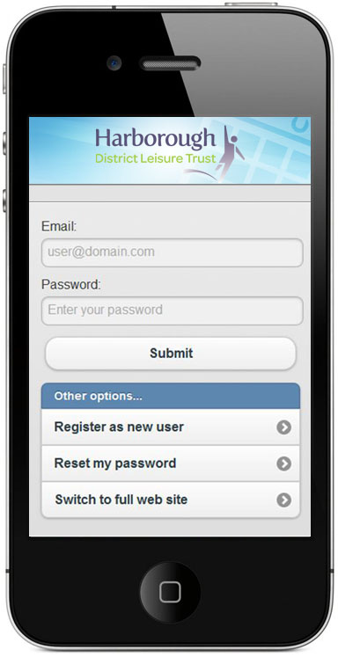
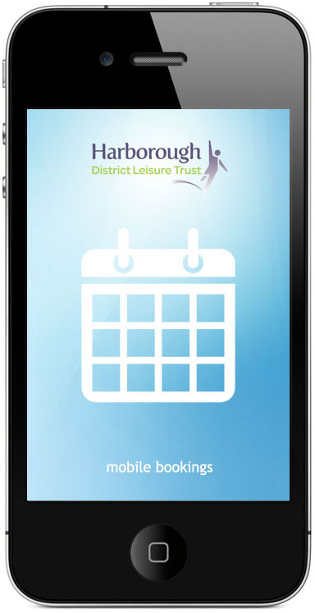
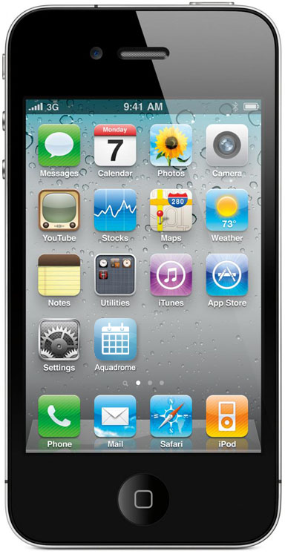

Mobile Bookings App with Social Media Integration
Serco was UK’s first leisure operator to offer mobile bookings app
Nearly 40% of web traffic is mobile
Nearly 2% of web traffic is from QR codes
Mobile optimised UI for booking classes and courts online
  iPhone
  Android
  Blackberry
  Windows Phone
Touch Friendly
Can be installed to homescreen like an app

Slide 5
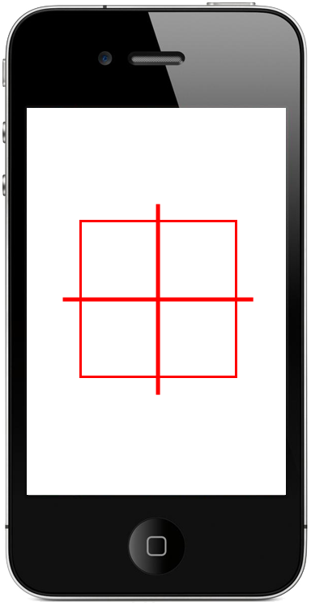
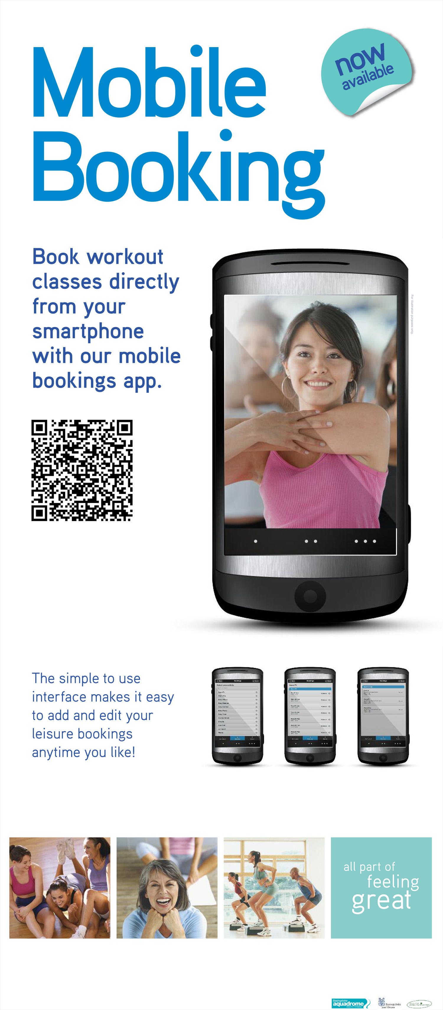

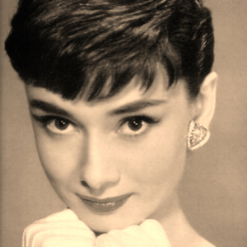

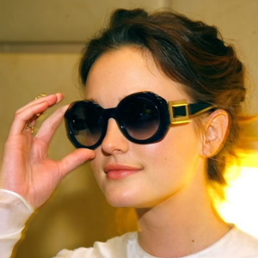
Example of Facebook Post through Bookings System
Single post seen by a total of 460 people.
If Ying and Nadia also book and post on Facebook, the whole process repeats/expands!
Sophie Smith
I just booked Legs, Bums and Tums at Bicester.
Come and join the Fun!
Bicester Fitness Club
Like - Comment – 5 Minutes Ago
Seen by ≈130 Friends
Terry Numan Likes this
Seen by ≈50 Unique Friends
Michelle Jones
Keep it up babe, you’ll look great for our holiday next month!
Like - Comment – 3 Minutes Ago
Seen by ≈50 Unique Friends
Ying Chau
Sounds cool, can I come with you?
Like - Comment – Just Now
Seen by ≈50 Unique Friends
Nadia Voss (Friends with Ying Chau)
I’m looking for a new gym, I’m going to give it a go too!
Like - Comment – Just Now
Seen by ≈130 Unique Friends

Slide 6




Lifecycle of a Tweet
John Smith @jsmith82
Just booked my first Legs, Bums and Tums class at Bisham Abbey NSC. On a mission for the perfect bum!
Users can ‘tweet’ their customised bookings messages at the end of their booking.
In the open twitter environment the sites can reply to / retweet their customer’s messages.
  Customer engagement, improved retention.
  All followers can benefit from information and entertainment.
  Link to our bookings system and twitter profile shown to all viewers.
  Activities which provide positive customer experiences become part of the training Wiki to help all staff in communicate with their members effectively. Improving customer service and retention.
Customers can directly message the site with questions and feedback within the twitter environment. This expands out reach beyond those already directly booking with us.
Bisham Abbey NSC @BishamBookings
@jsmith82 Looking forward to seeing you soon and helping you out on your quest!
John Smith @jsmith82
@BishamBookings LOL! I fear it’ll be an uphill struggle. Do I need to bring anything special with me, towels etc…?
Derren Jones @SportParrot
RT @jsmith82 Just booked my first Legs, Bums and Tums class at Bisham Abbey NSC. On a mission for the perfect bum!
Ralph Hound @theTash
@BishamBookings Looking to train for the London #Marathon, got any classes good for stamina.

Slide 7
Example of Community Engagement Facebook Post
The Sport England Fitness page shares this post with all of it’s followers.
Sport England – Fitness shared National Fitness’s Post
John Smith
What’s your workout ‘Power Song’?
I’m a fan of “Meat Loaf – Bat out of Hell”
Add your tracks below and we’ll add them to the gym playlist!
Like - Comment - 1 hour ago
John Smith (Marketing Manager)
Puts up a national message about music.
Terry Numan follows the national page and ‘likes’ this post. Terry’s friends can now be aware of this.
Terry Numan Likes this
Brian Jones
Anything by @DaftPunk for me!
Like - Comment - 1 hour ago
Brian follows ‘Sport England Fitness’, but can now comment on the national post.
The post will now have comments from national and multiple local users, reaching large scale participation/engagement.
Brian has also tagged the music group ‘Daft Punk’, spreading our message even further…

Slide 8
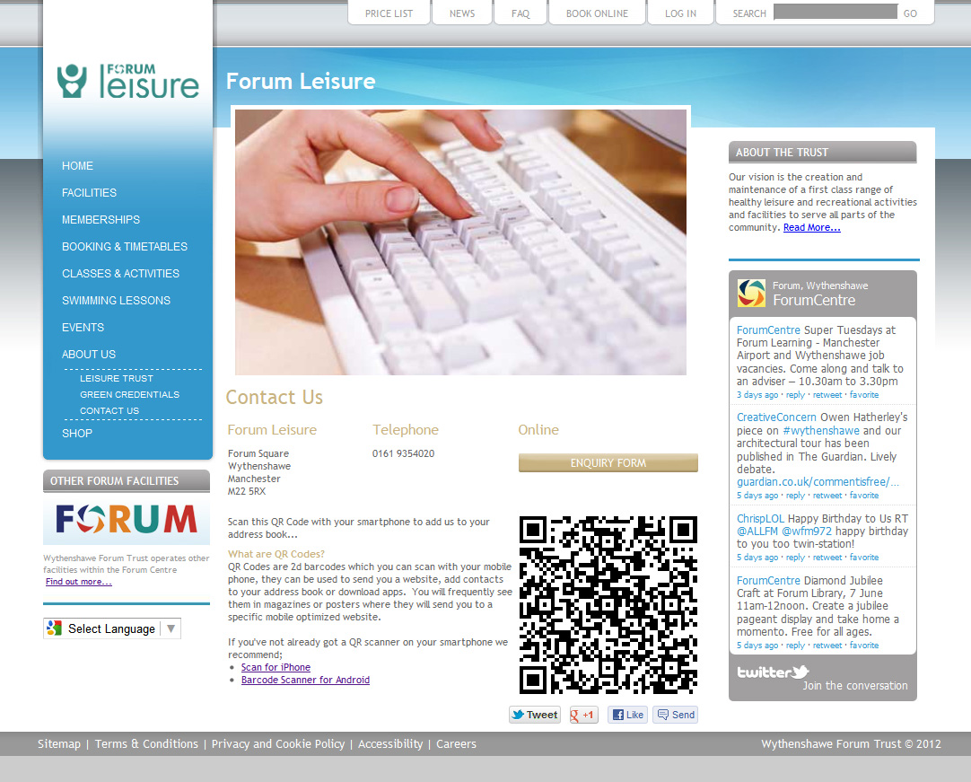
Interactive Features in Primary Websites
Already Online
  Tweet / +1 / Like and Send Buttons added to the footer of all content pages
  Inline Twitter Gadgets
  QR Codes for contacts and mobile bookings app
  Google Translate into over 50 Languages
Coming Soon
  Inline Facebook Gadgets
  Pinterest Pages

Slide 9
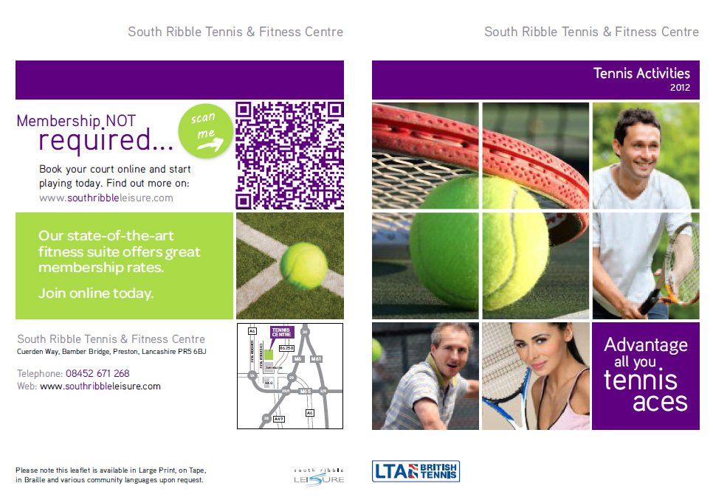
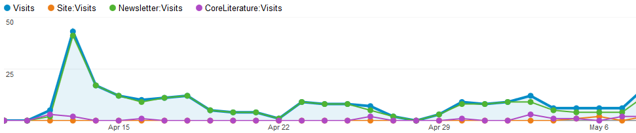
Interactive Features in Print Materials
QR Codes embedded into print materials
Can be used to add to smart phone contacts list
Link to specific mobile formatted URL
Links to promotional codes and vouchers
Good uptake of targeted messages

