Slide 1
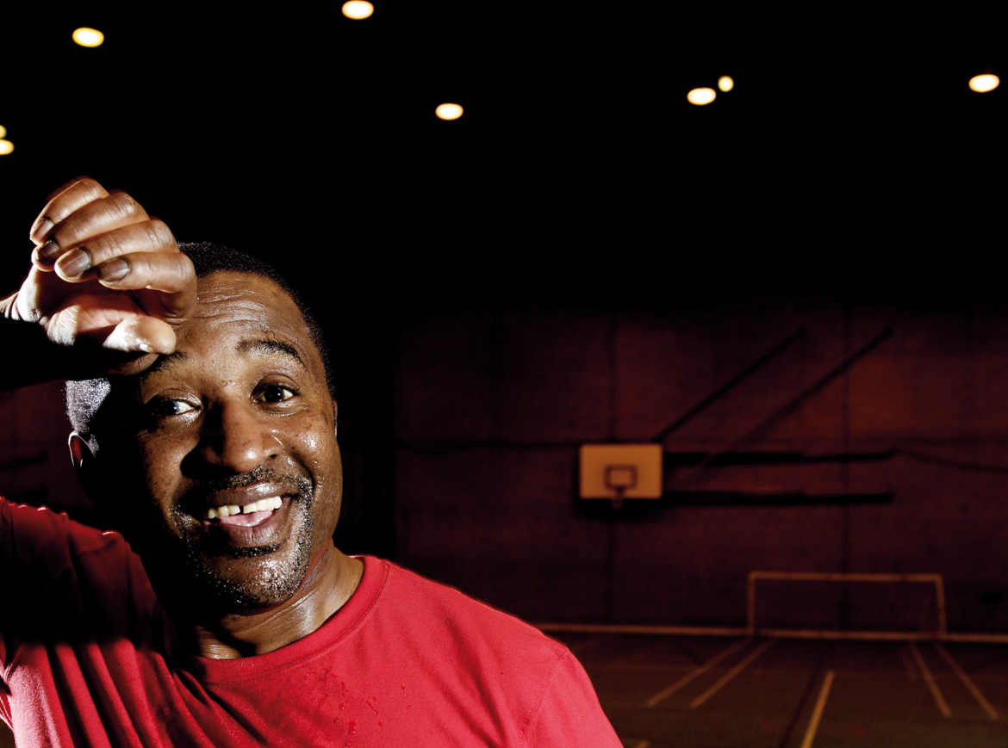

A Sporting Habit for Life – Update
Mike Diaper
Director Community Sport

Slide 2
A sporting habit for life
5 Year £1b Investment
2012/13 - 2016/17
Schools &
School Games
Up to £150 million
(Including Education,& Health funding)
Access
Whole Sport Plans (NGBs)
over £450 million 2013-17
Transition to Clubs
✓ WSPs start at age 14
✓ Focus on 14-25 for relevant sports
Mandatory growth targets
Payment by results
Enhanced governance
Talent development
Supported by CSP Club Link Makers
Higher Education
Rewards
Mid-range/
Improvement
e.g. pools/artificial pitches
Governance
Further Education
Door Step Clubs & Get On Track
Facilities
Up to £250 million
New capital
Community
Sport Pot
Local Investment
Over £250m
Health pilot
Iconic
Inspired
Playing fields
CSPs:
Coaching (Sportivate)
Volunteering (Sport Makers, Club leaders)
Disability
Market development

Slide 3
Current participation
No sporting activity
57%, 24 million people
At least 1 x per month
43%, 18 million people
At least 1 x 30 per week
36%, 15 million
At least
3 x 30 p.w.
17%,
7 million
More accessible entry point mass participation
Emphasis on “do something, do more”

Slide 4
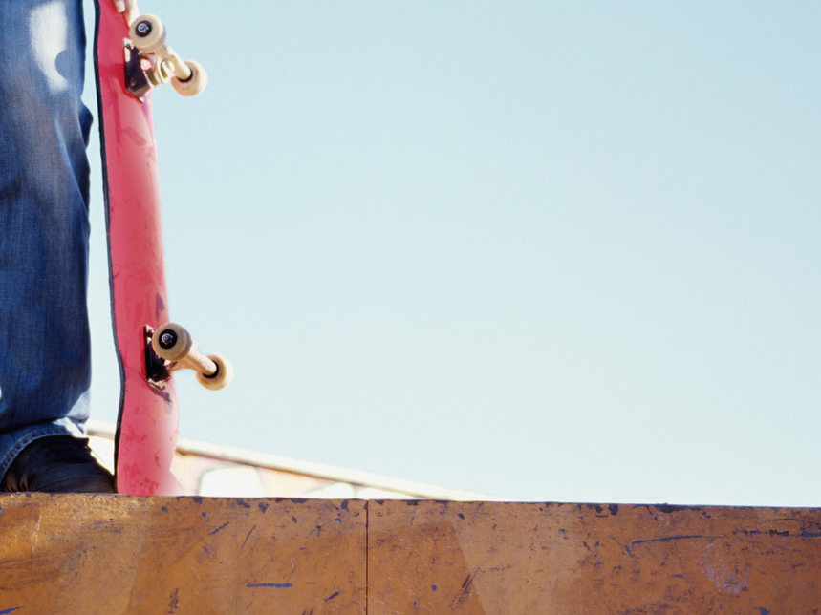
Accountability & Measurement
Plan to combine Taking Part and Active People
Keeping the best of existing surveys while capturing as much participation as possible
  Counts people and mass participation
  Continues to provide local data
  Supports the public health outcomes framework
  Performance manages NGBs
Please respond to the consultation by 8 August

Slide 5
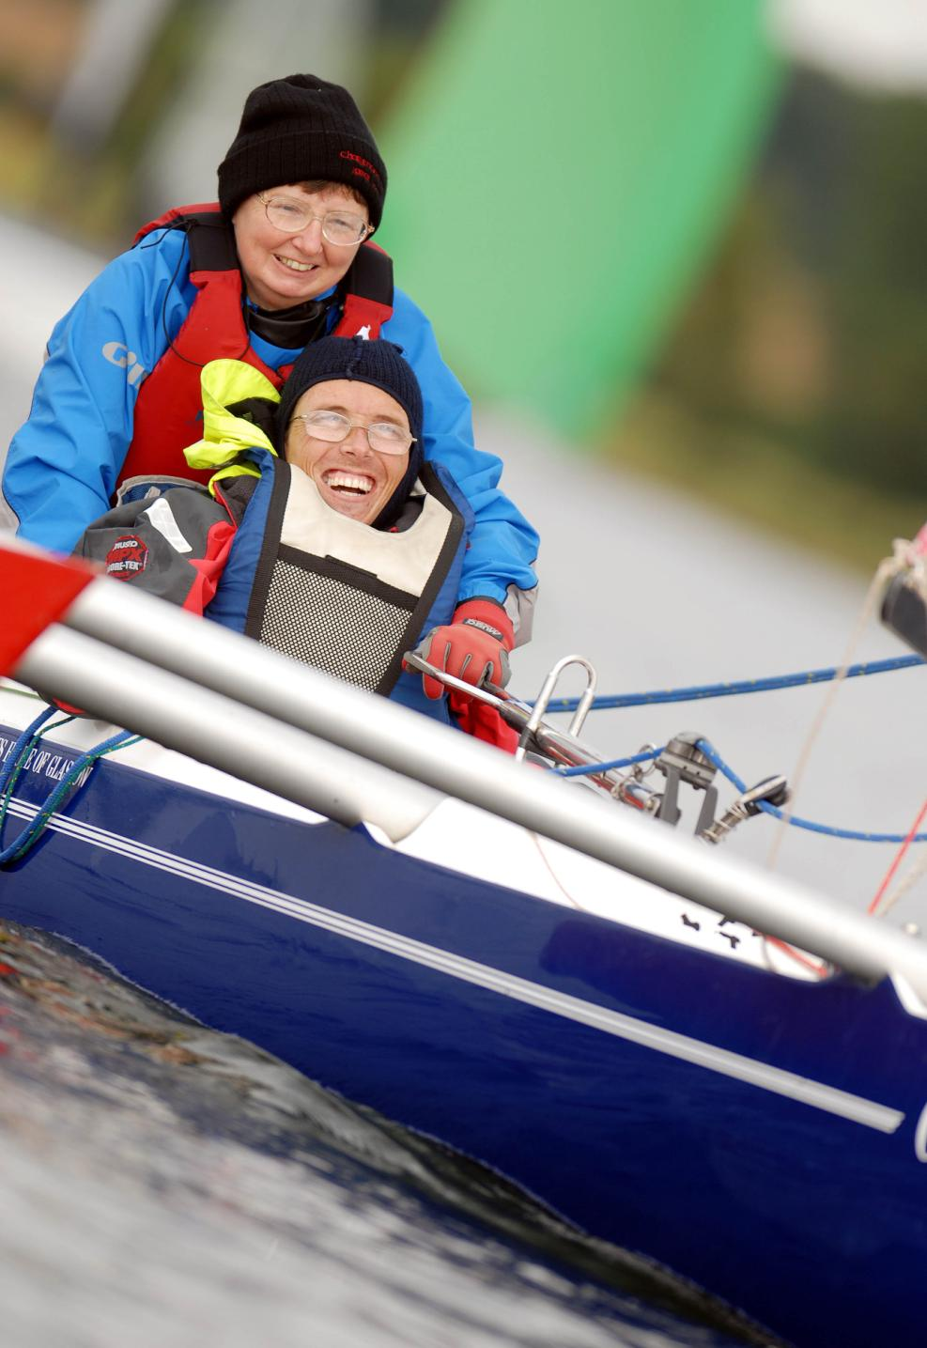
Increasing participation by disabled people is a priority
Focused on mass participation
Bringing the sports & disability sector together
New and existing partners
£8m Inclusion Fund open till 31 August

Slide 6
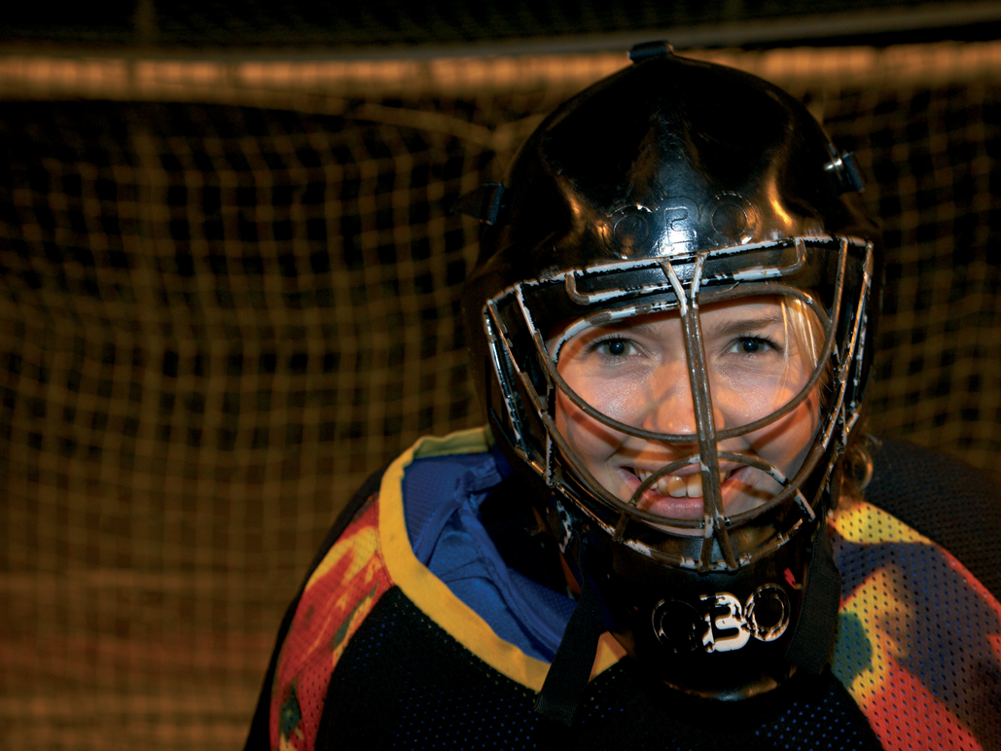
Reducing Inactivity
  Proving sport can reduce inactivity
  Economic Appraisal Tool
  £5m in 2012/13 for piloting sports contribution

Slide 7
Research Question
- Can sport engage the least active?
There is evidence from the published literature that sport can engage inactive people at an individual or group level
There is evidence from current practice in the UK that sport can reach inactive people especially if the programmes are properly marketed, planned and delivered

Slide 8
Recommendations From The Research
Establish more robust systems for evaluation of sport to meet health priorities – to secure health buy in
Plan programmes to target inactive people
Support project managers with training and guidance on targeting, marketing and monitoring of inactive people
Develop, fund and evaluate pilot projects that specifically set out to reach inactive people through sport

Slide 9
Reducing Inactivity (£5m - 2012-13)
Brief Interventions in Primary Care Improving the evidence base (Solicited) | Activation Fund Helping local communities & links with health & wellbeing boards (Open)
Advocacy, training and education across sport and health sectors

Slide 10

Next steps
January to April 2013
Detailed planning and development
Consultation with deliverers (e.g. clubs) and schools
Restructuring of internal resource
From April 2012
Testing and piloting
NGB Funding Allocation for 13 – 17
April 2013
New strategy in full force including Whole Sport Plans

Slide 11
Advice and Guidance on Leisure Management Contracts and Procurement
Project at Consultation
Kevin Mills – Strategic Lead Capital Projects

Slide 12
Basis for the project
Requests from LA’s and Operators
Requests through
  Local engagement - LA’s/ Sport England Relationship Managers
  Sport England meetings Operators/BISL/Sporta
  Sport England seminars on Strategic Solutions to Leisure provision
Building on the Lessons Learnt Report produced following the successful procurement process at the National Sports Centres

Slide 13
Project Objectives
Promote best practice
Reduce costs and time for client and contractor in the procurement of leisure contracts
Achieve fair contractual positions
Encourage partnerships which deliver increases in participation, enable the promotion of broader social and health outcomes and financially sustainable leisure provision.

Slide 14
Aims
To Provide:
toolkit information for clients, with guidance on procurement routes and process
template contract documentation and guidance
guidance on balancing quality, increasing participation, achieving broader outcomes in health and well-being, community engagement, commercial performance and cost.

Slide 15
Health and Well-being Outcomes
Encourage clients to consider the health and well-being issues within the leisure strategy
Consider the factors of importance locally – CHD, obesity?
Guidance on how to articulate the outcomes within the contract requirements - making use of Culture and Sport Outcomes Framework
Provide guidance on how to demonstrate the impact of increased activity - what can we measure
Reflect best practice case studies in the documents demonstrating local success or possibly links to the Public Health Outcomes Framework

Slide 16
Project Consultation
Operators/Sporta/BISL
Local Authorities/ DCMS
Leisure and Legal consultants active in the sector
Consultation drafts for written comment will be available on Sport England’s website in the near future – we will advise of this via CLOA

Slide 17
Capital Project Funding Streams

Slide 18
New Stream - Improvement Fund
Iconic, Inspired, Protecting Playing Fields – existing streams
Improvement Fund - result of the strategy consultation and the experience gained from existing streams
Aim to improve delivery of sport, increasing participation and quality of provision – significant proportion will go to L.A. projects
Seek to bridge gap between Iconic and Inspired funds with grants in region of £150k- £500k

Slide 19
New Stream - Improvement Fund
£45m of lottery funding over next 5 years
£3m 2012/13, £9m 2013/14 and £11m in the next 3 years
Criteria being developed – but will prioritise multiple partners, public and private sectors, NGB’s.
Simple application process – based on expressions of interest
As a result of Strategy consultation - first year focus on Swimming Change Facilities and Artificial Grass Pitches

Slide 20
Additional Slides in your Pack
Iconic Facilities
Inspired Facilities
Protecting Playing Fields
All of the above funding streams can be accessed on the Sport England website
www.sportengland.org

Slide 21
Finally
Any Questions?

Slide 22
Iconic Fund
£30m lottery funding investment over 3 years into innovative, large-scale, multi-sport facilities, some being of regional significant for at least two sports
Projects are expected to deliver against NGB and local authority sports facility priorities and demonstrate long-term financial viability
2 Rounds of £10m already delivered, over 140 applications received, 12 projects being supported across England with total project investment value of circa £290m
Round 3 opens 24 Sep 12, closes 17 Dec 12, initial funding decisions Mar 13. Applicants can apply for grants between £500k and £3m

Slide 23
Inspired Fund
£50 million capital investment
Organised into 5 funding rounds with up to £10 million being awarded per round
One round in 2011 completed, two rounds in 2012 and two rounds in 2013
Up to 70% of the funding available for community & voluntary sector projects (which includes parish and town councils)
Up to 30% of the funding available for Local Authority and other statutory bodies such as schools and HE/FE establishments. £1:£1 partnership funding required
A Catalogue helps reduce the burden on the applicant and allows Sport England to do the work for you
We have provided costs on the most popular facility improvements
These are grouped together in four “packages” and set out in a catalogue
It helps you select a facility type and come up with a budget price as easily as possible

Slide 24
Protecting Playing Fields
• Seeks to improve and protect playing fields
• £10 million lottery investment in total
• 5 funding rounds with up to £2 million per round
• Two rounds in 2011/12, 2 further rounds in 2012/13 and one final round in 2013/14
• Capital grants are from £20,000 up to a maximum of £50,000
• Partnership funding required by LAs, schools and HE/FE applicants
• No revenue grant available under this programme
• Improving the condition of pitches – drainage, re-grading, pitch remediation works
• Construction of cricket square & outfield; creating new playing field land (not less than 0.2 hectares)
• Bringing disused playing fields back into use; purchase of playing fields or land to form playing fields
• Protect by means of executing a legal charge on the site for a minimum of 25 years

