Slide 1

Olympic and Paralympic
Legacy
Emma Boggis
Head of Olympic and Paralympic Legacy Unit
Cabinet Office

Slide 2
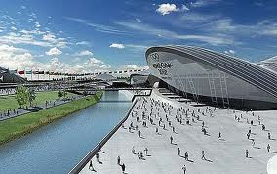
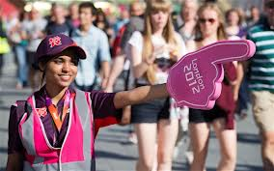
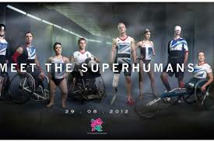
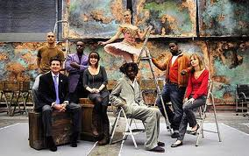
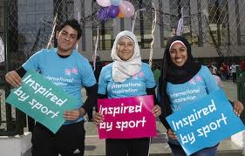
Olympic and Paralympic
Legacy

Slide 3
Olympic and Paralympic
Legacy
“So London’s vision is to reach young people all around the world. To connect them with the inspirational power of the Games. To inspire them to choose sport.”
Lord Coe, Singapore, 6 July 2005
“This historic city has created a legacy blueprint for future Games Hosts.”
Jacques Rogge, Beyond 2012 report March 2012

Slide 4
Olympic and Paralympic
Legacy
The Olympic and Paralympic Legacy Unit has four main functions:
  Programme management of London 2012 legacy
  Support to Lord Coe The PM’s Olympic and Paralympic Legacy Ambassador
  Development and oversight of legacy communications
  Secretariat to the Olympic and Paralympic Legacy Cabinet Committee

Slide 5
Olympic and Paralympic
Legacy
Legacy
Sport and Healthy Living
Economic Growth
Communities
Regeneration of East London
Paralympic Legacy

Slide 6
Sport and Healthy Living
Sports Participation
Community Sport Investment
School Sport
National Centres for Sports and Exercise Medicine
Links to healthy living
Elite Sport Performance
Major events

Slide 7

Economic Growth
On track to be delivering ambitious targets to boost the global awareness of the UK under the banner of the GREAT Campaign
£11bn of economic benefit from trade & investment by 2016
£2bn from increased tourism by 2016

Slide 8
Communities
Capitalise on the success of the 2012 volunteers to have a positive impact on volunteering
Team London Ambassadors assisting tourists, major events and visiting schools
Funds awarded through BIG Lottery
Continuation of the GET SET education programme
Development of legacy from the Cultural Olympiad
Olympic Truce successfully implemented

Slide 9
East London Regeneration
PEOPLE
25% of ‘transformation’ workforce resident in Host Boroughs
PARK
8 of 8 venues with legacy plans confirmed including Stadium
North Park, hub and Copper Box reopens July 2013
PLACE
Planning applications complete for phase one of new development

Slide 10
Paralympic Legacy
Ensure that elite and community sport funding recognises Disability Sport
Sustain the increase in perceptions of disabled people seen after the Games
Continue to build on accessibility improvements delivered by the Games
Paralympic Legacy Advisory Group established

Slide 11
Olympic and Paralympic
Legacy
Visits – domestic and international
“Inspired by 2012” brand
Social Media
Legacy report

Slide 12
Olympic and Paralympic
Legacy
Emma Boggis
Head of Olympic and Paralympic Legacy Unit
Cabinet Office
olympiclegacy@cabinet-office.gsi.gov.uk

