Slide 1

Supporting Sports to deliver ‘Legacy’
Andy Maddock
Programmes Director
Notes:
Introduction to me – Keep the noise from the front line, make things happen and interface with NGB
Limited time, Whistle stop tour of how you can assist NGB’s and all achieve results I will talk about
Partnerships
How you can help NGB’s/Elite Sport and we can help you
Finally a bit about our Rio mission

Slide 2
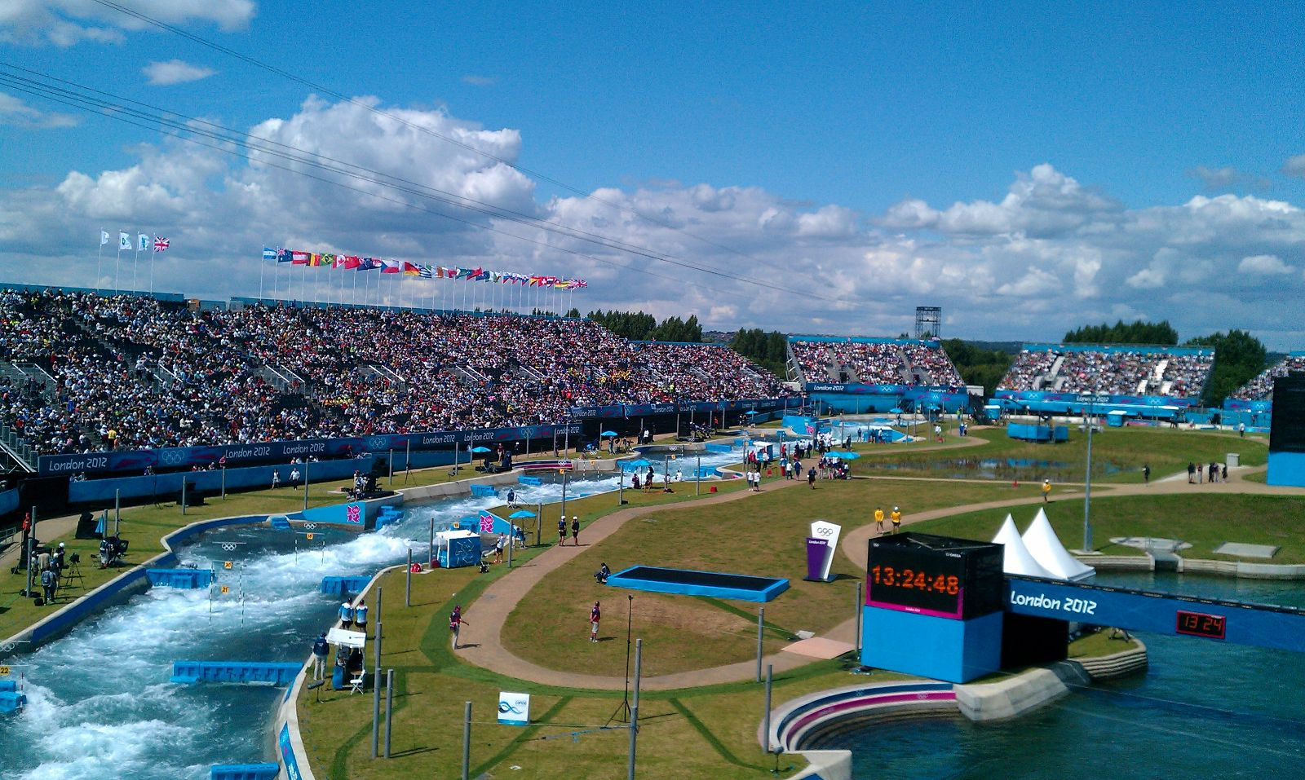
Case study -Legacy as a result of partnership
Legacy as a result of Partnership
Notes:
Last year @ Velopark, this year here at LVWWC
Partnership started in 1980’s with concept for WWC – OG was the catalyst
British Canoeing engaged in design and business model from the outset (in 2005/2006)
Appointed joint funded Paddlesport Development Officer between BC and LVRPA
NGB Committed to the venue and partnership with LVRPA from day 1 – regular off peak partner – guaranteed income
Capital projects – British Canoeing investment of £1.8m in Performance Centre and club base
Events – worked in partnership with LVRPA to secure major events (2014 ICF World Cup and 2015 ICF Slalom Worlds
Legacy – True legacy – now in 2015 Elite base, Hosting World Championships, Rapid Talent TID initiative, Canoe Sprint futures and started a club which in first year has over 200 members

Slide 3
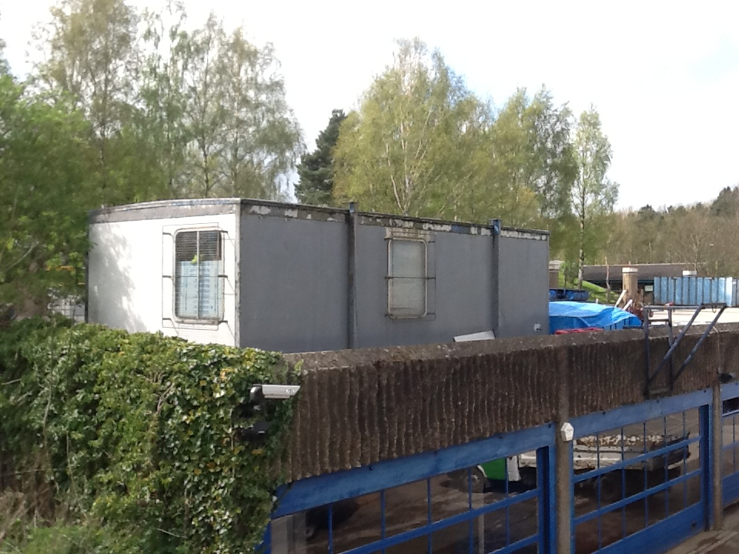
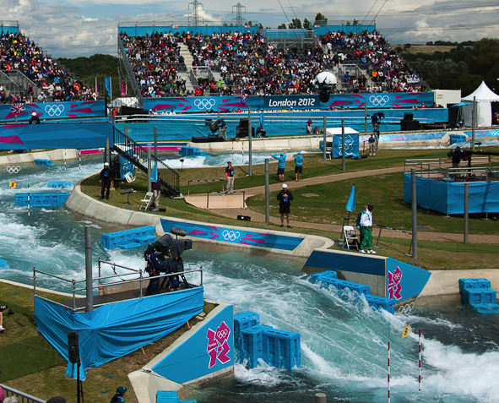
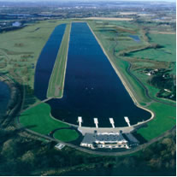
High Performance Environments
Notes:
Have other partnerships at Dorney, Lee Valley, Holme Pierrepont
High Performance Environment vital to long term success and ability to compete with best in the world

Slide 4
British Canoeing / NGB’s – How we can benefit you
Associating with success – partnerships
Linking to Outdoor Activity agenda
Meeting targets collaboratively
Bringing events to your venues
Off the shelf products – gocanoeing.org.uk
Regular off peak usage – income model
Notes:
British Canoeing
Go Canoeing.org.uk
Events
Taster sessions
Trails
Guided Tours

Slide 5
How you can help British Canoeing / NGB’s
Think broader than conventional sports – engage with the new outdoor initiatives
Look at wider value that association with an NGB brings
Involve NGB’s in capital projects/designs – use their expertise
Small grants to emerging elite athletes
Provide facility access to emerging talent and remove barriers
Notes:
Opportunities around the new focus on outdoor by Government
Most medals and success away from mainstream sports – sitting on your bottom is key!
Profile that athletes and NGB based from your facility gives to attract other business and users
Most medals and success away from mainstream sports – sitting on your bottom is key 66% of medals in Sydney!
Facility access – Adopt BOA passport scheme/allow juniors to access gyms – remove not create barriers

Slide 6
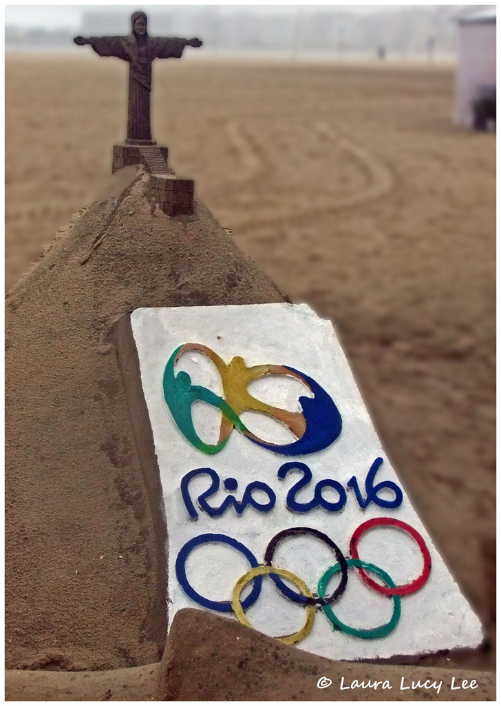
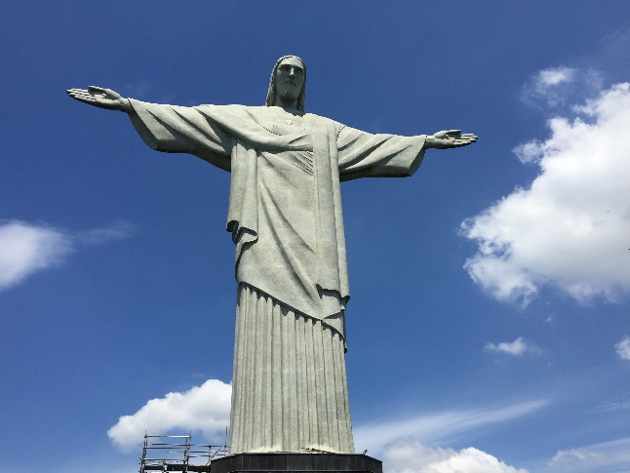
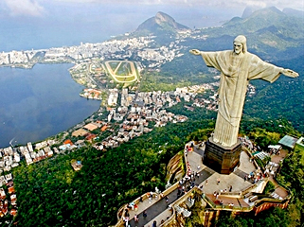
Rio Mission
Notes:
Nearly 400 days to go to Games
Different challenges – 8 years since an away Games

Slide 7
British Canoeing
- Olympic Profile
1936-1996 - 1 Olympic medal (1992)
2000 Sydney - 2 Medals
2004 Athens - 3 medals
2008 Beijing - 3 medals, first Gold
2012 London - 4 medals – 2 Gold
2016 Rio - Target 4 Medals
2016 Paracanoe Debut Paralympics

Slide 8
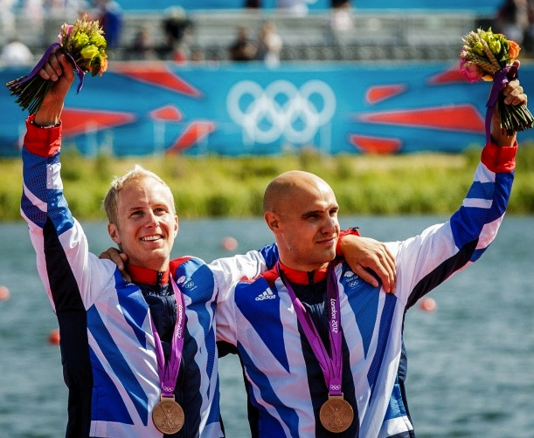
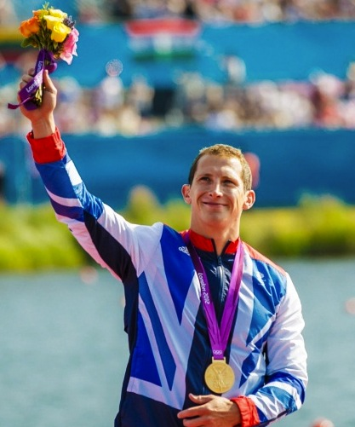
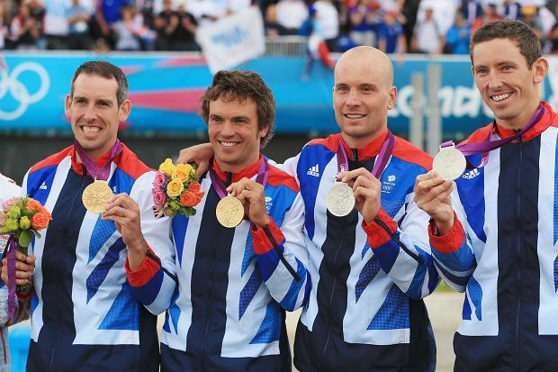
Notes:
JDA
Our greatest team

Slide 9

Canoelondon2015.com
Notes:
First step Olympic Qualification at the World Championships
Get your tickets at canoelondon2015.com

