Slide 1
Set the disruptive scene
David Minton
Director of The Leisure Database Company

Slide 2

airbnb
Allows you to rent unique accommodation from local hosts.
Airbnb has over 800,000 rentals.
Airbnb has recently partnered with the Rio 2016 Olympics to offer 20,000 rentals to the cities guests.

Slide 3

Uber
Get a taxi, private car or ride share from your mobile phone.
Uber is the fastest growing company that Google Ventures has ever invested in.

Slide 4

zipcar
An alternative to the traditional car hire services, allowing its customers to rent a car by the hour.
A Zipcar is reserved somewhere in the world every 6 seconds.

Slide 5

Netflix
Stream TV shows and films anytime, anywhere to your phone, TV, games console and PC or MAC.
Netflix outranks any cable TV network in the US.

Slide 6

The cloud
Storing and accessing data and programs over the internet instead of on your computers hard drive.
An estimated 41% of top executives in major companies around the world claim to use the cloud to streamline some portion of their business.

Slide 7

Spotify
Allows you to stream music on the go.
Spotify has 60 million users, of which 15 million are paid subscribers.

Slide 8
What is it that these platforms offer?
Payment infrastructure to make transactions smoother.
Identity infrastructure to screen out any unwanted passengers.
Sensor infrastructure, present on our smart phones, which traces the location of the car and the customer in real time.

Slide 9

Consumer power
The power is in the hands of the consumer.

Slide 10











Examples of Aggregators

Slide 11
How much do disruptive industries know?
Disruptive industries know 100% about their consumer.

Slide 12

Disruptive Highlights from the Consumer Electronics Show

Slide 13

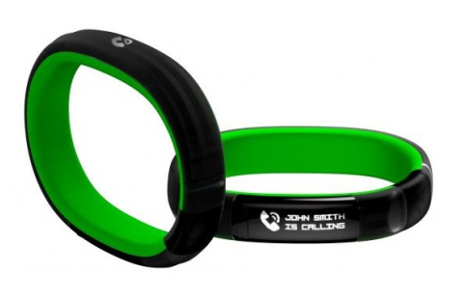
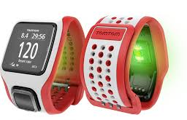
Razer Nabu
Measures steps, stairs climbed and how well you sleep.
Allows you to dismiss a call at the shake of the wrist.
Companions gamifying your life by awarding badges for fitness milestones.
Atlas Fitness Track
Tracks the movement of the body on three different axes, automatically telling the difference between the types of exercise and counting reps.
TomTom Multi-sport Cardio
Records routes and feeds essentials stats.
Has a light that shines through the skin to monitor changes in blood flow and calculate heart rate without a strap.
Newer Examples

Slide 14
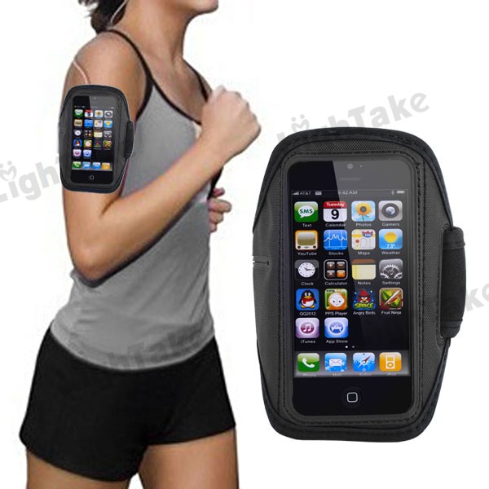
Bring your own device

Slide 15
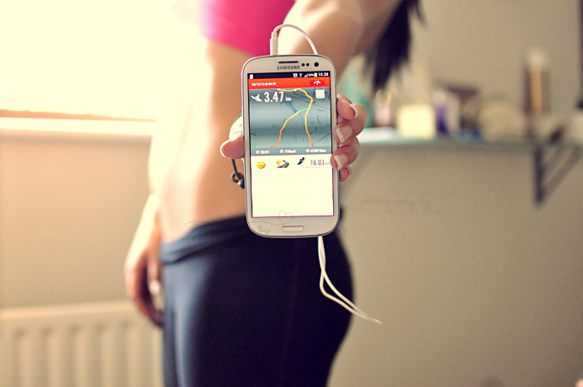
Self monitoring

Slide 16


Sports and fitness is changing
Individual Sports
Teams Sports

Slide 17
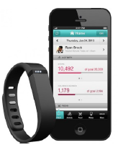
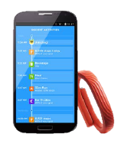
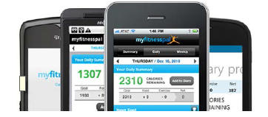
Fitbit
2.4 Trillion steps recorded in 2013.
The same distance as walking Earth to Saturn!
My Fitness Pal
65 Million users.
    That’s a 50% year on year growth.
100 Million lbs lost by users since inception.
Jaw Bone
50 Billion activity data points crunch per week.
100 Million nights sleep have been logged that’s the equivalent of 27,000 Years.
Growing fast

Slide 18
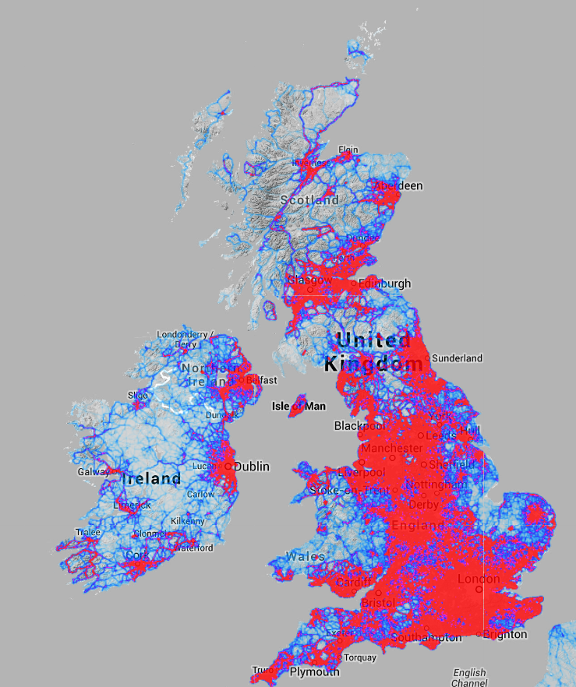
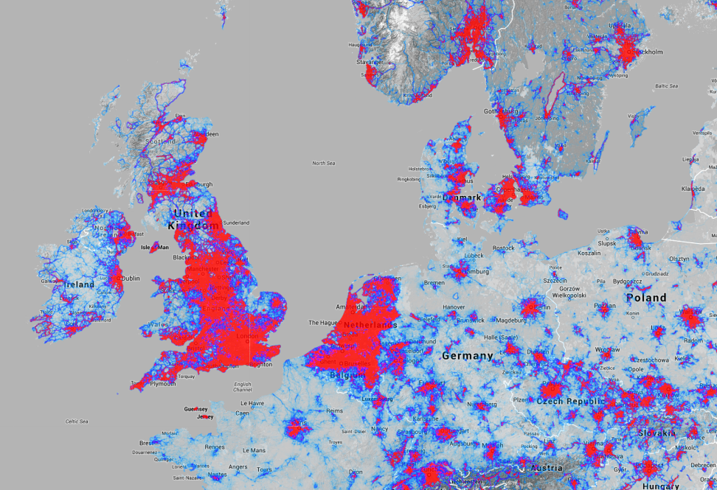
Strava Heat maps

Slide 19
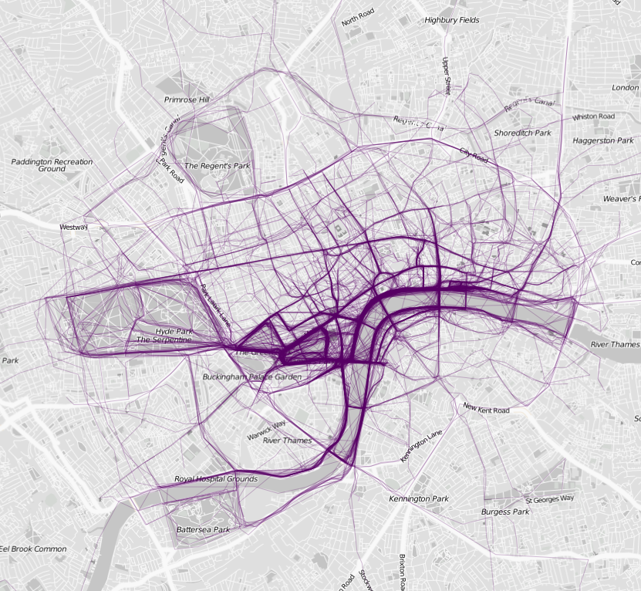
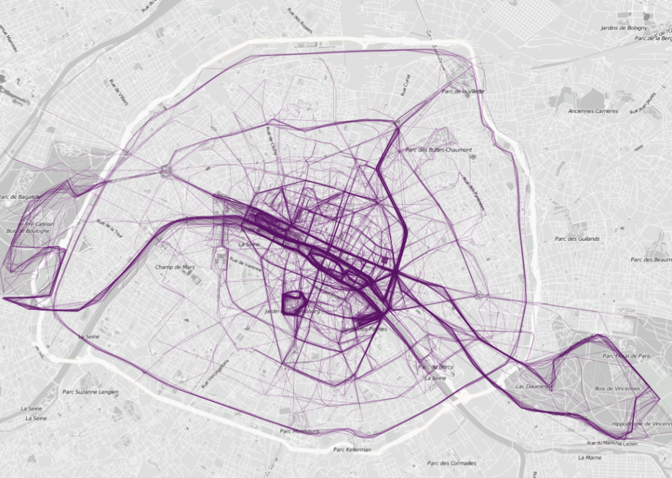
Map my ride maps
London
Paris

Slide 20


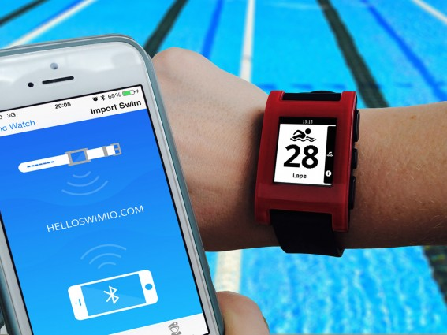





The pebble

Slide 21
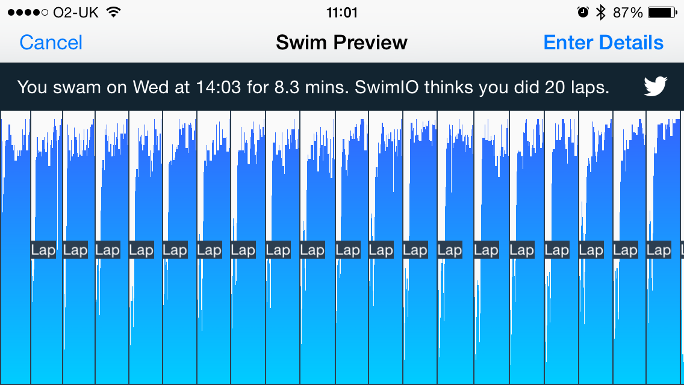
Swimio or kevin pacey
Pebble app store

Slide 22
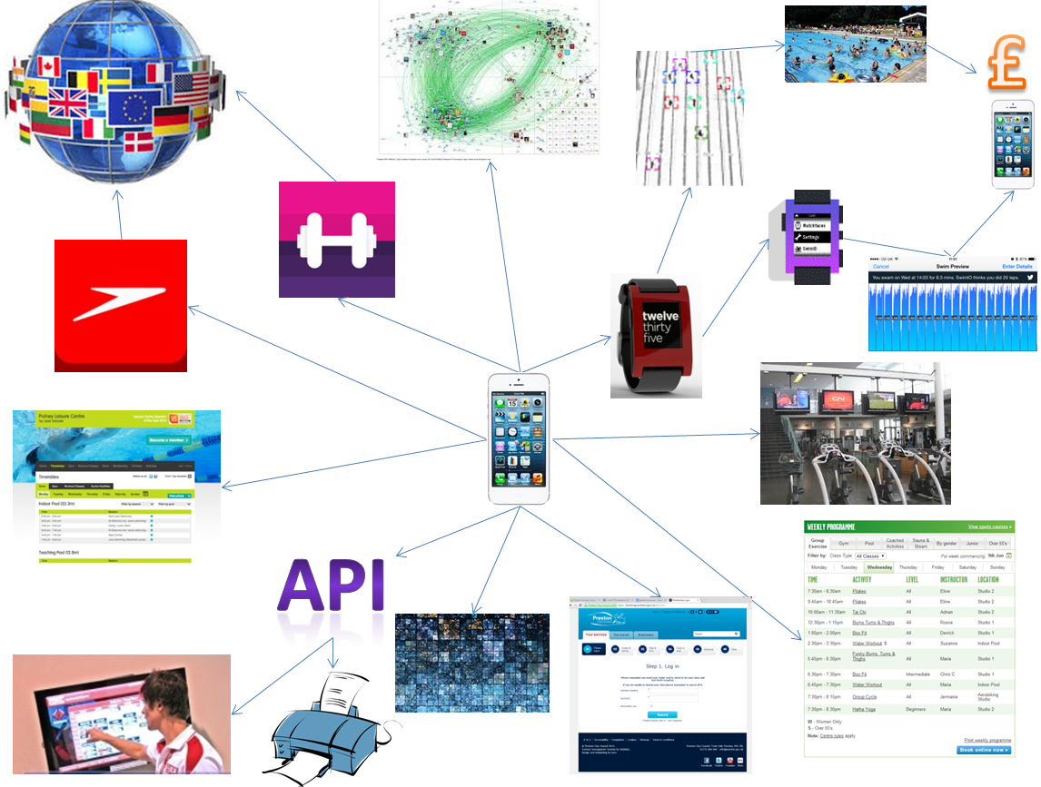
Internet of sport things

Slide 23

David Minton
The Leisure Database Company
david@leisuredb.com
Tel: 07860 237008
www.leisuredb.com
uk.linkedin.com/pub/david-minton/19/94a/5b0

