Slide 1


Commissioning support for local authority sport and physical activity services
^{c}CLOA AGM
25 June 2015

Slide 2
Aim of this session
To give an overview of the ^{c}CLOA/Sport England commissioning project
Share the learning and discuss what it means for the sector

Slide 3
Why the project was undertaken
  Overall slow to understand and engage in commissioning– results are patchy
  More focus on procuring efficient sport & leisure service than the service being commissioned by others
  Austerity and health/social care reform offer huge opportunities for the sector to be part of wider service transformation
  There are huge risks if commissioning is seen as “a dash for cash” rather than delivering shared outcomes

Slide 4
Project Aims/Objectives
Increase understanding of the commissioning agenda
Improve the ability of the sector to engage as a strategic partner
  building relationships with commissioners
  helping identify how the service can hone its offer
Share the learning

Slide 5
The commissioning cycle
Review
Analyse
Sector needs to be seen here
Sector mainly found here
Do
Plan

Slide 6
The process
Scoping with the leisure team
Mapping
Awareness raising with the leisure team
Follow up with commissioners
Plan and implement

Slide 7
Commissioners’ views & perceptions
Challenges | Sector seen as provider not a strategic player, lacks visibility and connectivity
 | Sector seen as income & facility focussed, interested in getting the active more active rather than focus on the inactive
 | Still gaps in evidencing impact and value for money
 | Sector is not commissioner ready - fragmented , independent quality assurance required
 | Sport is exclusive, not relevant to those in greatest need
 | Industrial scale solutions, innovation required – service transformation
Opportunities | Value of physical activity is better understood; “physical activity is a win-win”
 | Prevention gradually gaining traction because of costs of health and social care
 | Mental health a growing issue / concern
 | Joint funding pots (e.g. Better Care & Integration Transformation funds) are driving innovation and new ways of working
 | Workforce programmes, worklessness, re-enablement, improved parenting, healthy children, drug and alcohol rehabilitation
 | Come and talk to us – show us what can be done and make a difference

Slide 8
Examples of impacts
Durham - the sport and leisure service became a strategic player in helping define need and pulling together a consortium to achieve a Well-being for Life contract of £2.1m per annum for 3 years.
Oldham - a ‘Top Leaders Summit on Physical Activity’ of key organisations from local government, health (including the chair of the CCG), housing, education and the voluntary sectors secured forty specific pledges for individual and organisational actions.
Hertfordshire – have a systematically organised partnership with a shared vision and strong understanding of commissioner’s needs. This has led to £300,000 CCG investment in a Get Healthy Get Active project to increase the number of inactive adults in deprived areas getting more active and playing sport over three years. The County Council’s Public Health Directorate have also invested nearly £1m in physical activity linked to health outcomes, with a range of providers

Slide 9
Project participant comments
Created an opportunity for us to think together
Forced us on focus on the important rather than the urgent
“We have made a quantum leap. We’ve broken into the circle and grown our understanding. We’re now part of the game, in a position to have the conversations and continue to learn.”

Slide 10
Lessons learned
The process worked and role of expert adviser was key
Transformational change is the long term solution councils will be following
No end of opportunities – need to listen and focus attention on need and evidence what works and sector needs to be around the tables where strategic planning takes place
Language is critical
Not a dash for cash
Influence the influencers’ - about relationship building to influence commissioning – need to be patient
Elected members are critical to the influencing process
Its can be harder in two tier areas but not impossible

Slide 11
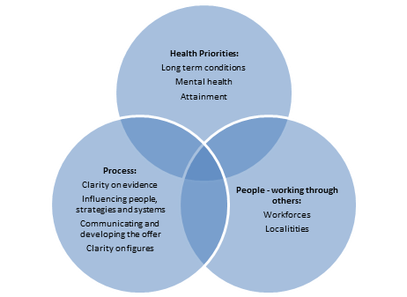
Leeds

Slide 12
Going forward
There is a need to apply a transformational lens to service integration and position sport & physical activity in the wider sphere of public service reform, better outcomes, prevention and early intervention as well as non-clinical interventions & pathways.
For health & social care there is a need for sport & physical activity to respond to delivering universal, targeted and personalised services.
There is a need for capacity and capability locally to ensure opportunities are maximised and relationships sustained to maintain momentum.
To enable this to happen their needs to be systemic workforce change across the sector including within councils, operators, clubs

