Slide 1


Public Health
CLOA 2015

Slide 2
Three key aims…
1) Improve population health
eg: smoking, obesity, alcohol, mental health, falls prevention
2) Protect against communicable disease
eg: vaccination, sexually transmitted disease, outbreaks
3) Provide technical expertise & advice
eg: data collection & statistical analysis, evidence review

Slide 3
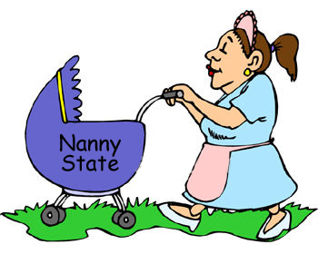
Not an aim…

Slide 4

Smoking and
The Nanny State

Slide 5
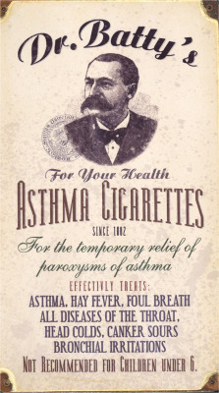

Slide 6

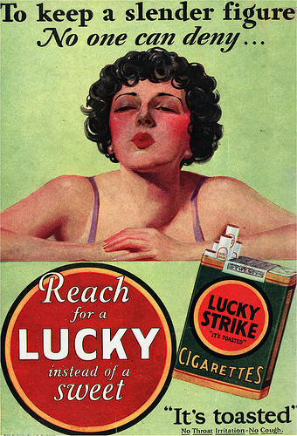

Slide 7
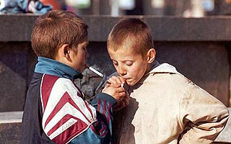
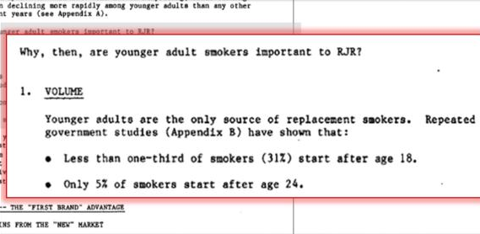
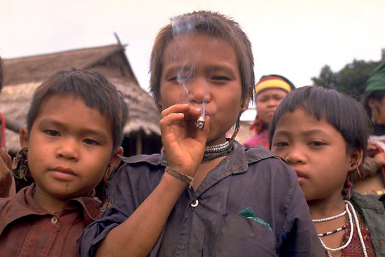

Slide 8

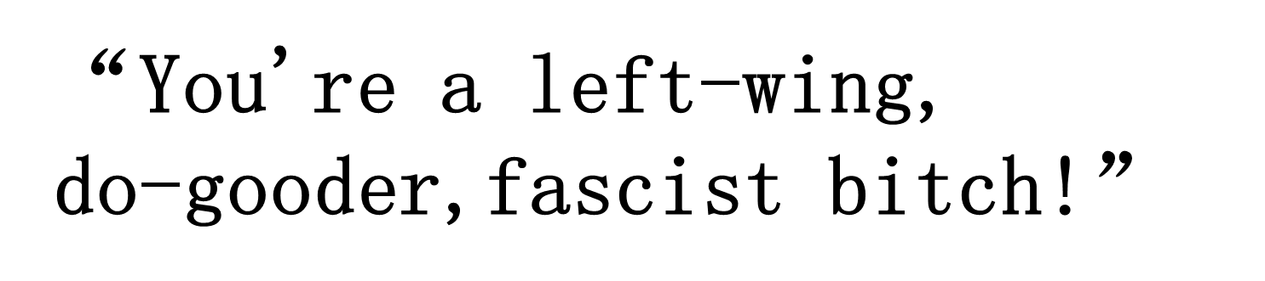

Slide 9

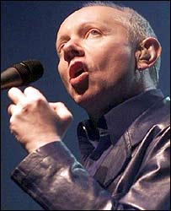
FOREST
Freedom Organisation for the Right to Enjoy Smoking Tobacco
www.forestonline.org
“All sense of proportion has been lost in the exaggeration of the health risks .”
Joe Jackson
Musician and FOREST Supporter
(and Idiot)

Slide 10
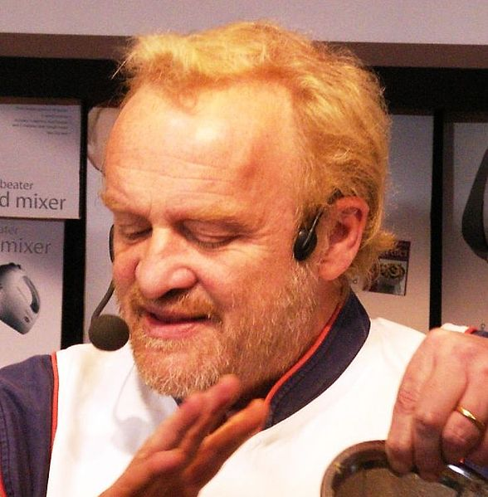
FOREST
Freedom Organisation for the Right to Enjoy Smoking Tobacco
www.forestonline.org
“Why should the anti-smoking lobby dictate our lifestyle at the expense of our well known culture of tolerance?”
Anthony Worrall Thompson
Celebrity Chef and FOREST Supporter

Slide 11
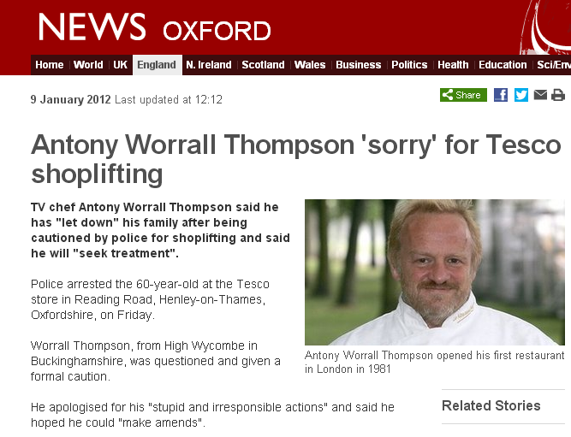

Slide 12
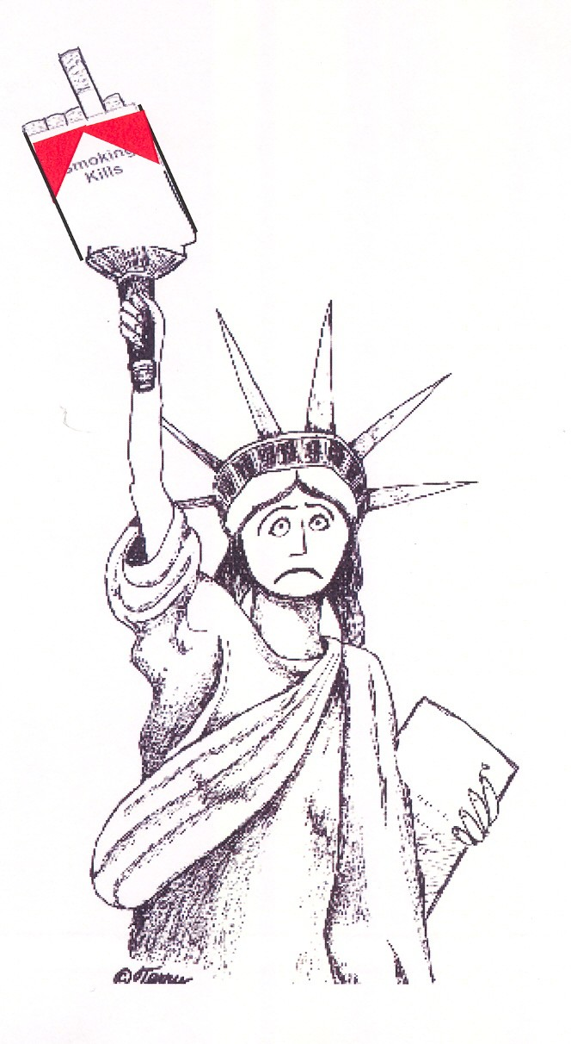
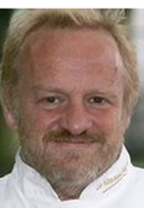
The theme of ‘Control’
Who ‘wins’ when you smoke?
Who ‘loses’?
Who’s really in control?
Do we really find liberation through smoking?
Or by quitting?

Slide 13
Who we work with…
CCG
Residents
NHS
Public Health
Reg Services
Social Care
Leisure
Vol Sector
Schools

Slide 14


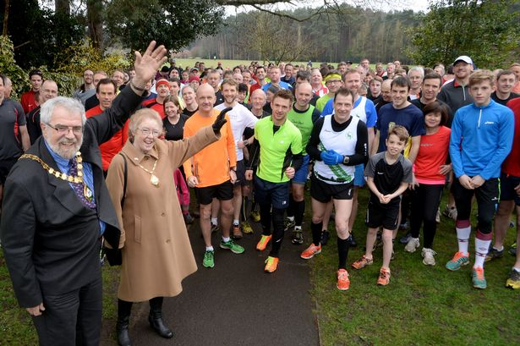
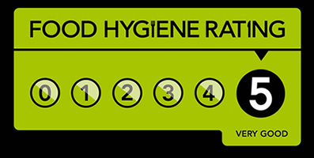

Work with ECC…

Slide 15
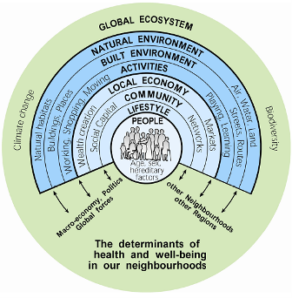

Slide 16

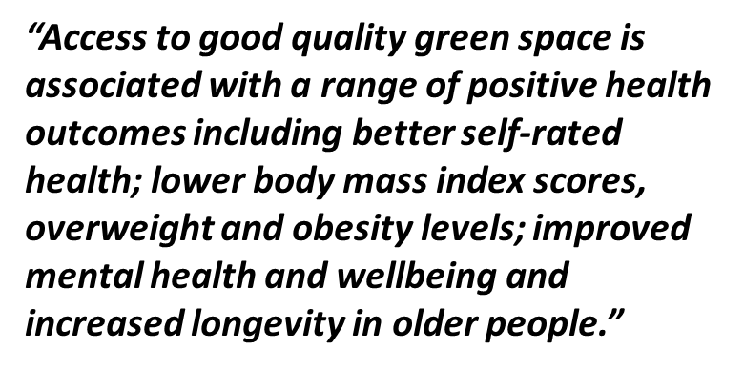
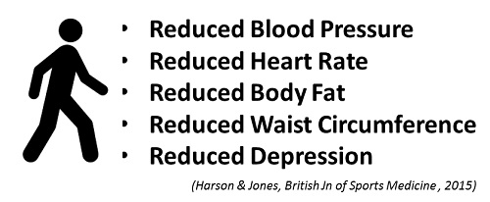

Slide 17
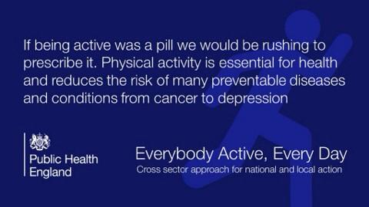


Slide 18
Public Health Interventions – Cost per QALY saved
Telehealth for people with LTCs (Henderson et al. 2012) | £92,000
Chlamydia screening (under 25 yrs age) (Woodhall et al. 2014) | £27,269
Buprenorphine maintenance therapy (NICE. 2007) | £26,400
Group Exercise Programme (>65 yrs) (Garrett et al. 2011) | £13,890
Walking Groups (‘GWKW’) (Garrett et al. 2011) | £2,700
Exercise ‘Prescriptions’ (>65 yrs) (NICE 2006) | £74

Slide 19
Opportunities…?
- Council Cuts (eg: to Public Health)
- H&WB Boards criticism
- Membership
- Use of evidence
- Better Care Fund
eg: Falls Prevention

Slide 20

Key Challenge…?

Slide 21


