Slide 1
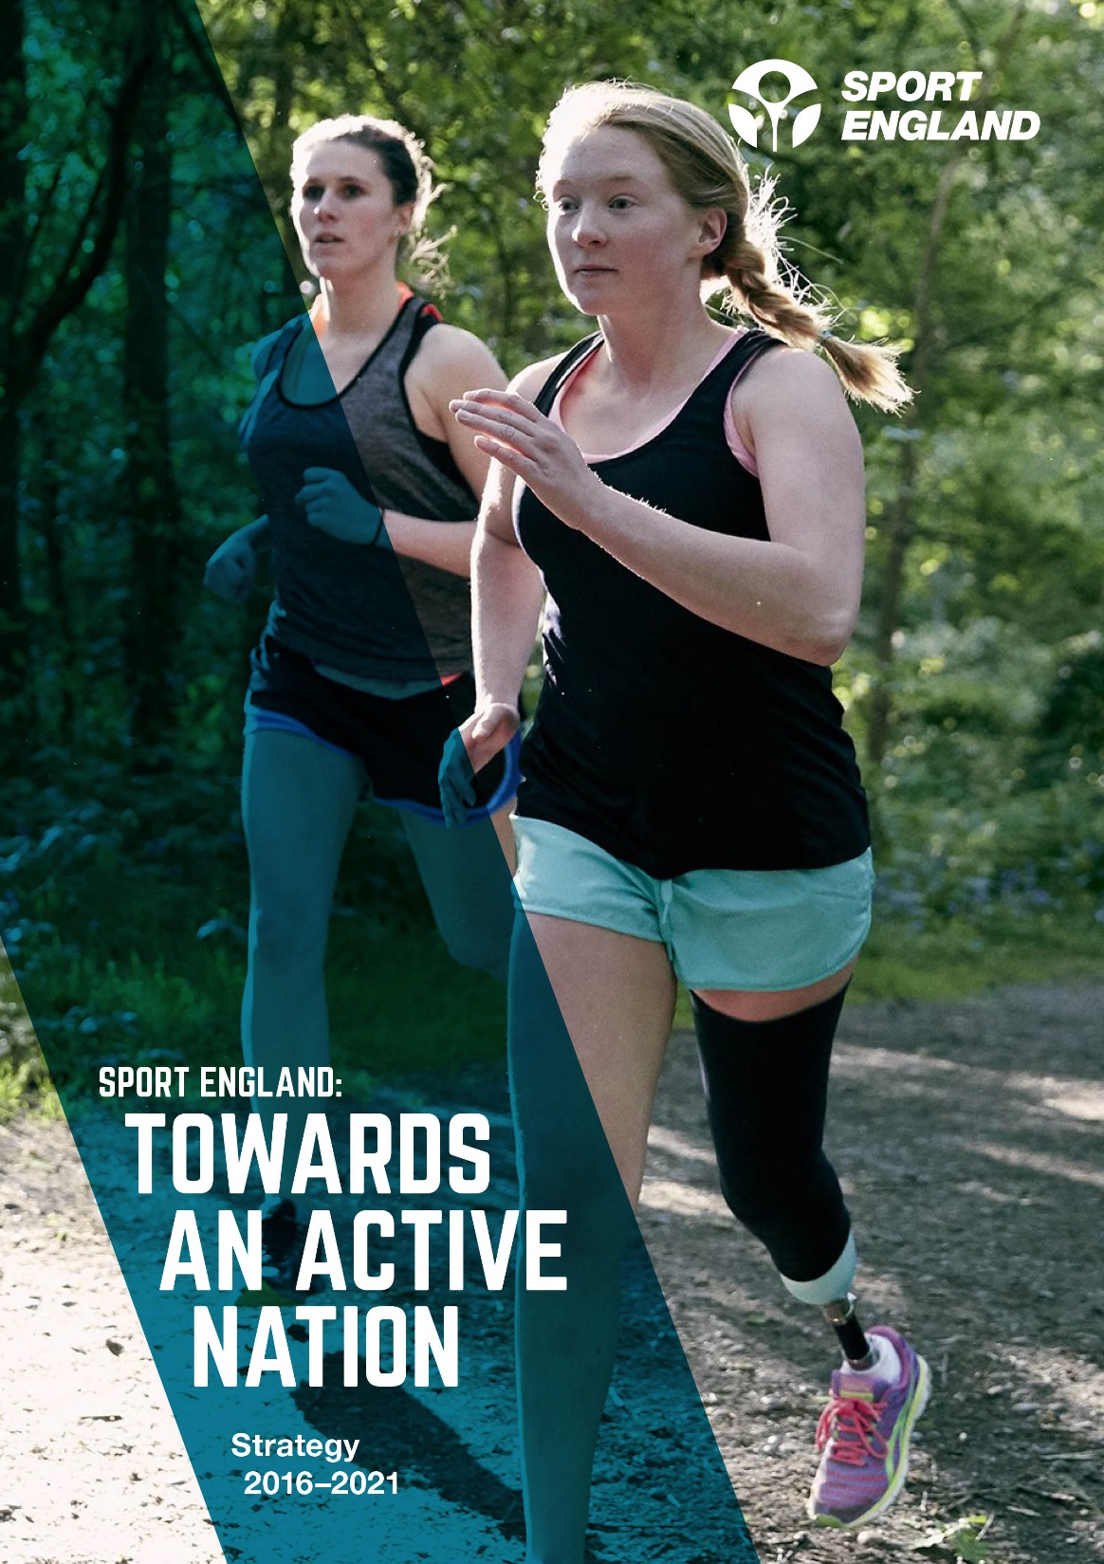


@mikediaper

Slide 2
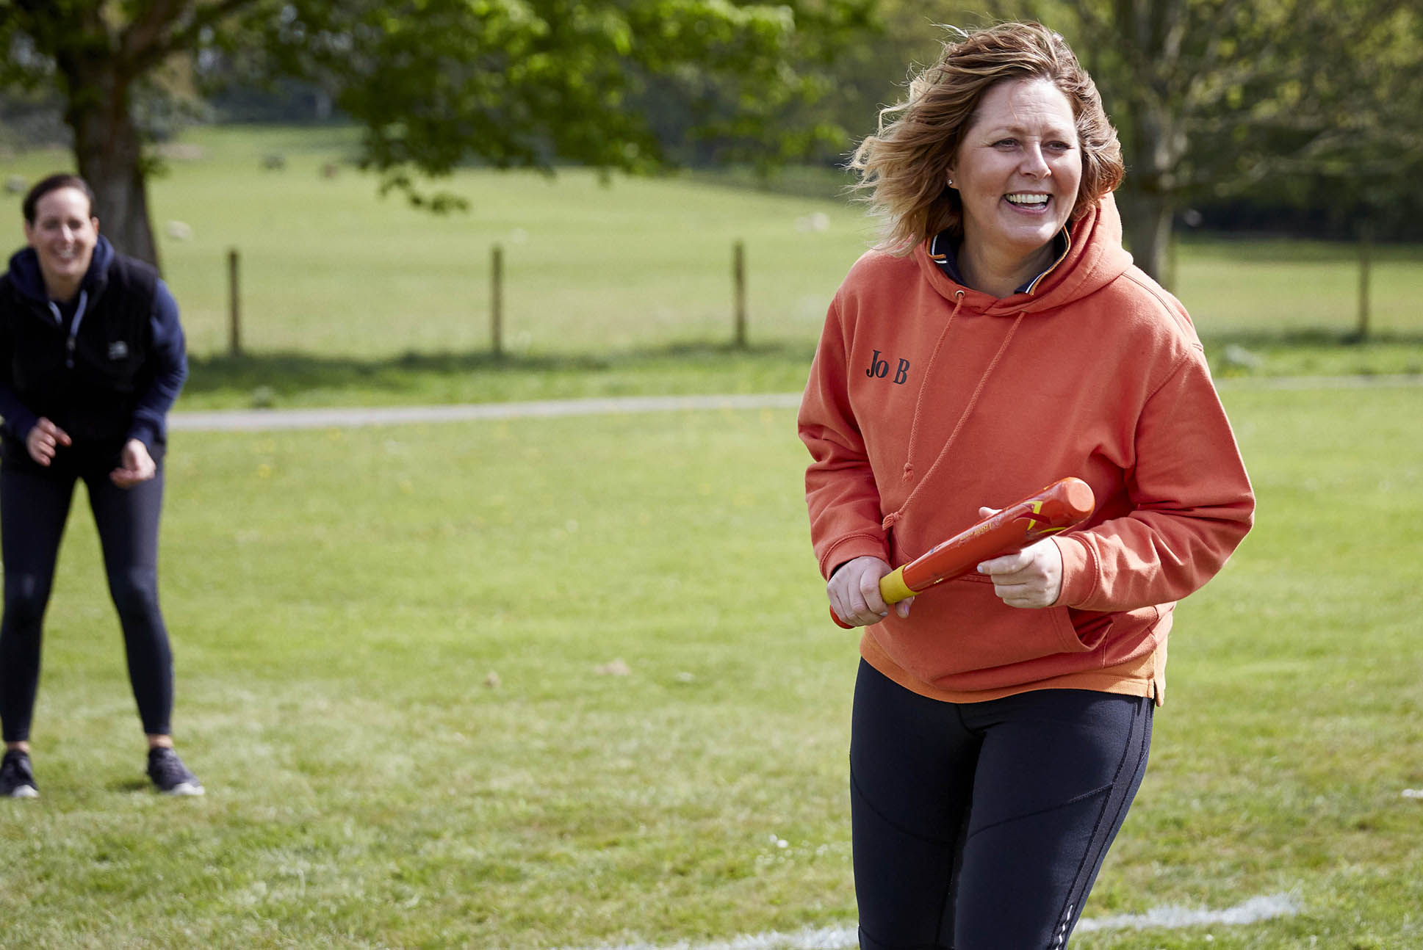
Sport England’s Vision
We want everyone, regardless of age, background and level of ability, to feel able to engage in sport and physical activity.
Some will be young, fit and talented, but most will not. We need a sport sector that welcomes and meets the needs of everyone, treats them as individuals and values them as customers.

Slide 3
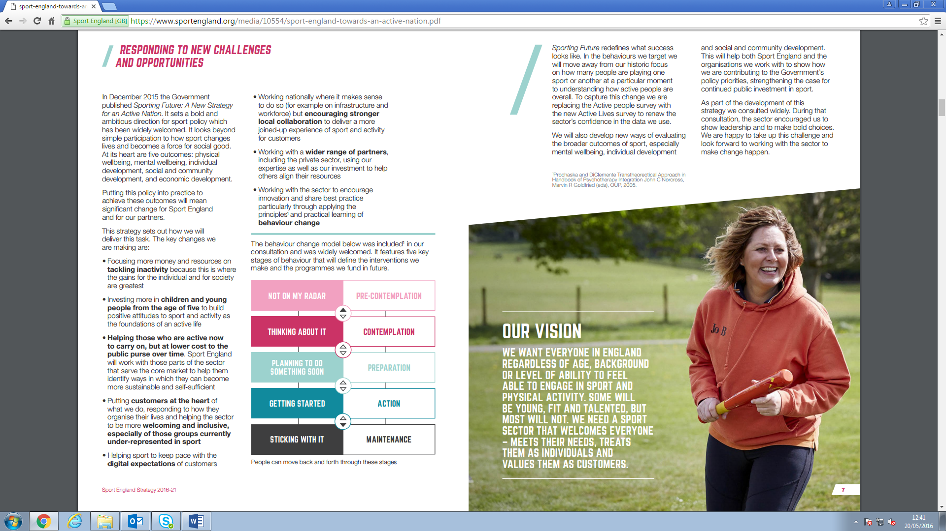
Sport England Strategy: Towards An Active Nation (2016-21)
Physical
Wellbeing
Mental
Wellbeing
Individual Development
Social and Community Development
Economic Development
Outcomes
Increase in % meeting CMO guidelines
Decrease in % inactive
Improved subjective wellbeing
Levels of perceived self-efficacy
Levels of social trust
Gross Value Added by sport sector
Outcome Measures
More people from every background regularly and meaningfully taking part in sport and physical activity
A more productive, sustainable and responsible sport sector
How we think
Customer Focus
+

Slide 4
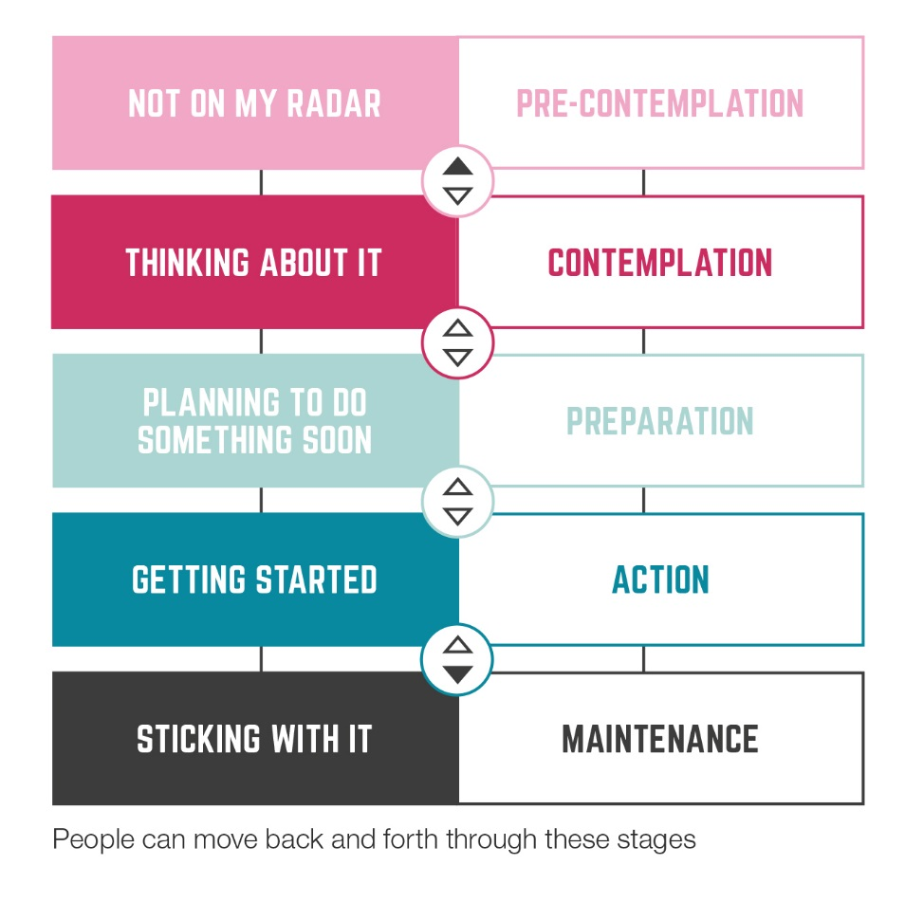


We are all somewhere on the behaviour change journey
1
Tackling inactivity
Challenging the intention/action Gap
2
Creating regular activity habits
Building a new habit is challenging
3
Helping those with a resilient habit to stay that way
Life gets in the way and is challenging

Slide 5
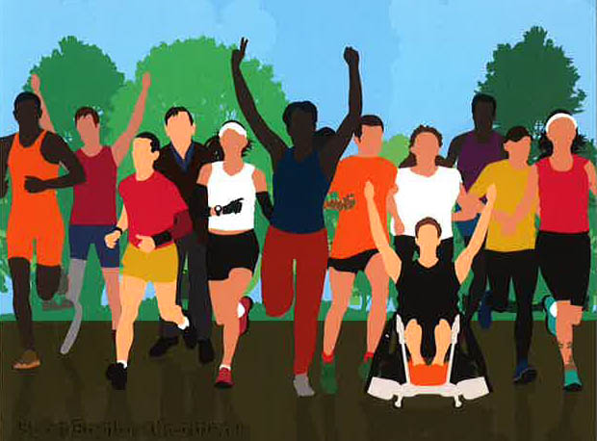
We need to understand the whole person
Perceptions
Influences
Who and what impacts on their behaviour
Information
What do they have and where does it come from
Benefits
Barriers
Knowledge
Who are they?
(demographics)
Where they are?
(geographies)
What do they do?
(active or non-active)
But don’t stereotype

Slide 6
Sport England Strategy: Towards An Active Nation (2016-21)
Physical
Wellbeing
Mental
Wellbeing
Individual Development
Social and Community Development
Economic Development
Outcomes
Increase in % meeting CMO guidelines
Decrease in % inactive
Improved subjective wellbeing
Levels of perceived self-efficacy
Levels of social trust
Gross Value Added by sport sector
Outcome Measures
More people from every background regularly and meaningfully taking part in sport and physical activity
A more productive, sustainable and responsible sport sector
How we think
Customer Focus
+
How we decide
Seven Investment Principles

Slide 7
Investment Principles
Clear line of sight to outcomes and KPIs
Targeting under-representation
Using behaviour change
More than a bank
Balanced portfolio – bankers and innovators
Flexible investment and regular reviews
Greater efficiency

Slide 8
Wider Partnerships
It’s what you can do that counts, not who you are
Finding a common purpose
Wider range of organisations
Sport England as broker and collaborator
Simplified competitive processes

Slide 9
Governance & Efficiency
Governance (applies to all)
  Governance Code for Sport in the UK
Efficiency
  More money to the frontline and lower dependence on public funding
Diversification of funding
  Other Government Departments and more third sector collaborations
  Serving customers better
  More commercial funding

Slide 10
Sport England Strategy: Towards An Active Nation (2016-21)
Physical
Wellbeing
Mental
Wellbeing
Individual Development
Social and Community Development
Economic Development
Outcomes
Increase in % meeting CMO guidelines
Decrease in % inactive
Improved subjective wellbeing
Levels of perceived self-efficacy
Levels of social trust
Gross Value Added by sport sector
Outcome Measures
More people from every background regularly and meaningfully taking part in sport and physical activity
A more productive, sustainable and responsible sport sector
How we think
Customer Focus
+
How we decide
Seven Investment Principles
Tackling inactivity
Children and young people
Mass market
Core market
Volunteering
Facilities
Local delivery
What we invest in
Underpinned by
Workforce
Coaching
Active Lives

Slide 11
Key Shifts in Focus
Investing for a purpose, not sport for sport’s sake
Behaviour change
Customer focus
Under-represented groups
Children & young people
Wider partnerships - its what you can do that counts, not who you are
A new approach to measurement & evaluation
Sport England as broker and collaborator

Slide 12
What we invest in
Tackling inactivity
Children and young people
Volunteering
Taking sport and activity into the mass market
Supporting sport’s core market
Local delivery
Facilities

Slide 13

mike.diaper@sportengland.org

Slide 14
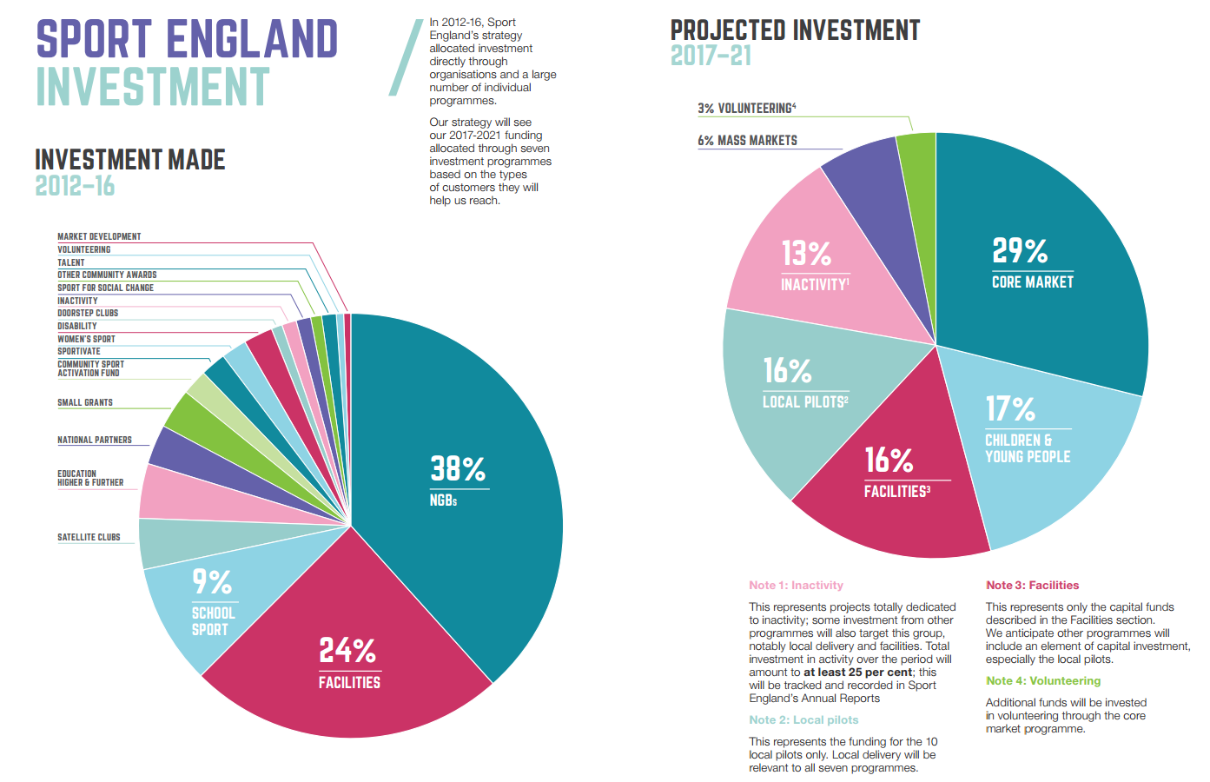

Slide 15
Tackling Inactivity
“The biggest gains and best value for public investment”
£120m with accelerator for what works
25% of total investment
Closer collaboration with Public Health England and other health charities

Slide 16
Children and Young People
“Building stronger foundations through basic competence and enjoyment”
Insight-led teacher training – 2 in every secondary school
£40m families investment

Slide 17
Tacking Sport & Activity to the Mass Market
Back ideas with big potential
Digital innovation
National-level campaigning

Slide 18
Supporting Sport’s Core Market
“The third of the population that already has a genuine habit”
Not just about NGBs
Excellent experiences including through NGBs and talent
Lower cost to the public purse
Talent is about progression and inclusion

Slide 19
Volunteering
“A dual benefit”
Increasing numbers and diversity
Better understand volunteer motivations
More investment into Club Matters
Strategy for volunteering backed by £30m by November 2016

Slide 20
Facilities
“Easy access to the right facilities”
New support for Community Assets
Increased investment in Strategic Facilities
Capital investment will feature in other programmes
Major investment in football through Parklife and Football Foundation

Slide 21
Local Delivery
“Because our customers don’t live in a vacuum”
Strong sustainable partnerships building on existing relationships
Wider support available – a new conversation locally
10 strategic pilots with substantial support (human and financial)

