Slide 1


National Funding Scheme
(Registered Charity no. 1149800)

Slide 2
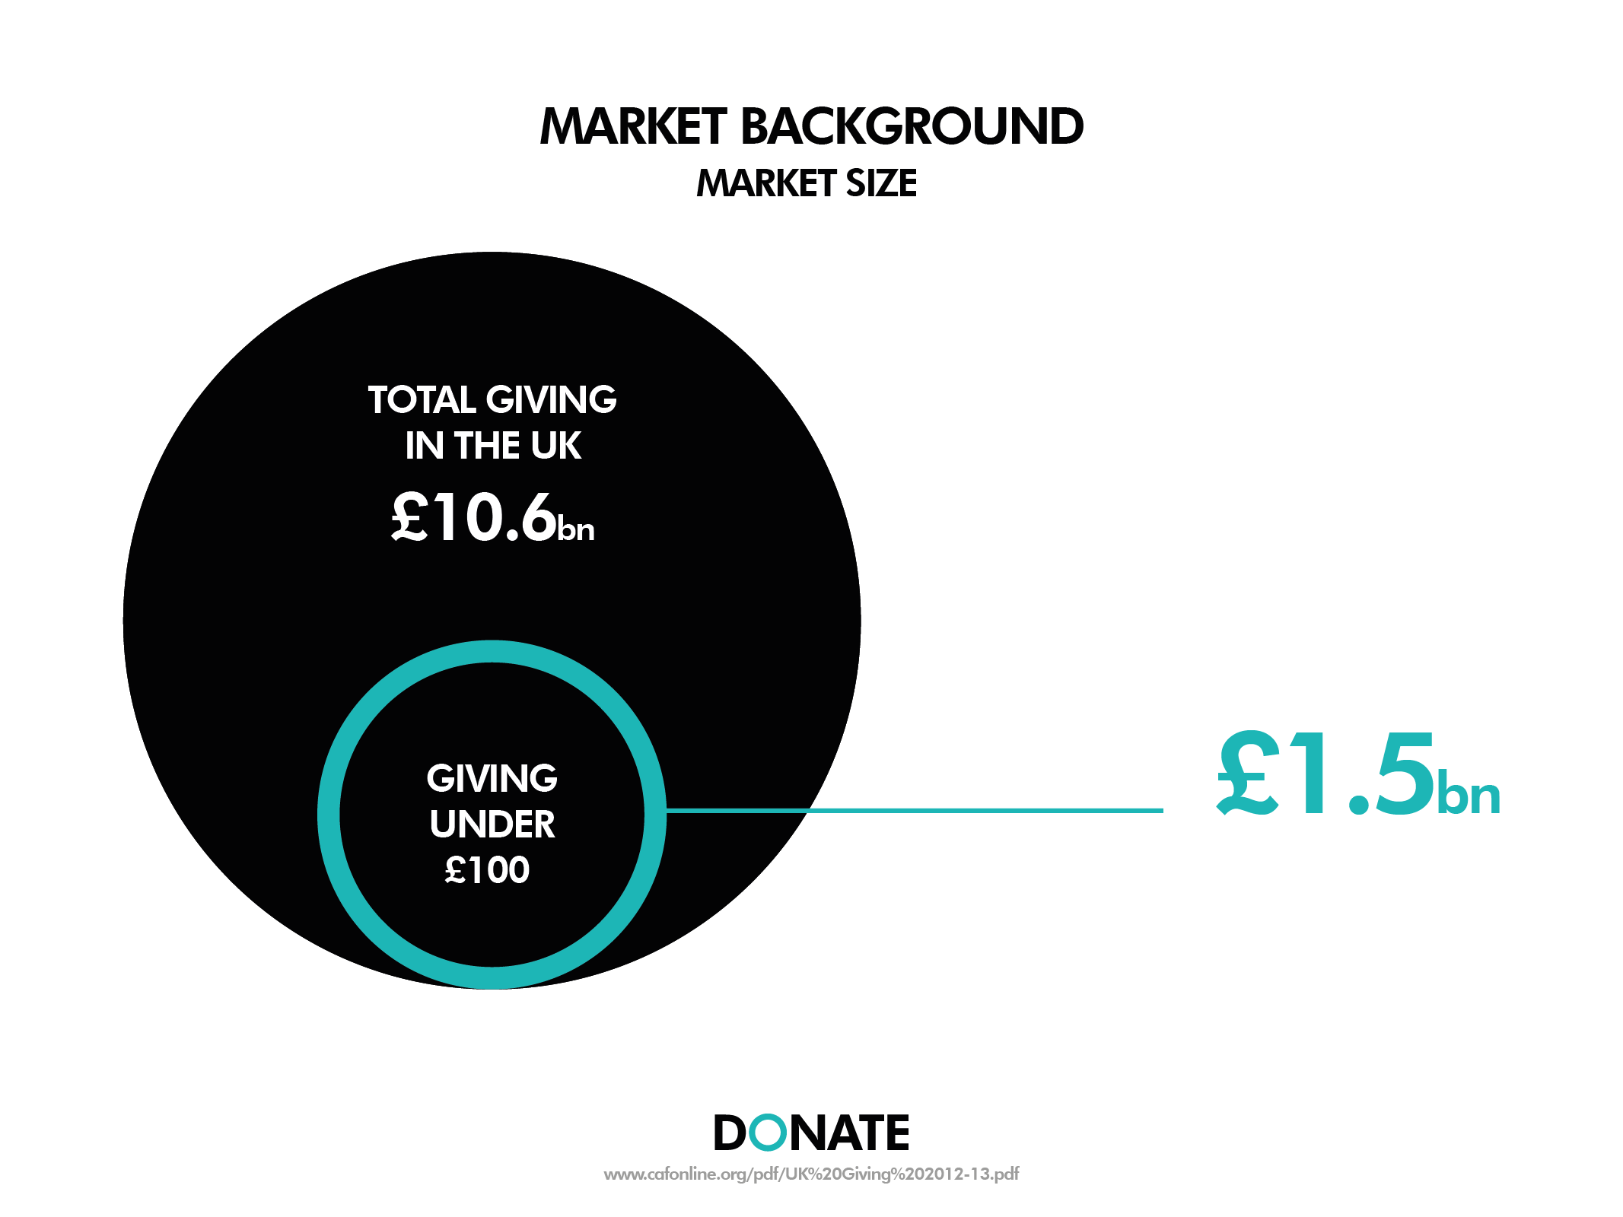

Slide 3
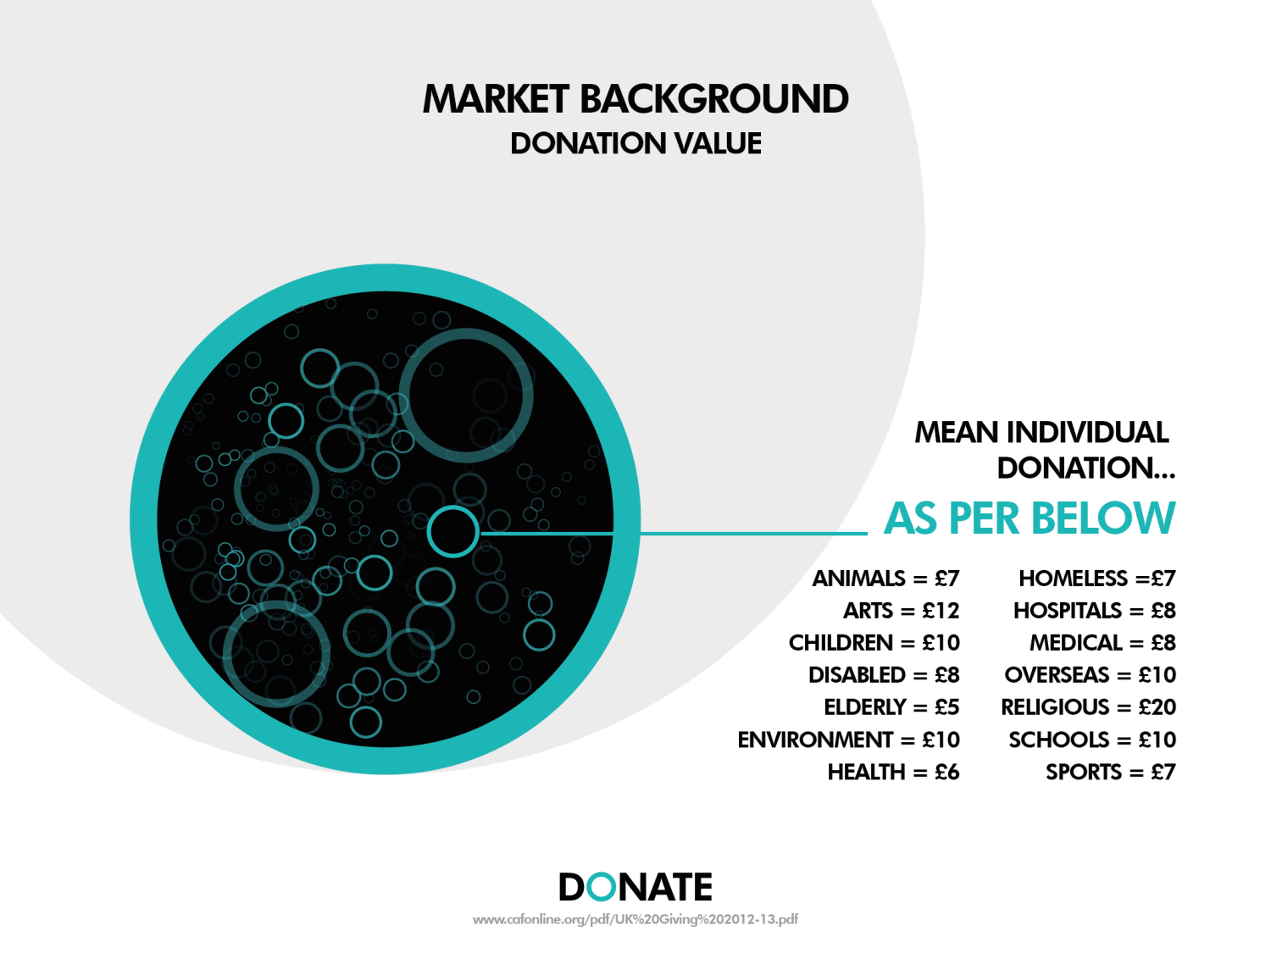
Notes:
52 local authorities responded to the request for information, representing just under 16% of the 326 local authorities in England.
8 (20%) Sports/Leisure closed / decommissioned
9 (23%) - Play closed or decommissioned
7 (18%) – Tourist Information Centres closed / decommissioned
7 (18%) – Libraries closed / decommissioned
removed or reduced community grants and aid above 15% for the arts.
Biggest impacts - sports development (17) and libraries (16).

Slide 4


Slide 5
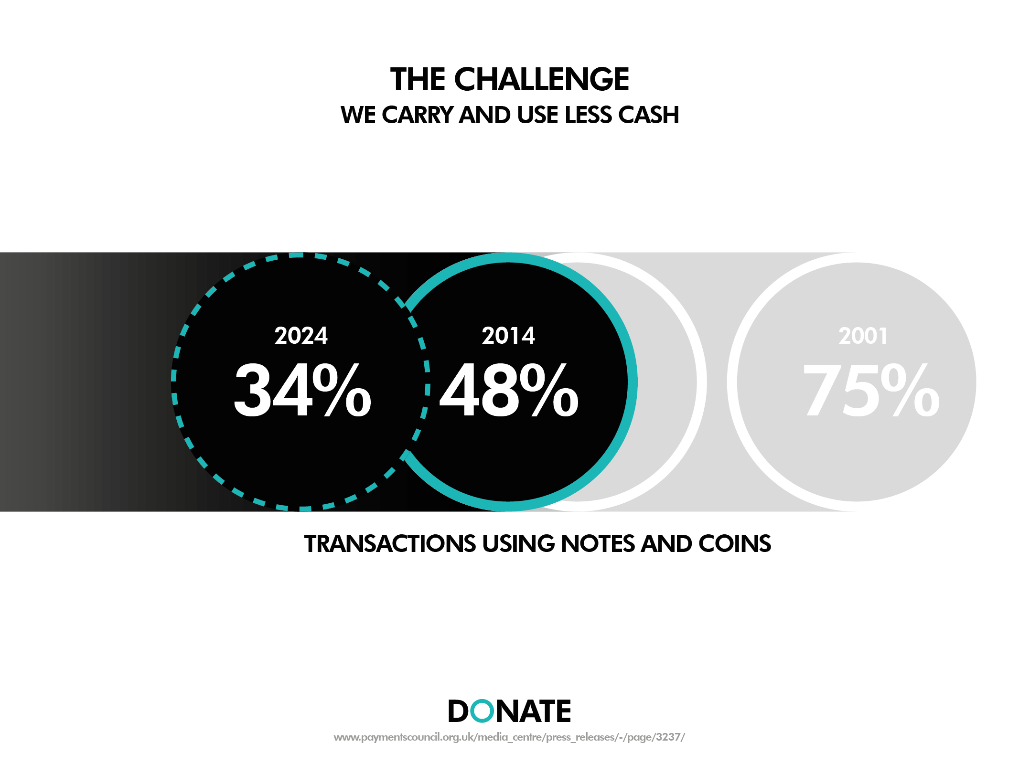

Slide 6
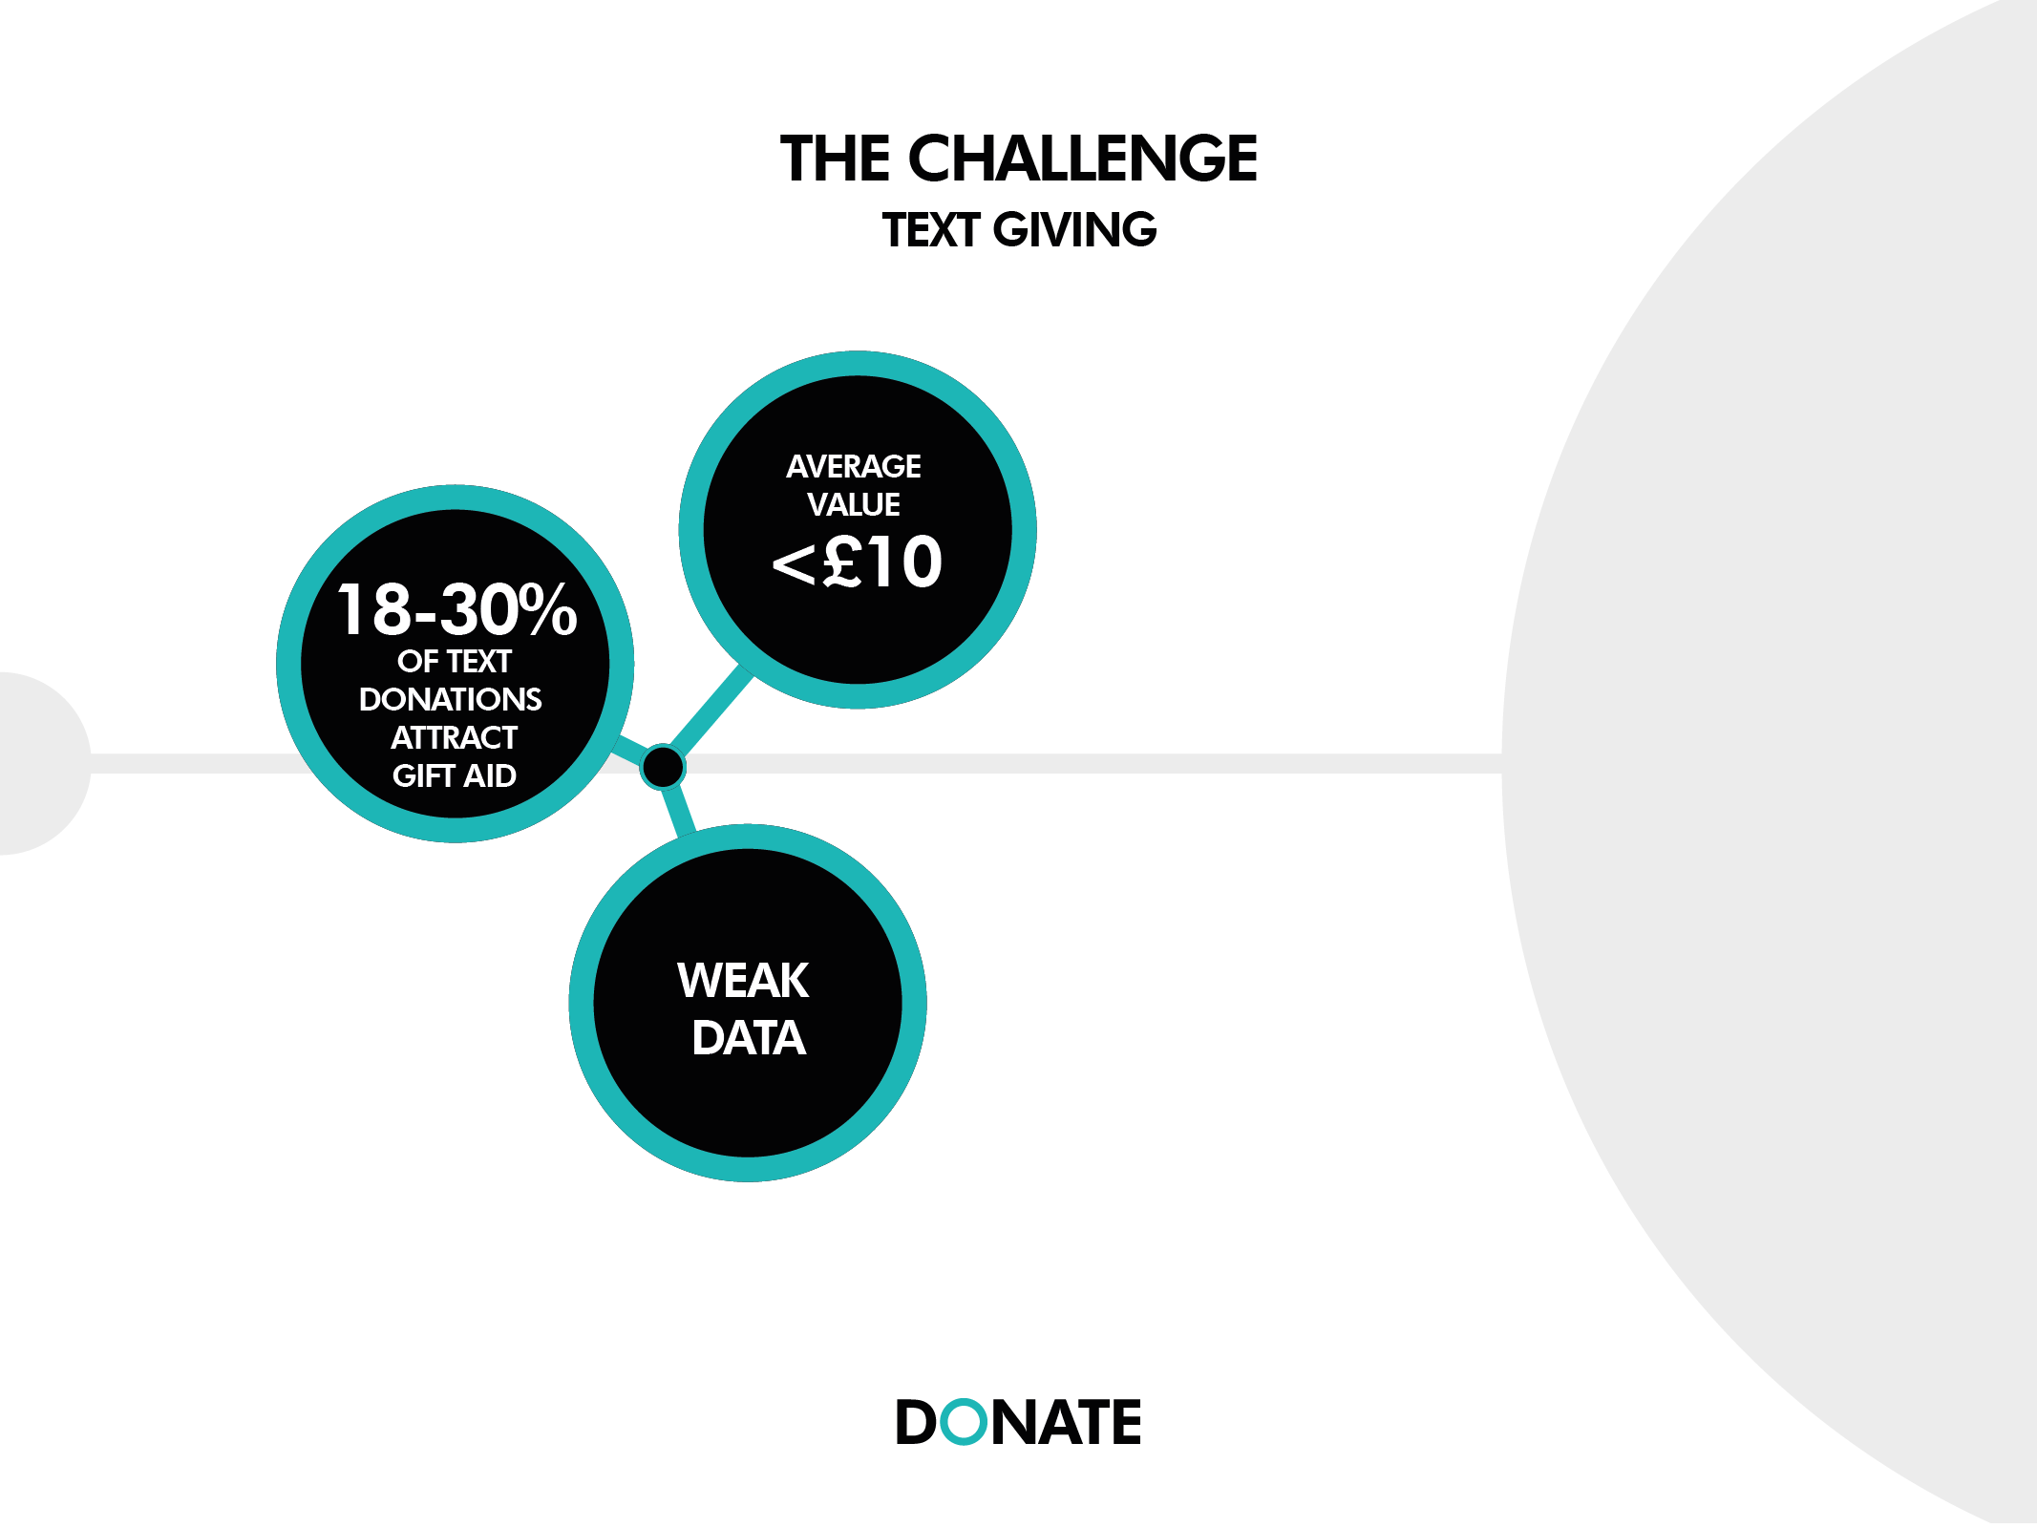

Slide 7
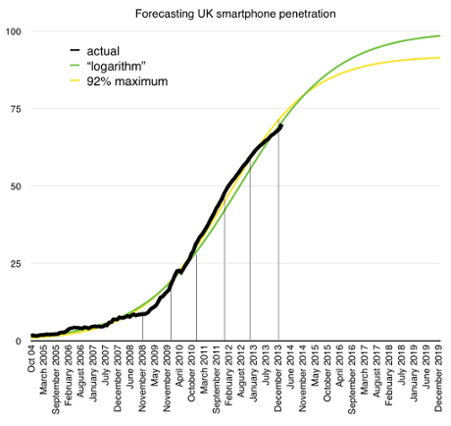

Notes:
29% of UK smartphone owners have made a purchase using the mobile web
25% of UK consumers have made a purchase using their mobile

Slide 8
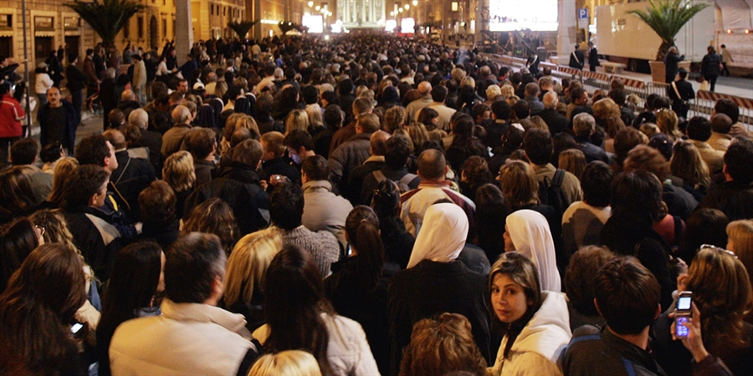
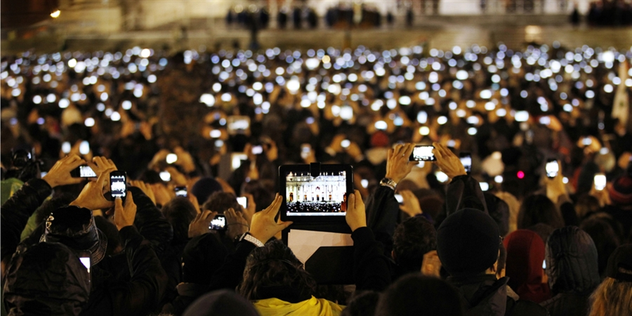
2005
2013
Notes:
Rationale - https://www.cafonline.org/pdf/UK%20Giving%202012-13.pdf
90% of donations are between £1-£1000

Slide 9


Slide 10
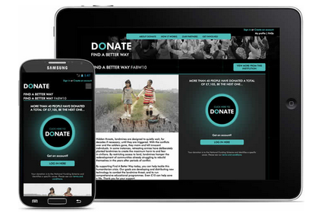
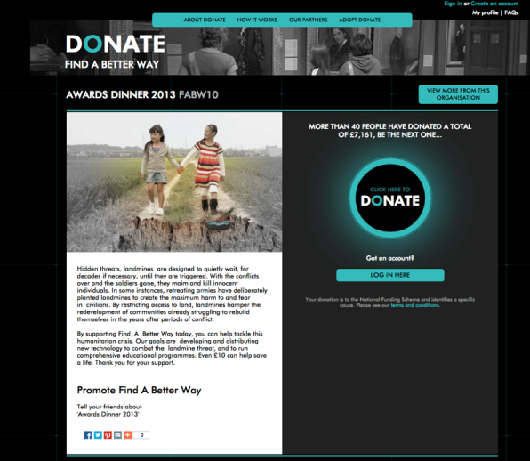
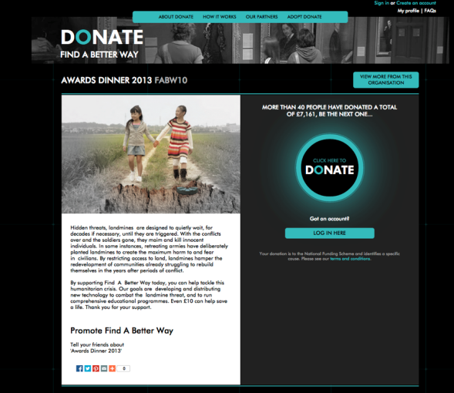
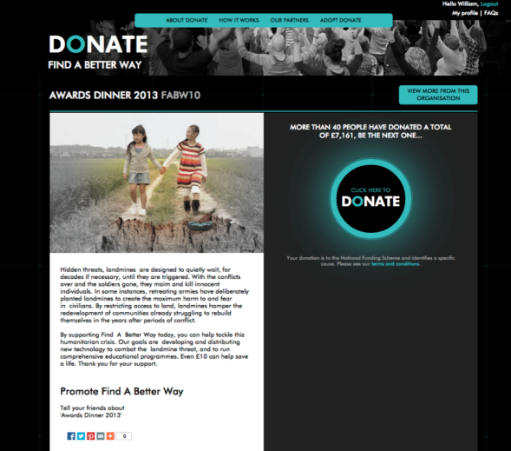


Slide 11
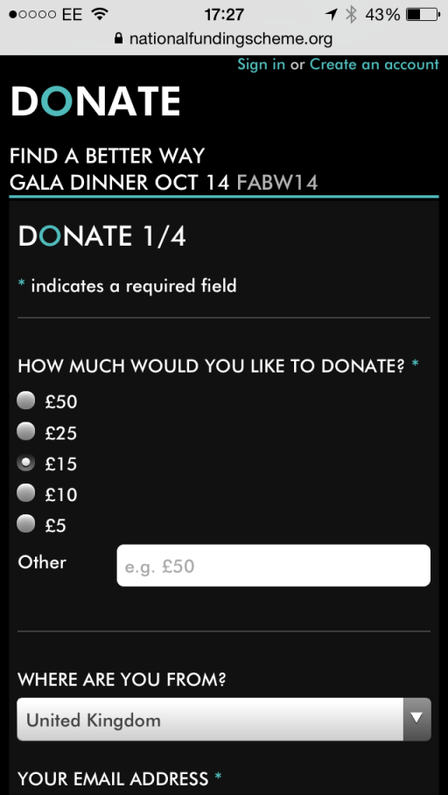


Slide 12
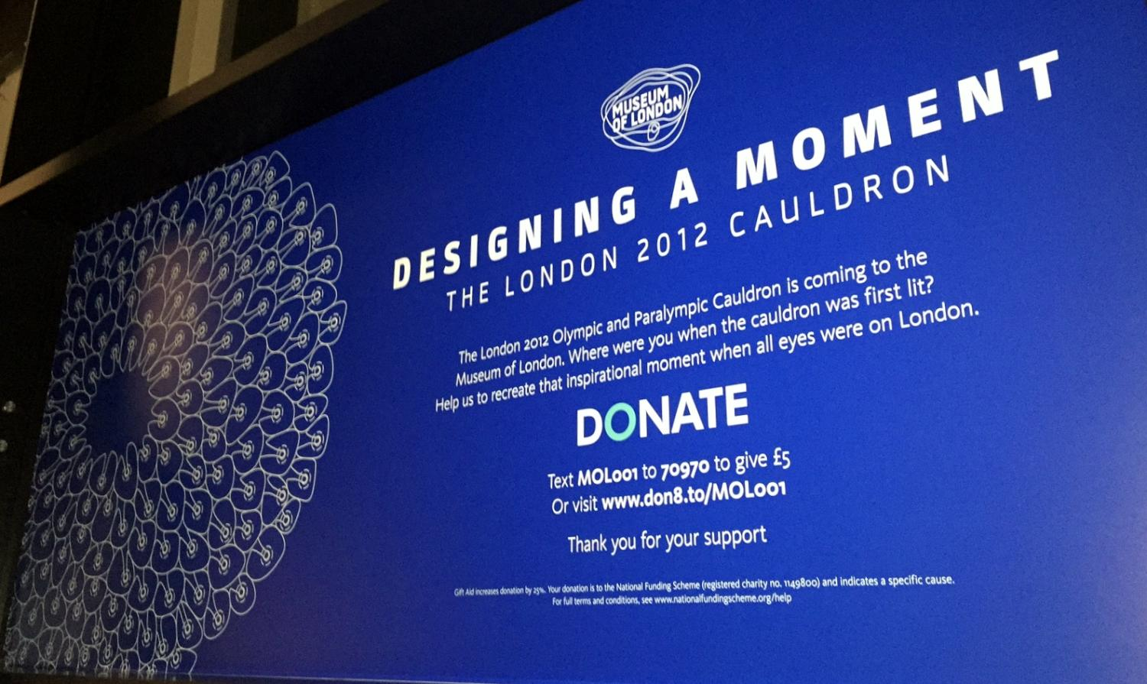

Slide 13
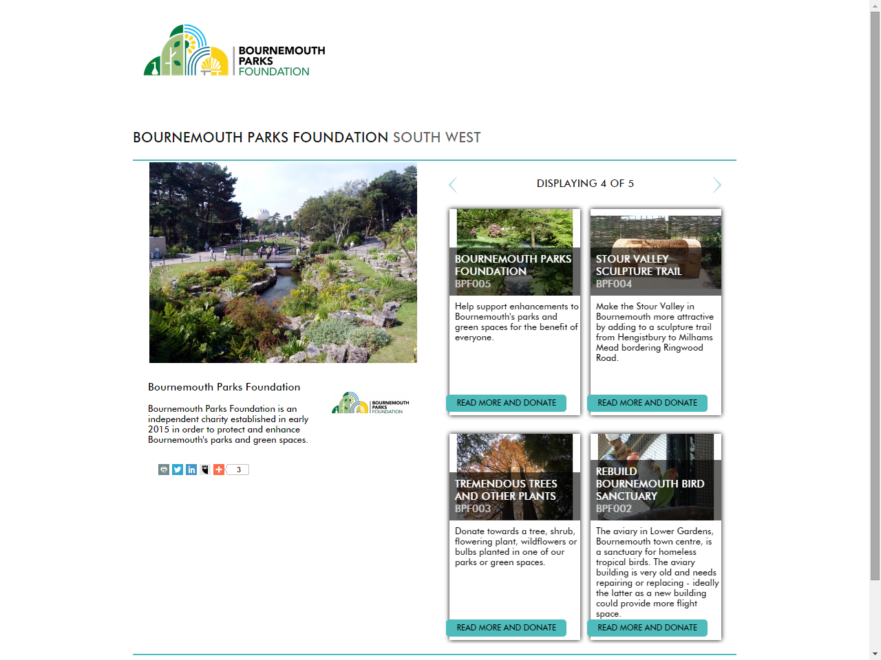

Slide 14


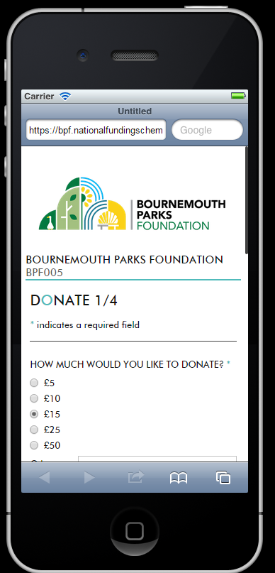

Slide 15


Slide 16


Slide 17
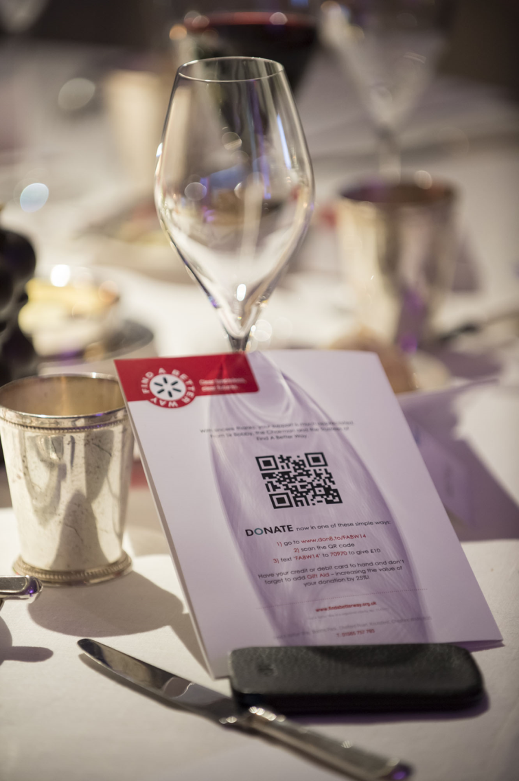

Slide 18


Slide 19
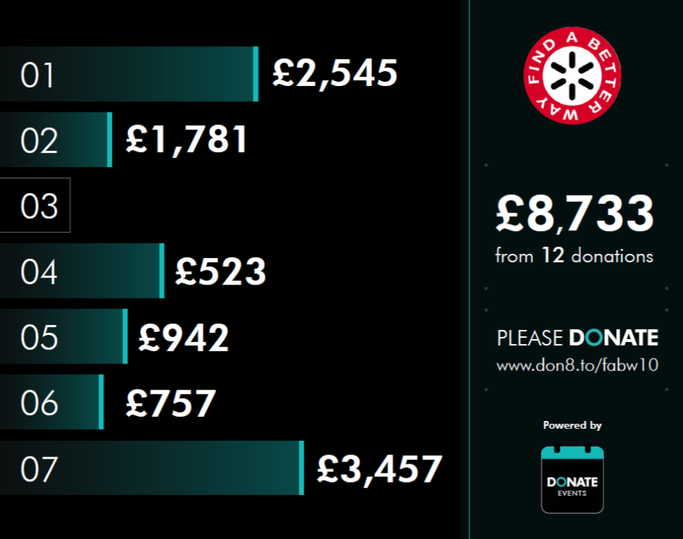
48

Slide 20
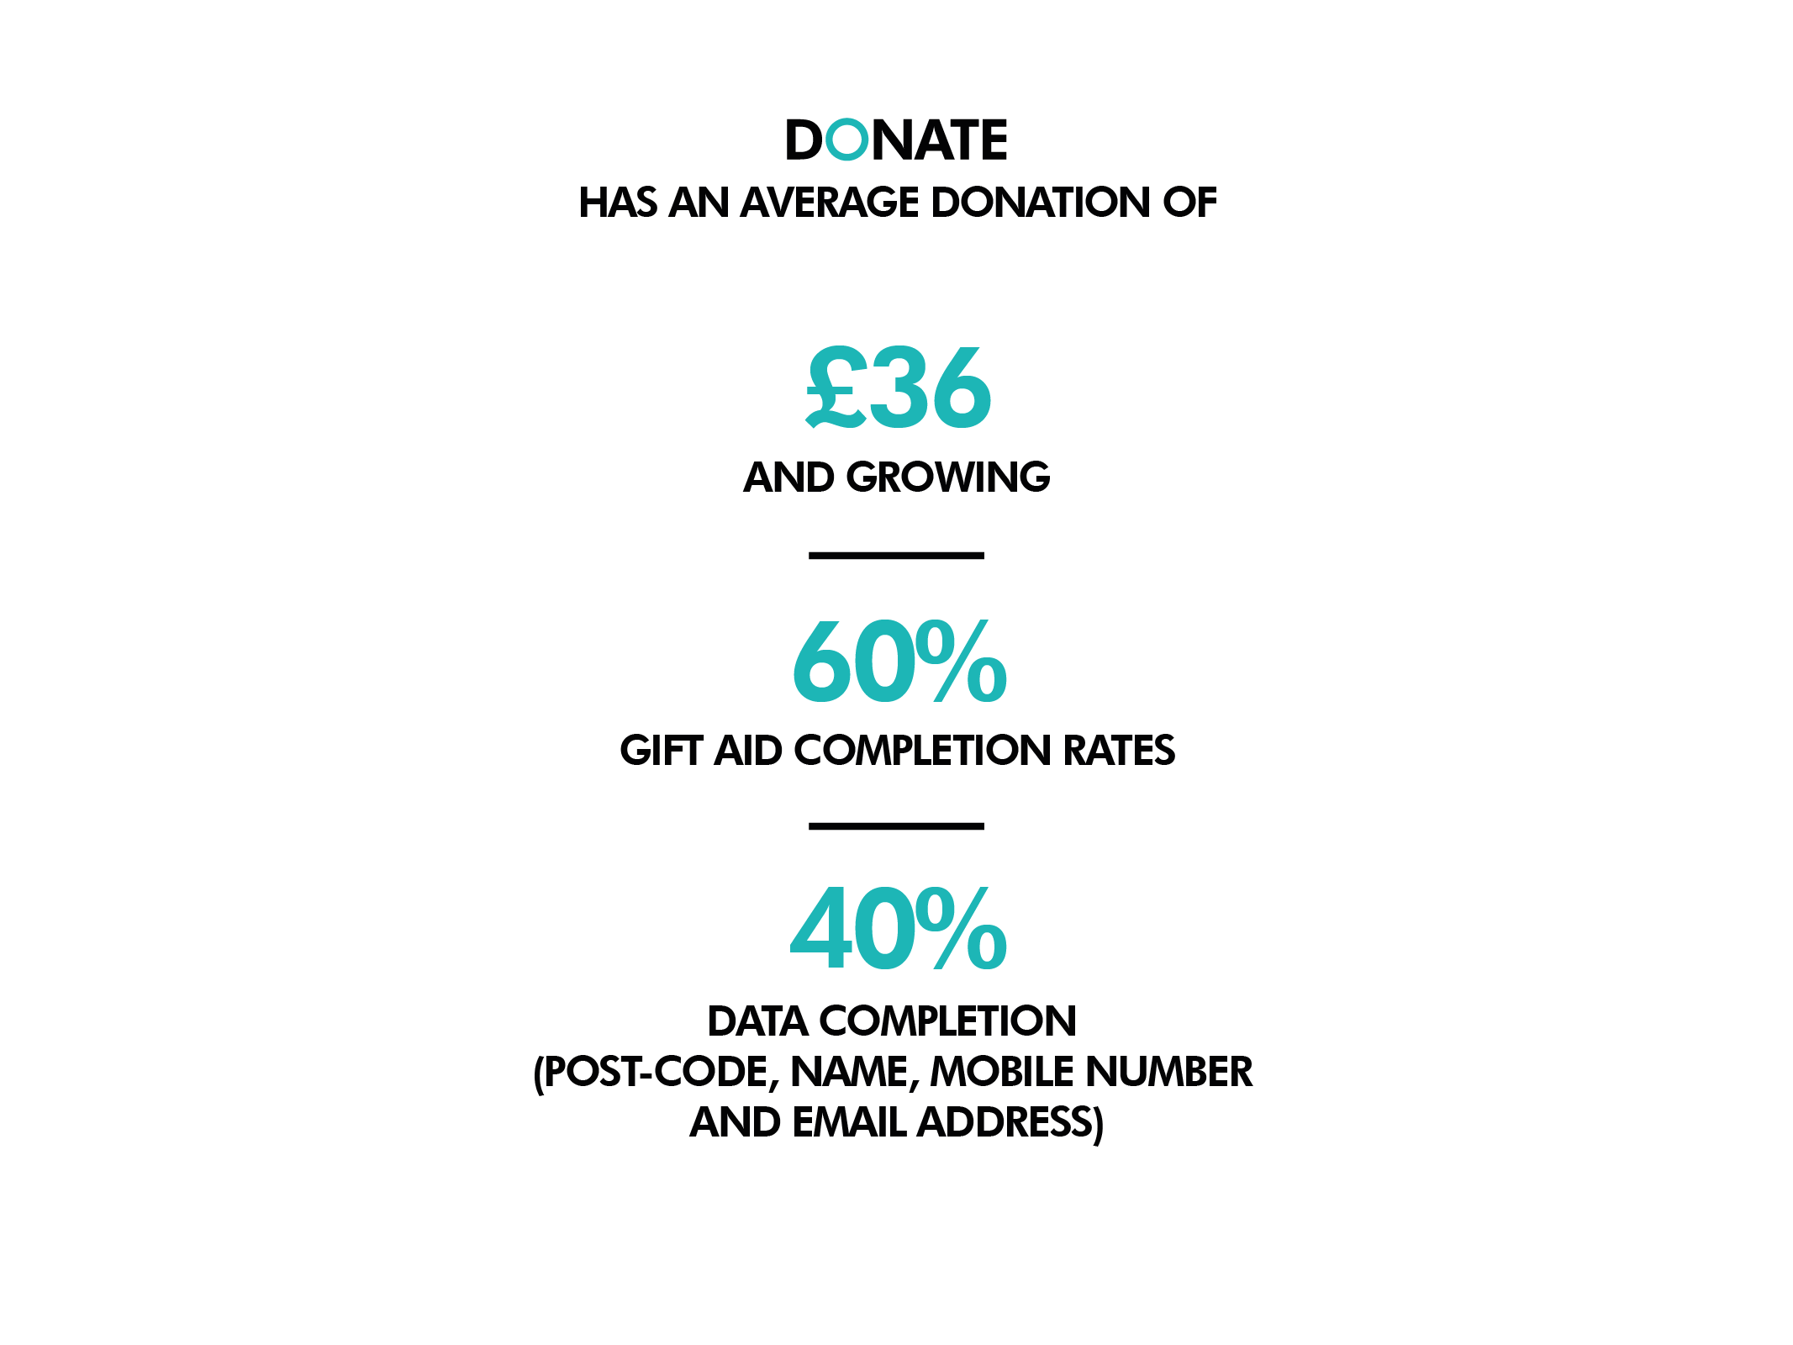
Other channels
avg £15
up to 30%

Slide 21
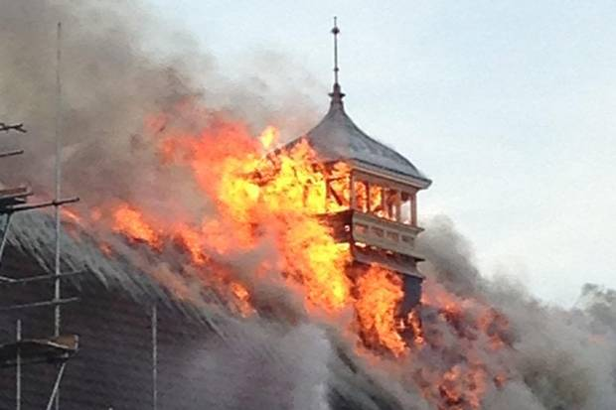
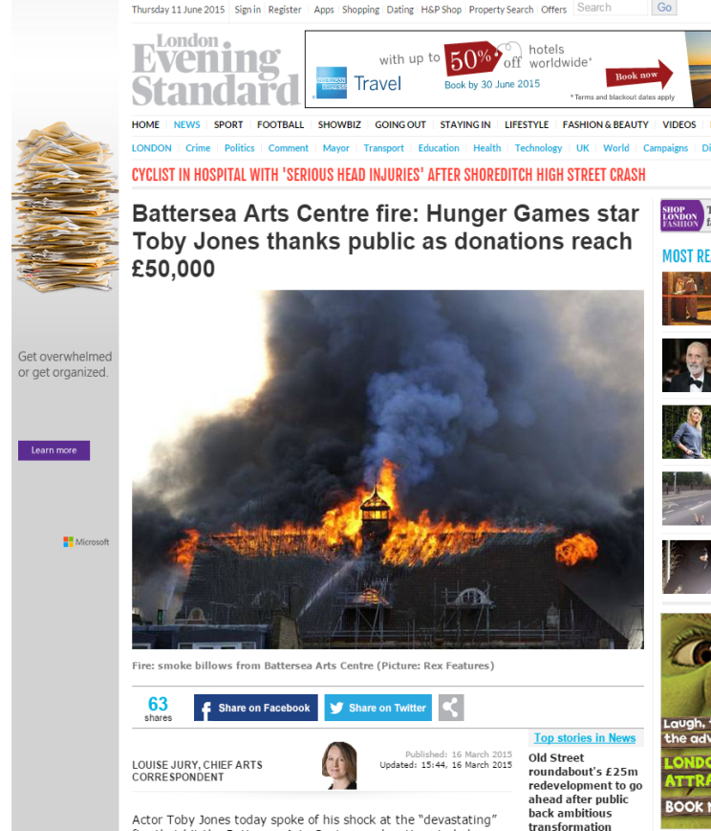

Slide 22

1.
£75,000 FROM 2,500 DONORS IN 4 DAYS
2.
63% OF DONATIONS BY MOBILE / TABLET
3.
60% OF DONATIONS FROM FB AND TWITTER
4.
99% OF DONORS GAVE DATA RIGHTS
5.
83% OF DONORS ADDED GIFT AID
6.
34% OF DONATIONS BY 25-34YR OLDS
7.
AVERAGE DONATION OF £31.81

Slide 23
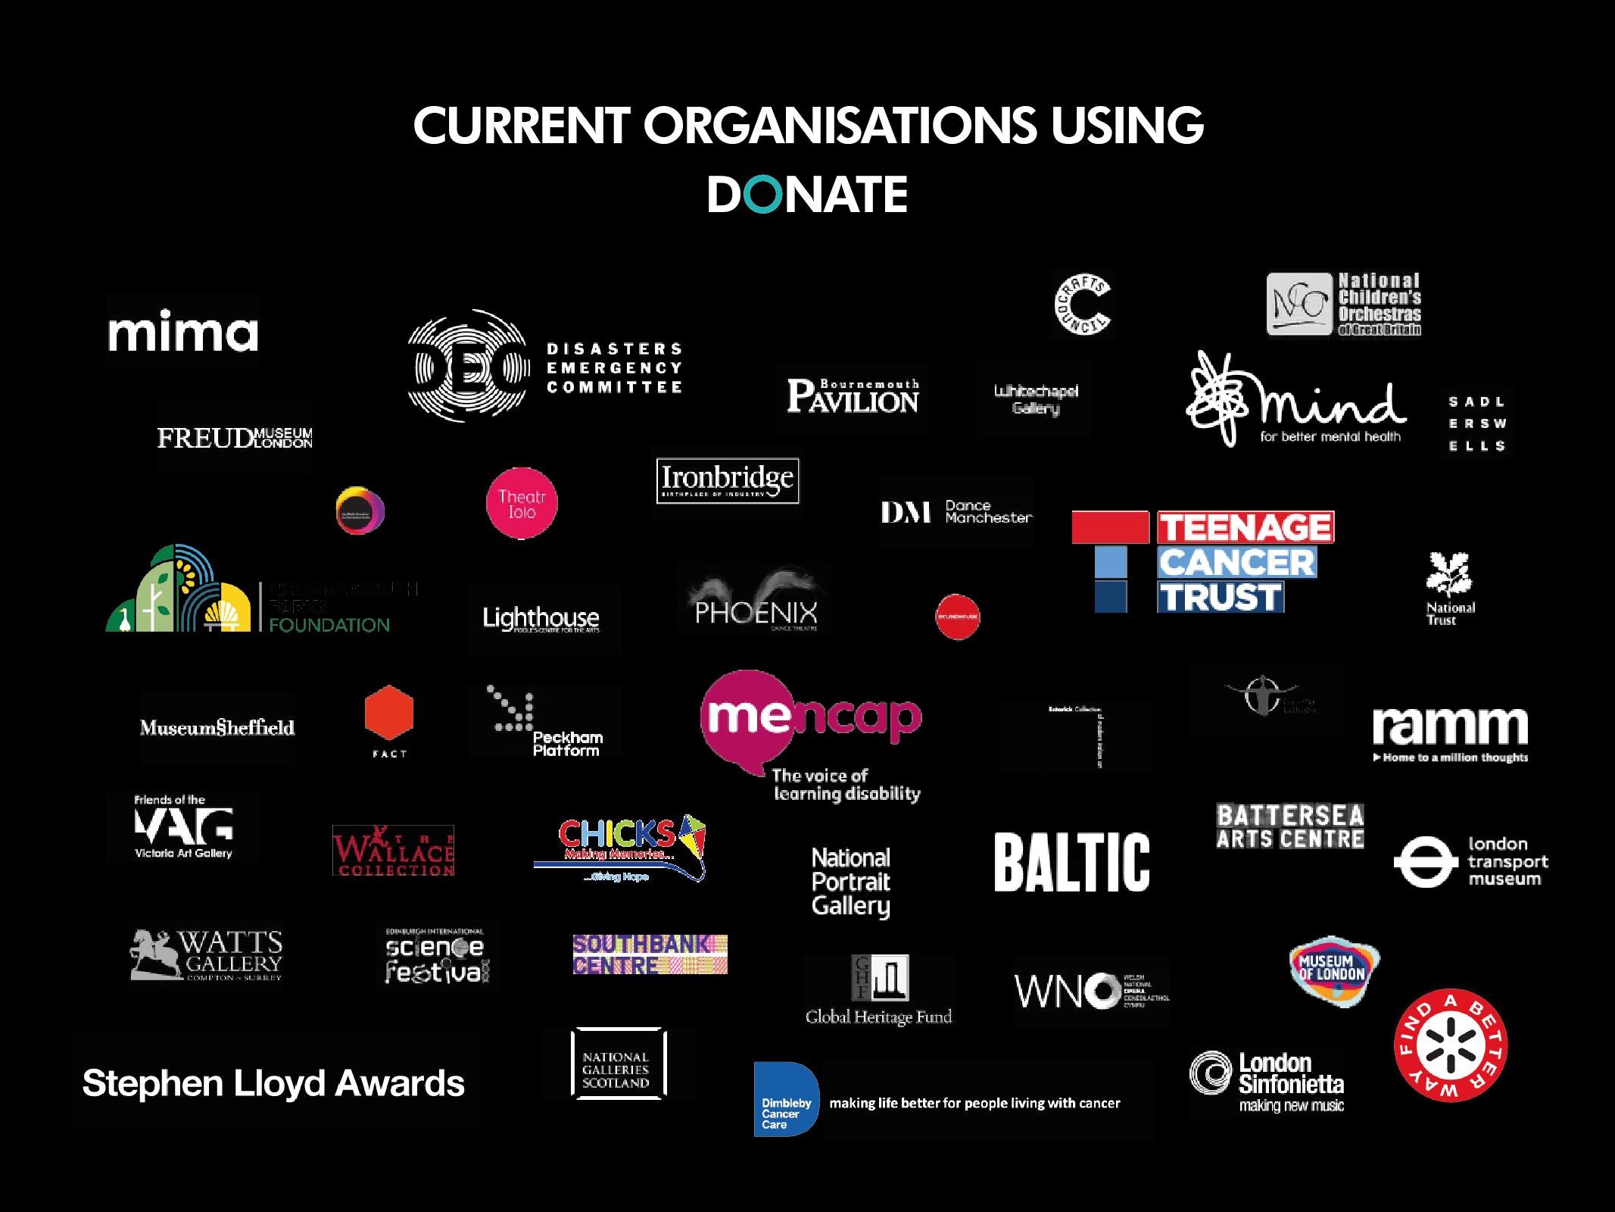



Slide 24
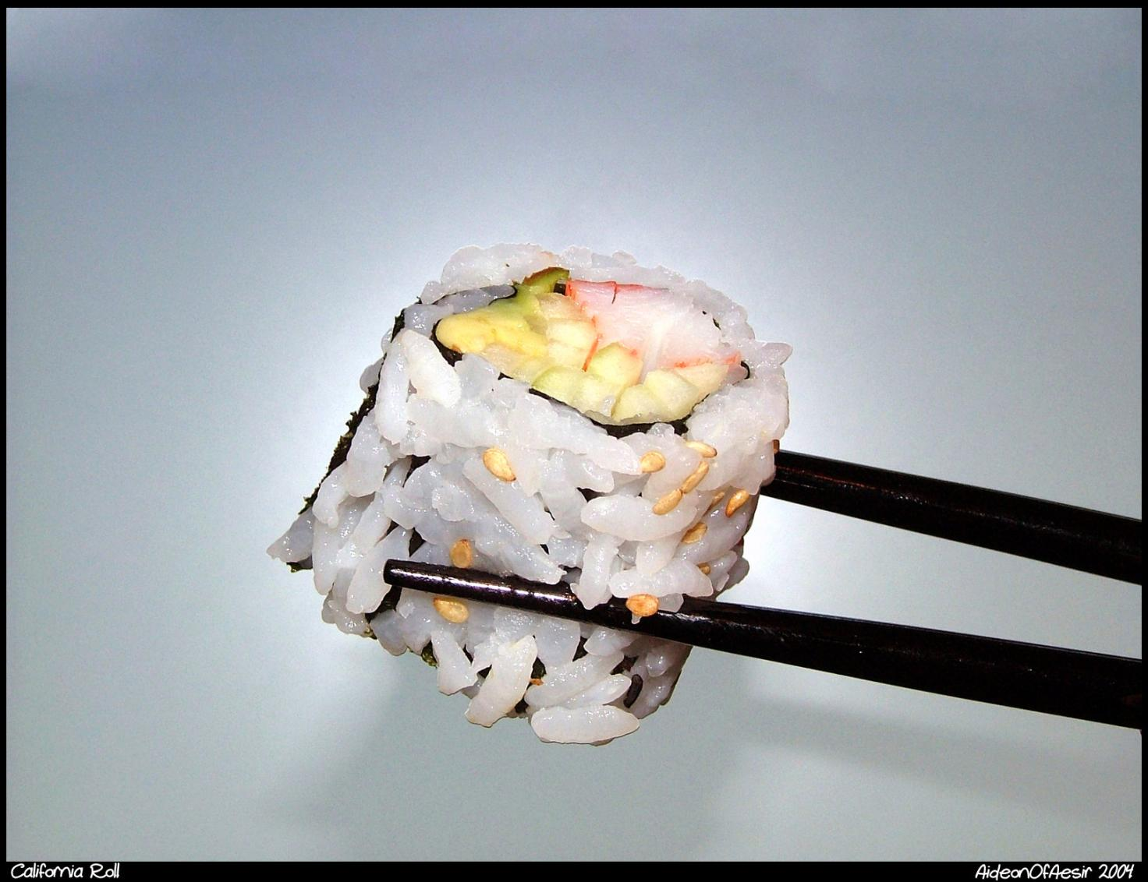
Notes:
As one of the most popular styles of sushi in the US market, the California roll has been influential in sushi's global popularity and in inspiring sushi chefs around the world in creating their non-traditional fusion cuisine.
In the 1960s, Los Angeles, California became the entry point for sushi chefs from Japan seeking to make their fortune in the United States. The Tokyo Kaikan restaurant then featured one of the first sushi bars in Los Angeles. Ichiro Mashita, a sushi chef at the Kaikan, began substituting avocado for toro (fatty tuna), and after further experimentation, the California roll was born.
Mashita realized the oily texture of avocado was a perfect substitute for toro.[Traditionally sushi rolls are wrapped with nori on the outside. But Mashita also eventually made the roll "inside-out", i.e.uramaki, because Americans did not like seeing and chewing the nori on the outside of the roll. After becoming a favorite in Southern California it eventually became popular all across the United States by the 1980s.

Slide 25
william.makower@nationalfundingscheme.org
020 3174 2428
National Funding Scheme
(Registered Charity no. 1149800)

