Slide 1





proud sponsors of
#TransformingLeisure
Notes:
PAUL TO INTRO AND COMMENCE:
Delighted to have been shortlisted

Slide 2
Our Investment in the Industry
Turnover
£100m+
2000
£20m
Investment
Visits in
Support over
clients
4 weeks
250
100,000
members
100%
20% ⬆
YoY Sales
On Budget
Generate
60,000
New Sales
5k→26k
Increase in Users
300
More kids
swimming
Trained
3000
individuals
100+
100%
On Time
£8k→£400k
Projects Delivered
Growth
Notes:
Essential that we protect leisure as a non stat service, if we don’t there is a real risk loss of services
Reputation of delivering on time and on budget. Our Unique model protects clients
Huge success in delivering training to upskill the sector and ensure professional and successful industry

Slide 3

Ravenscraig Activity Centre

Slide 4

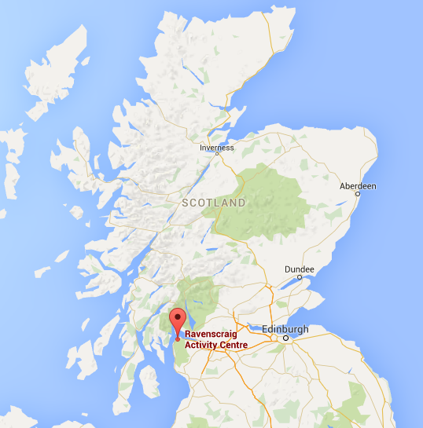
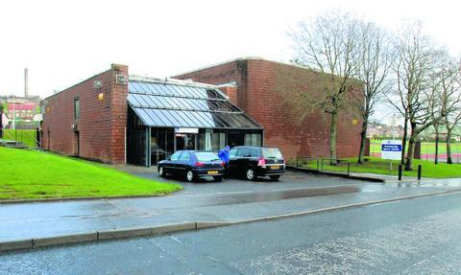
Pre-development

Slide 5
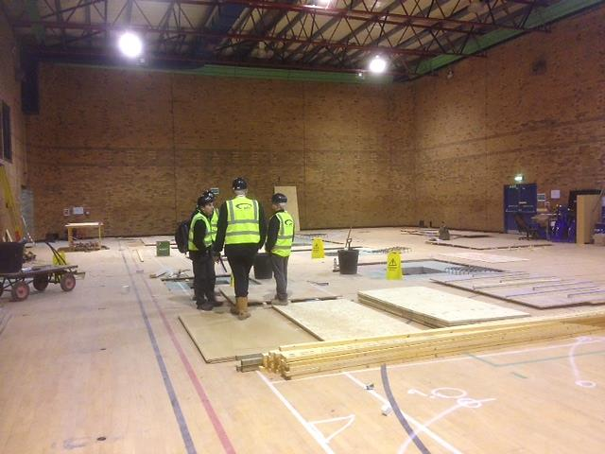
Old 4 Court Sports Hall

Slide 6
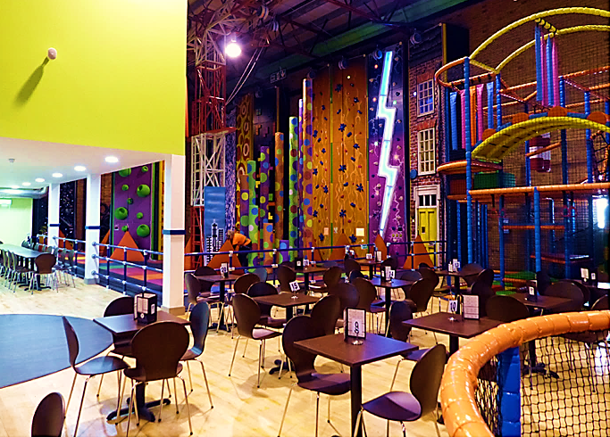
XHeight / Soft Play / Costa Café

Slide 7
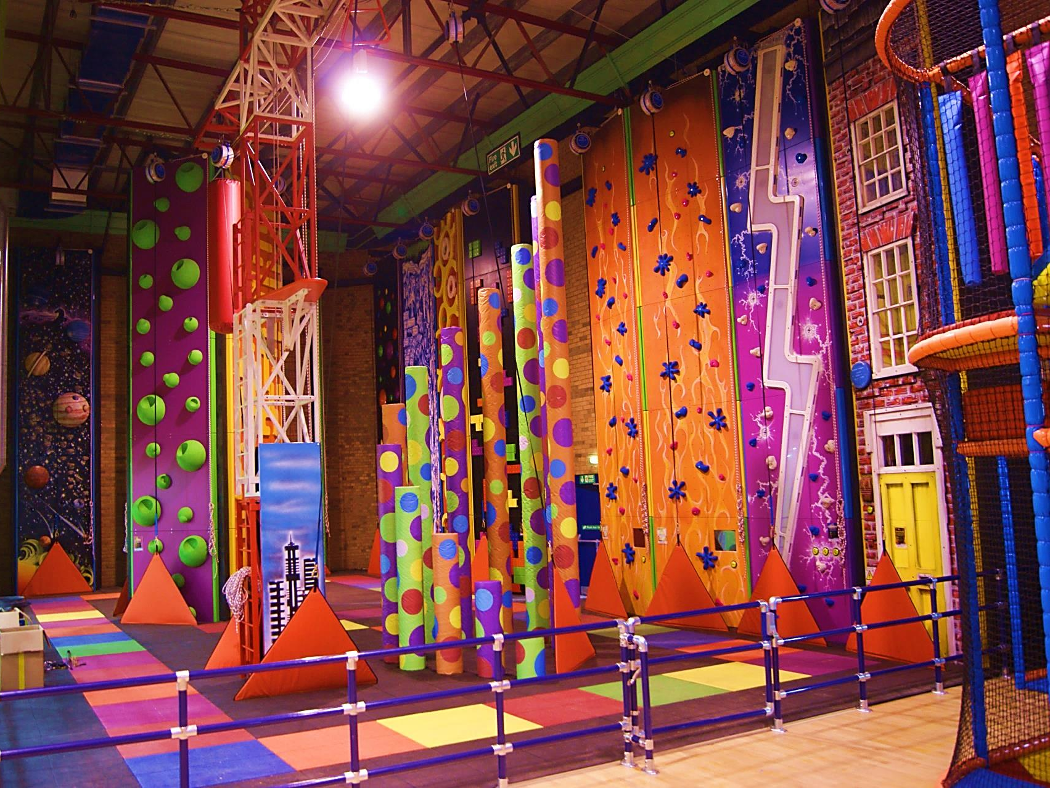
XHeight Adventure Climbing

Slide 8
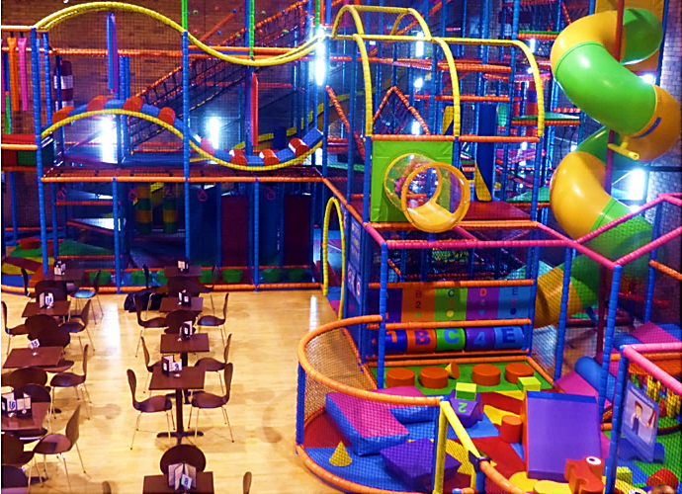
Soft Play

Slide 9
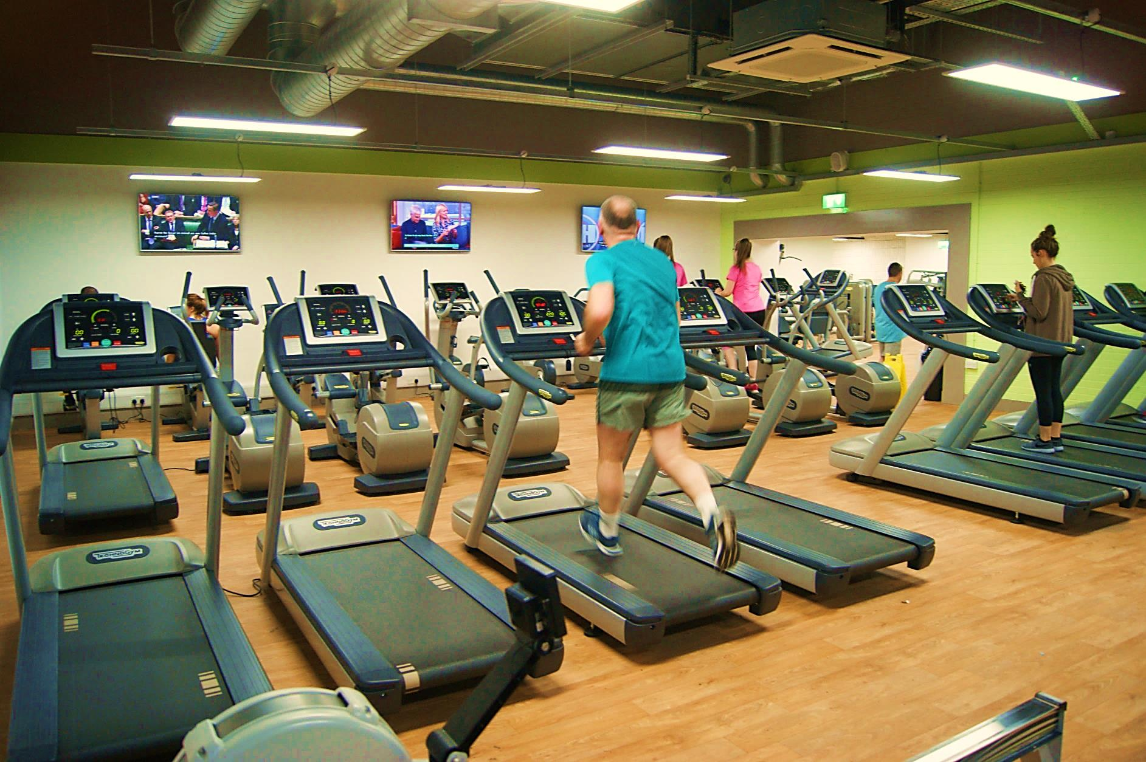
New Gym : mezz over Sports Hall

Slide 10
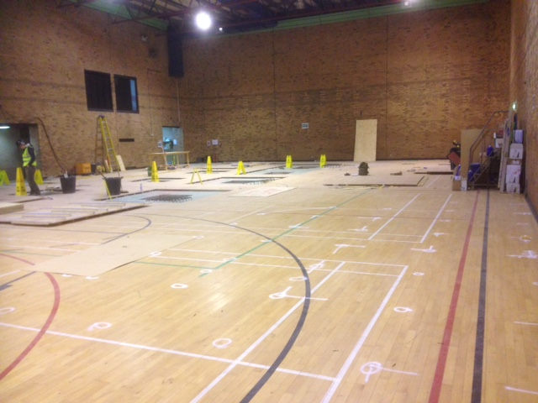
Old 4 Court Sports Hall

Slide 11
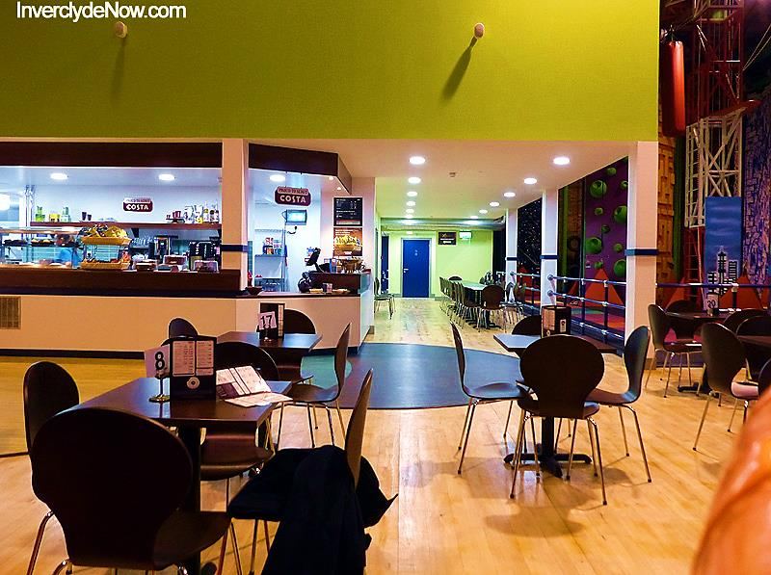
Costa Café / New Gym above

Slide 12
Summit Indoor Adventure
Selby (Inspiring Healthy Lifestyles)
Notes:
JAMES FROM HERE:
We address the plethora of aging facilities and look to transform them to make them relevant. Over the last 10 years, there has been a tenfold increase in hospital admissions due to obesity related health issues.
We believe that facilities have to be attractive, inviting and appropriate to customer demands

Slide 13
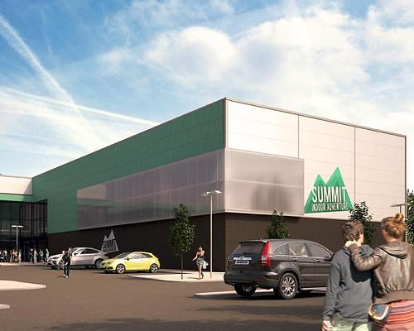

Slide 14
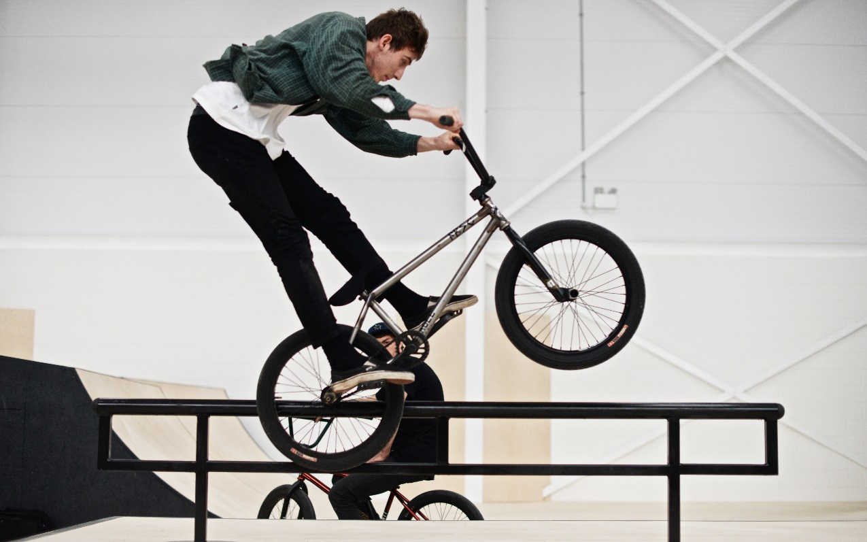
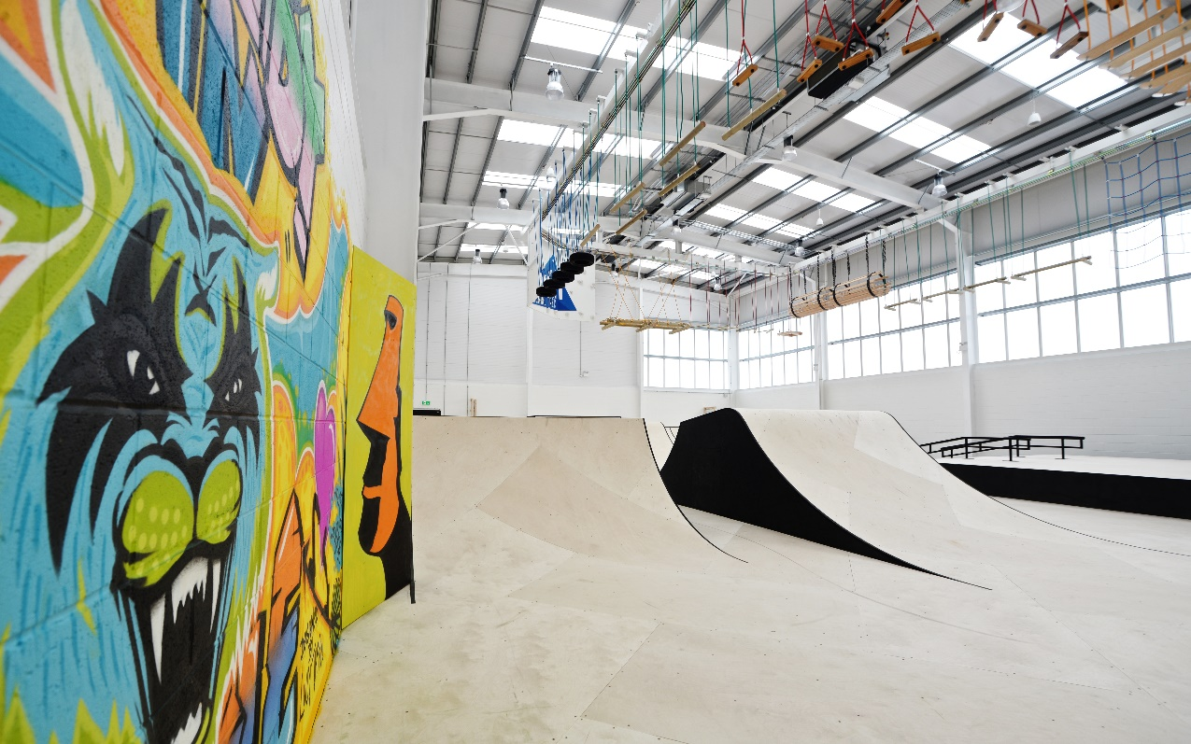
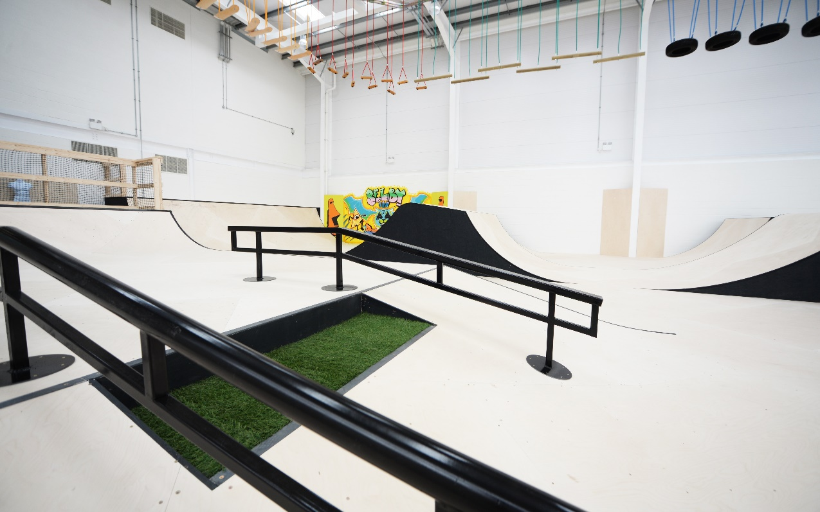
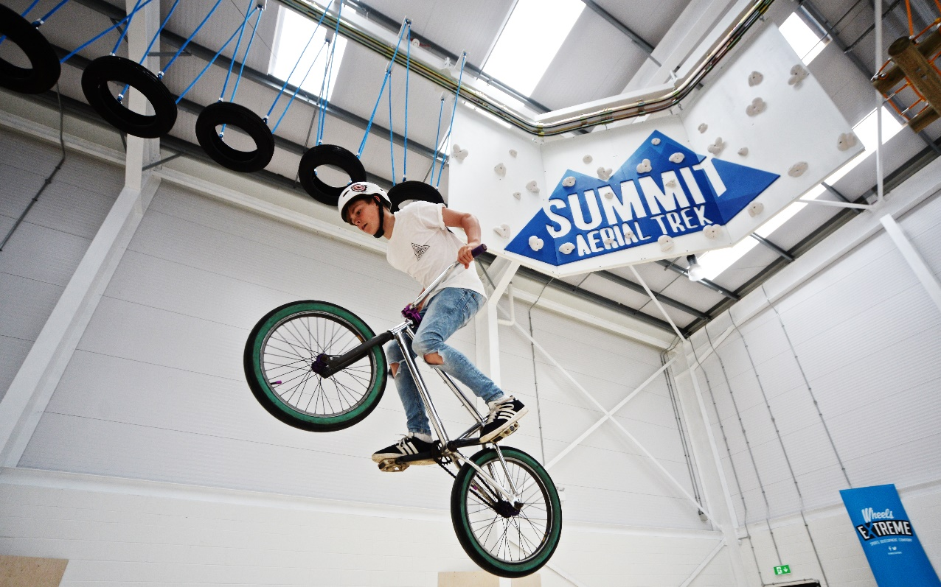

Slide 15
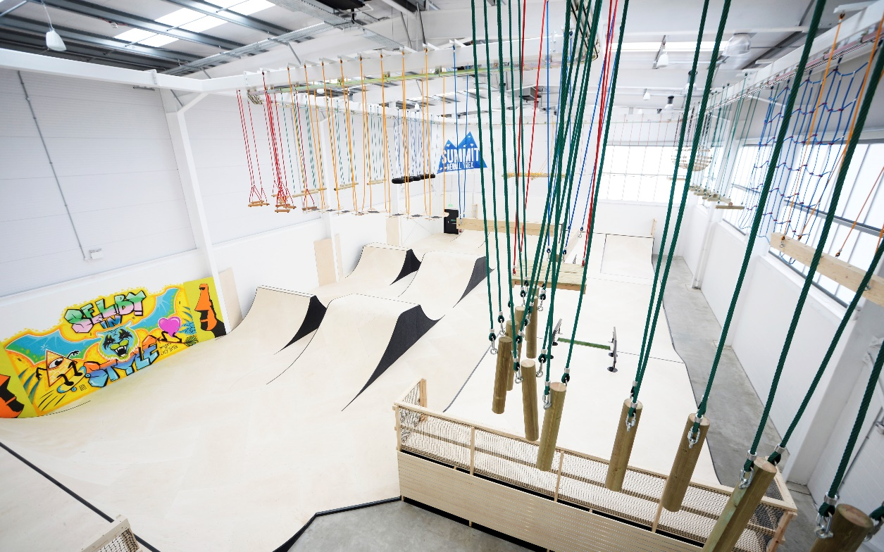
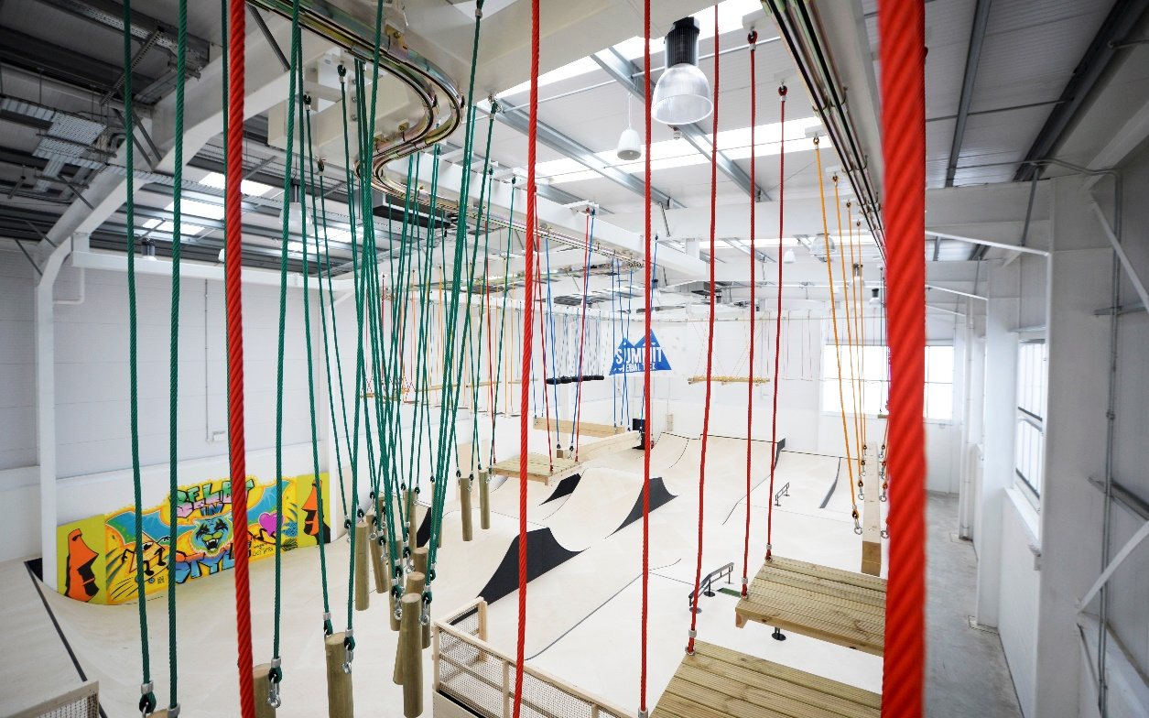
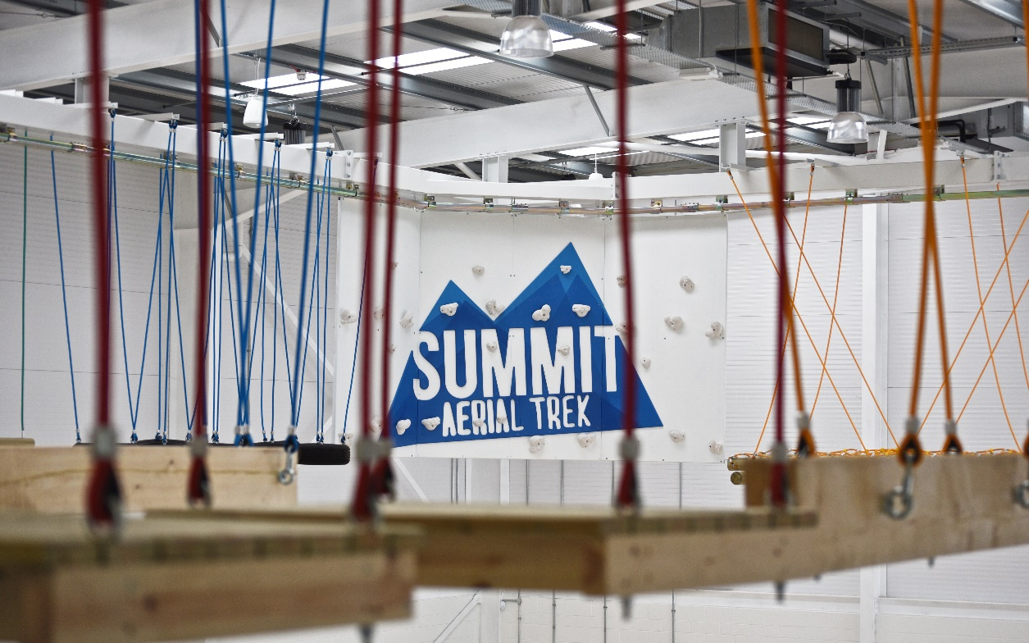
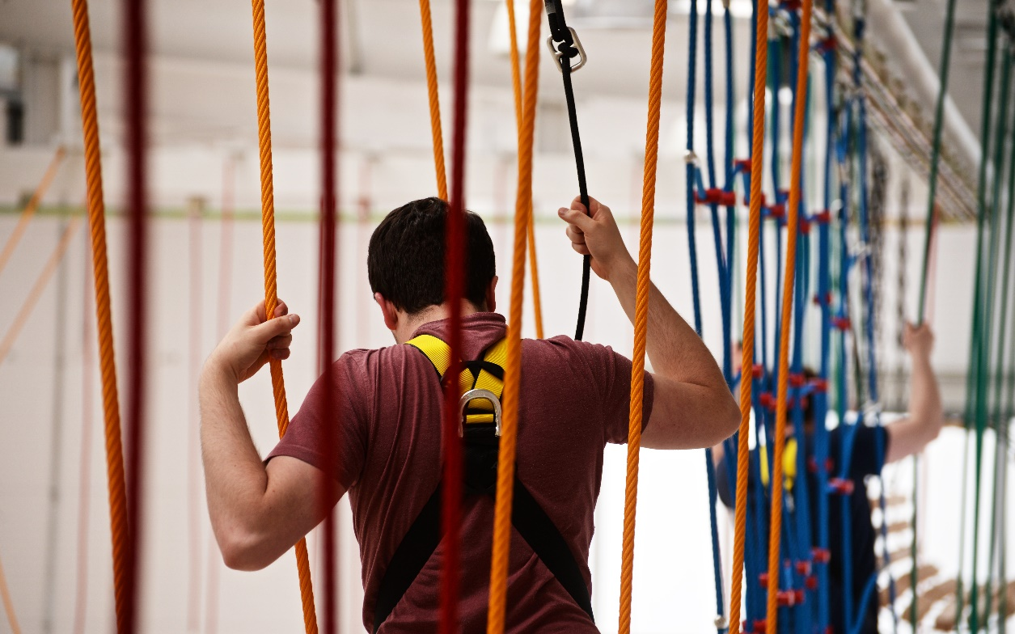

Slide 16
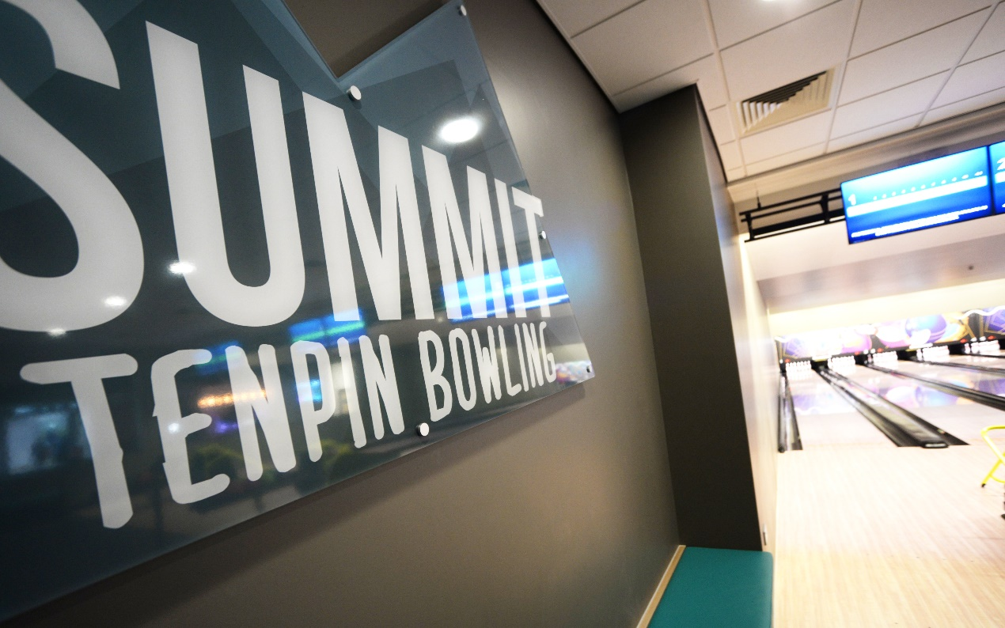
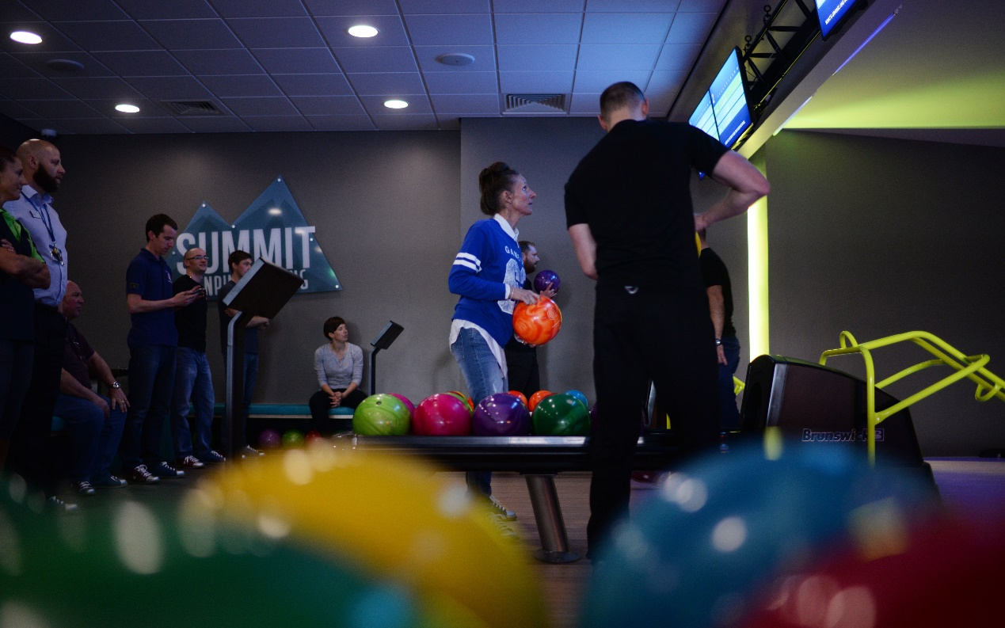
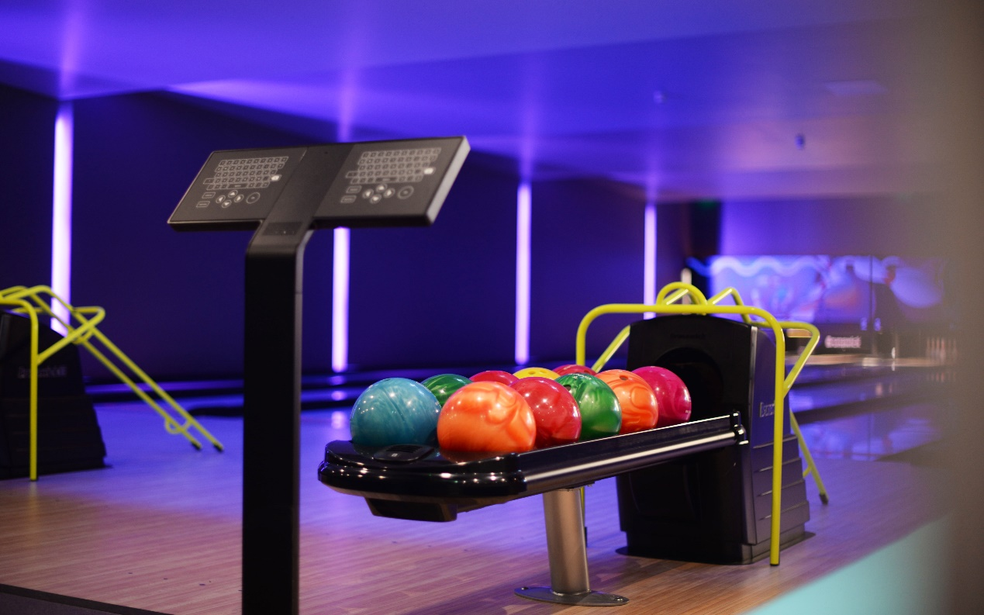
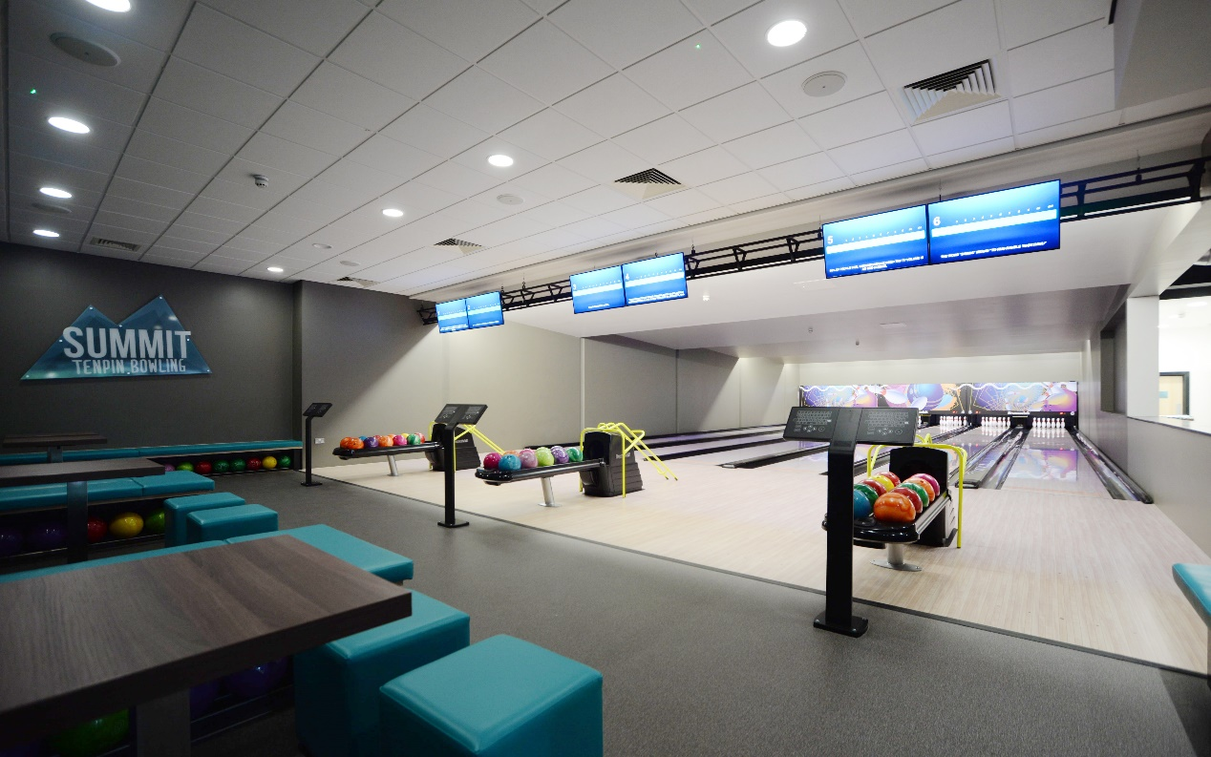

Slide 17

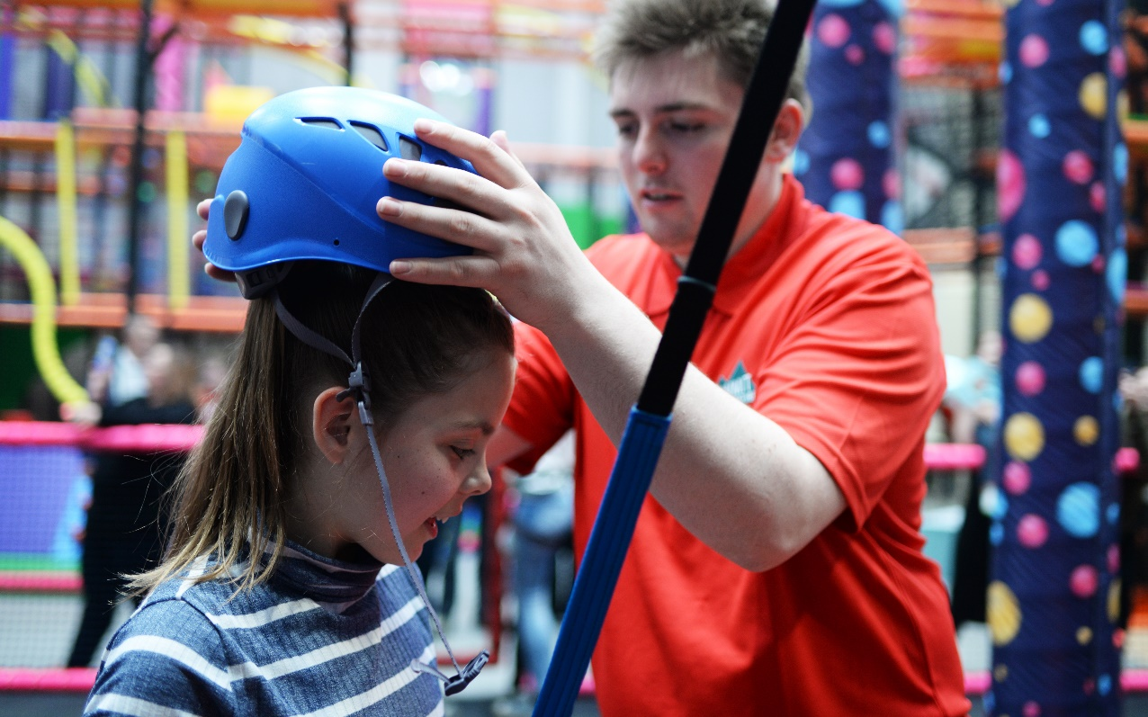
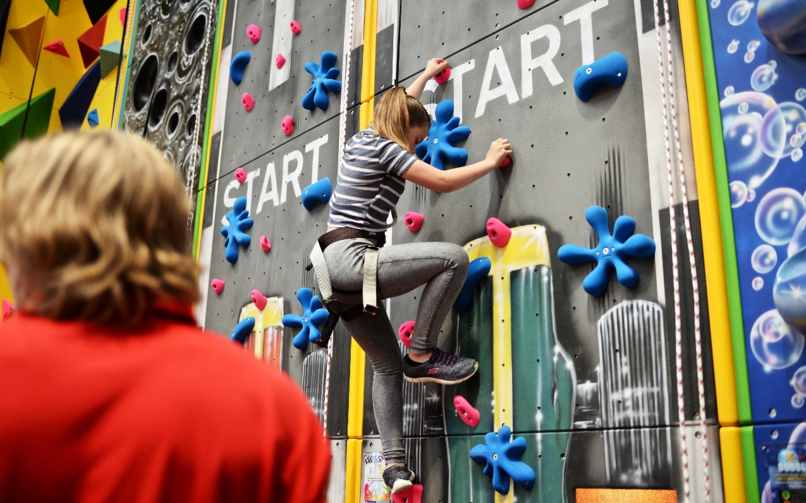
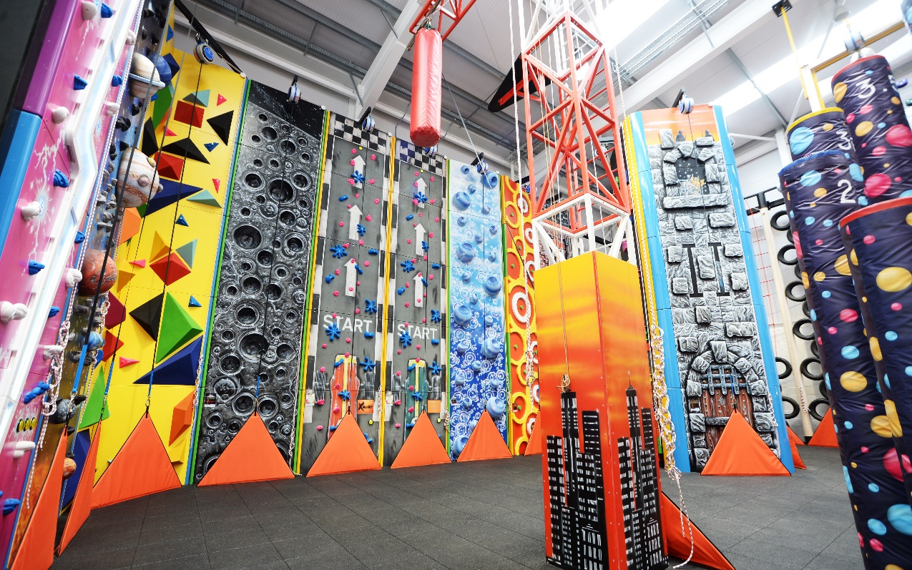

Slide 18
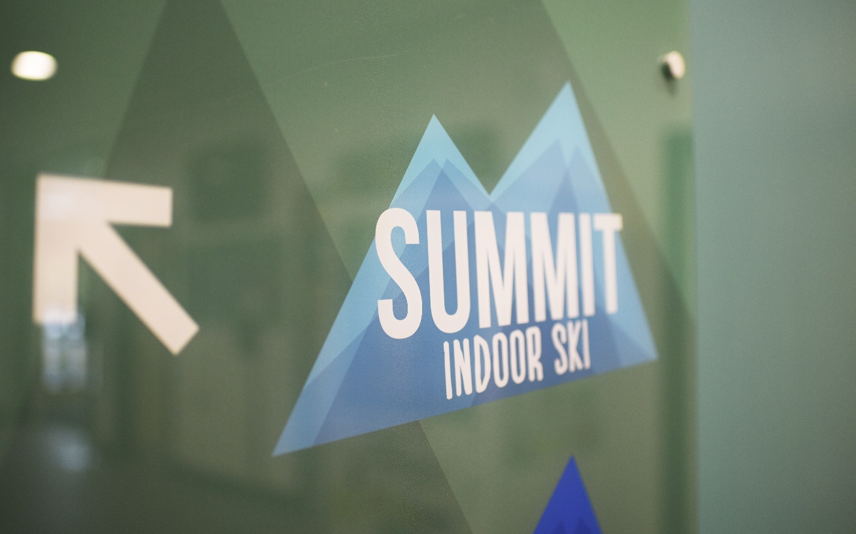
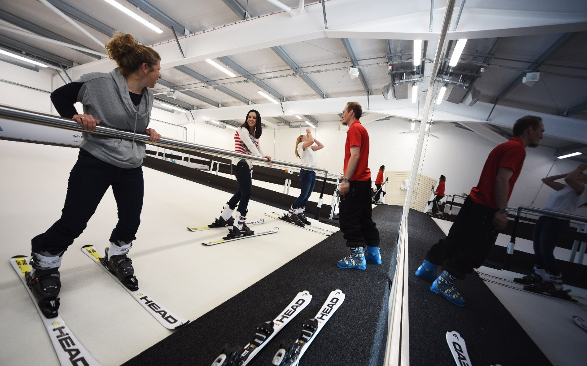
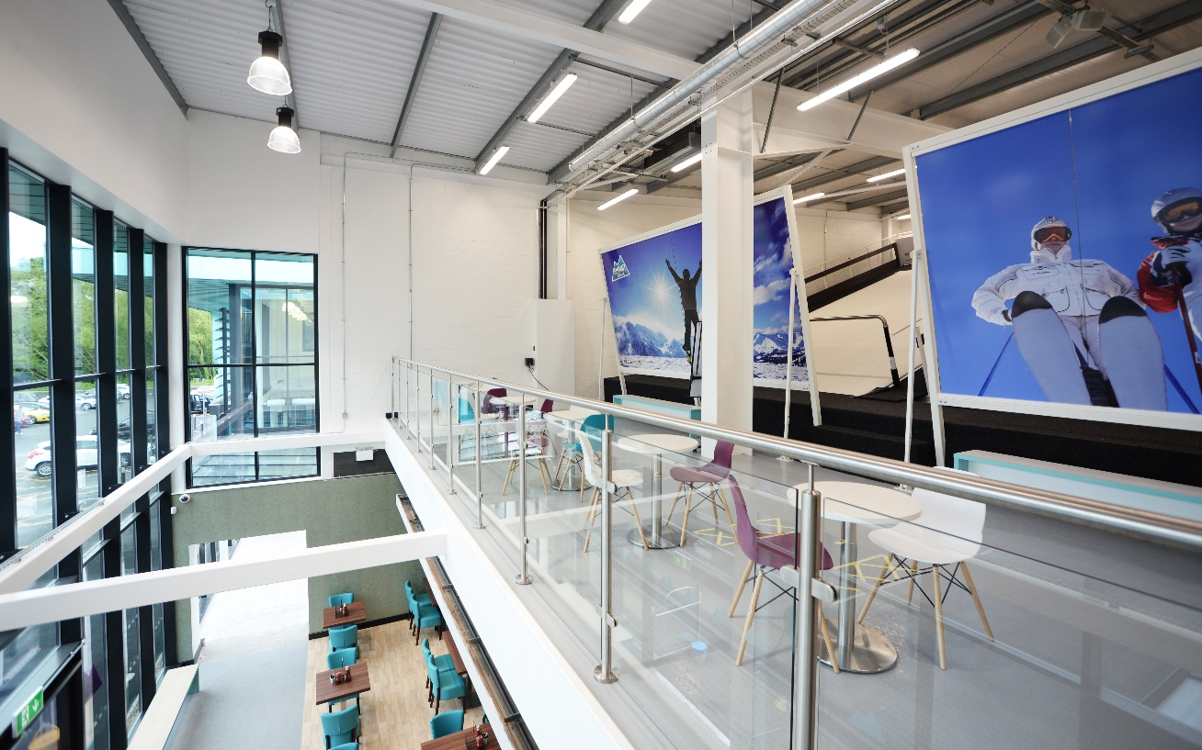
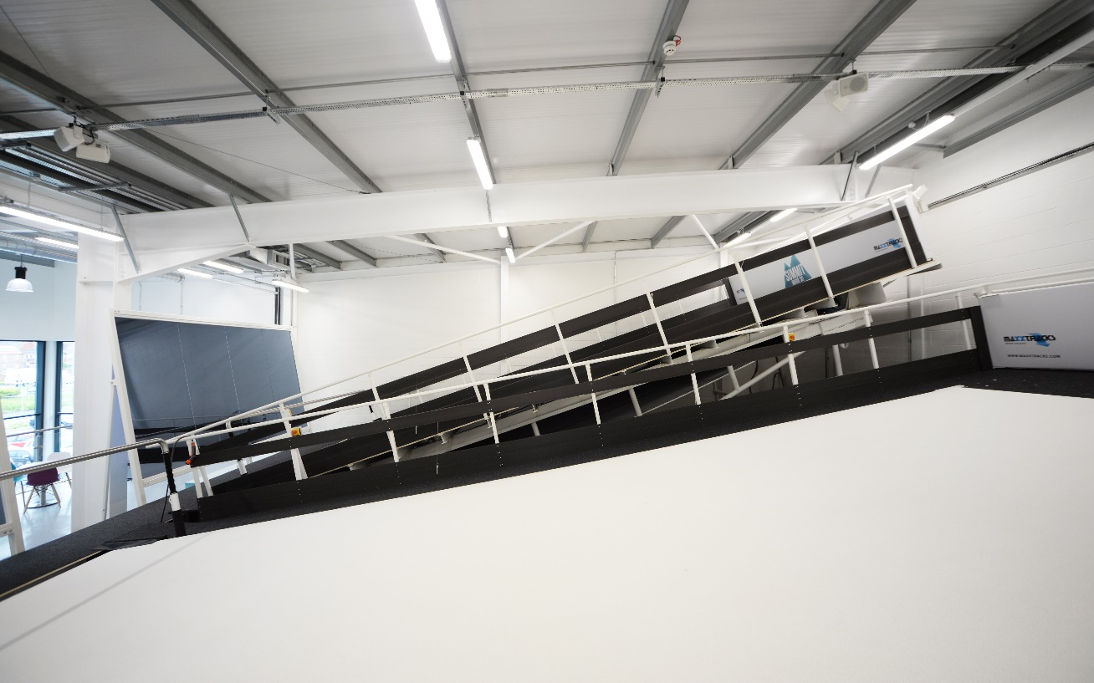

Slide 19
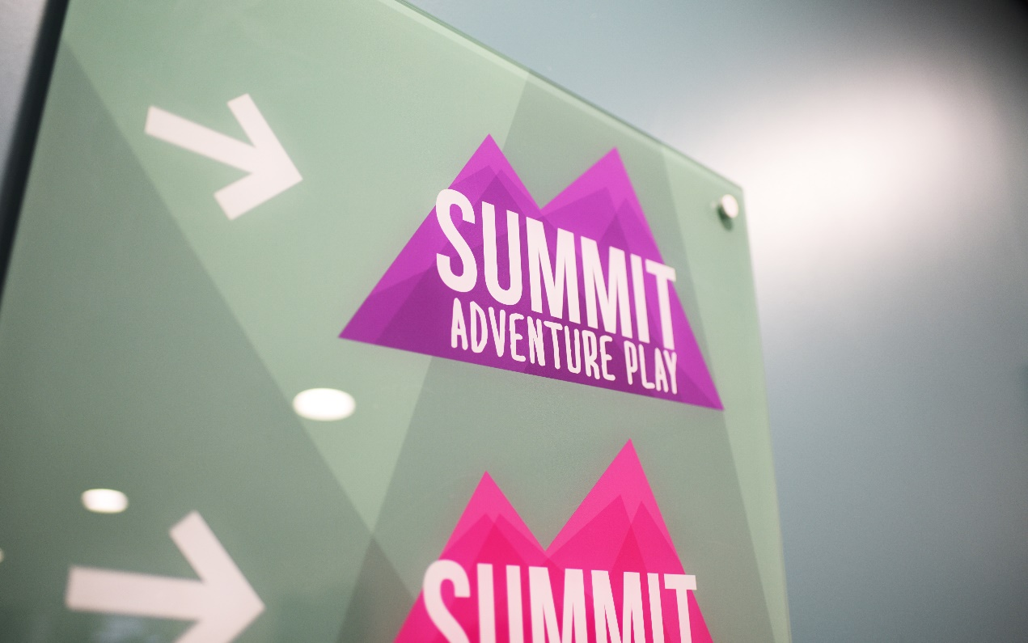
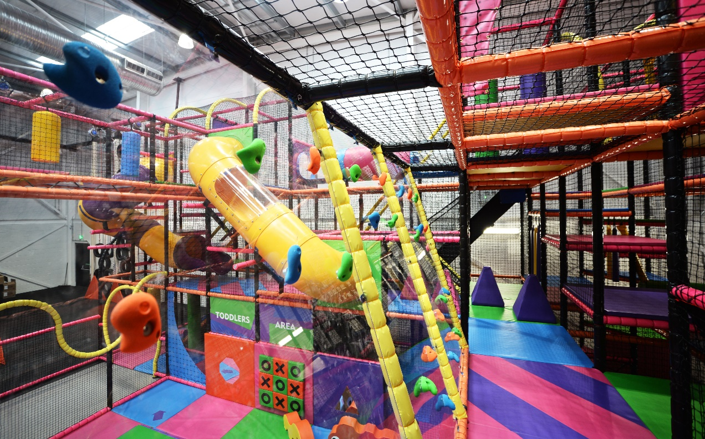
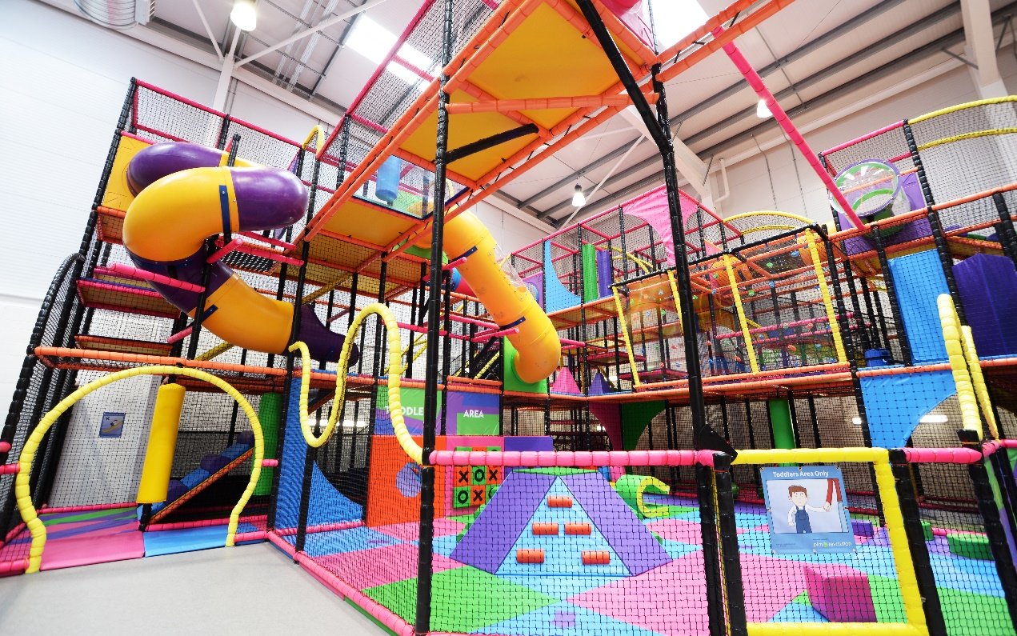
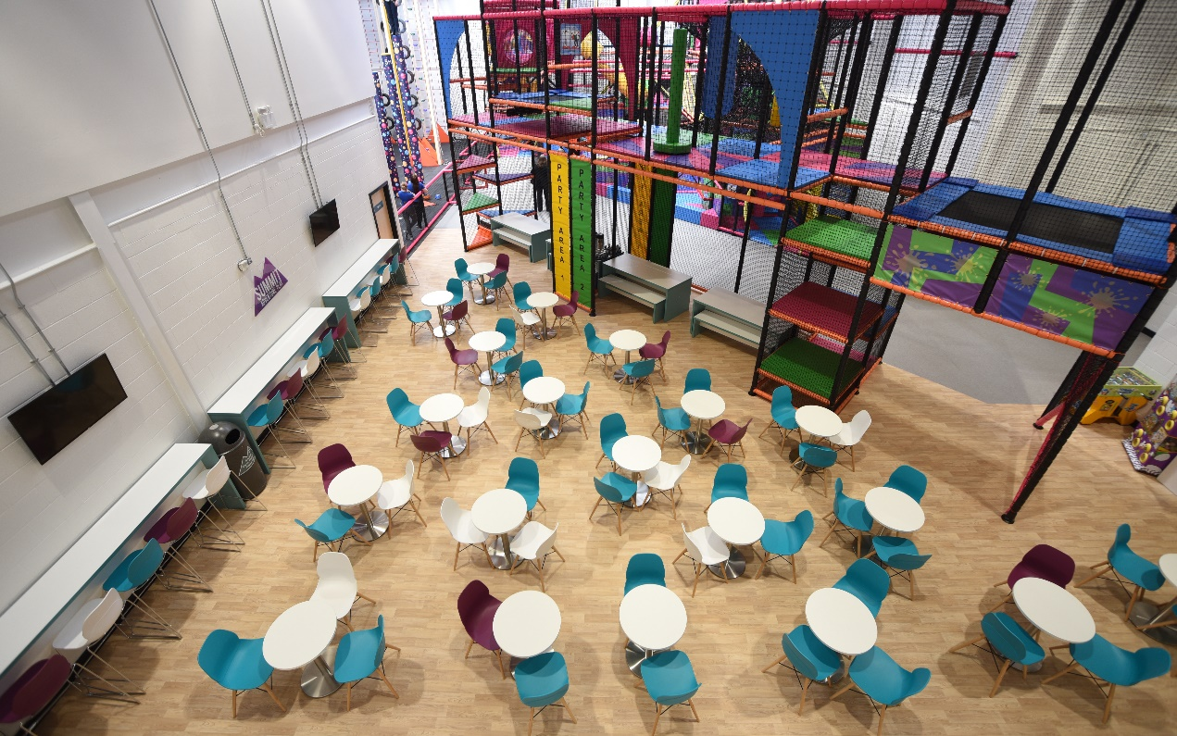

Slide 20

#TransformingLeisure

