Slide 1

Mark Allman: Vice Chair

Slide 2
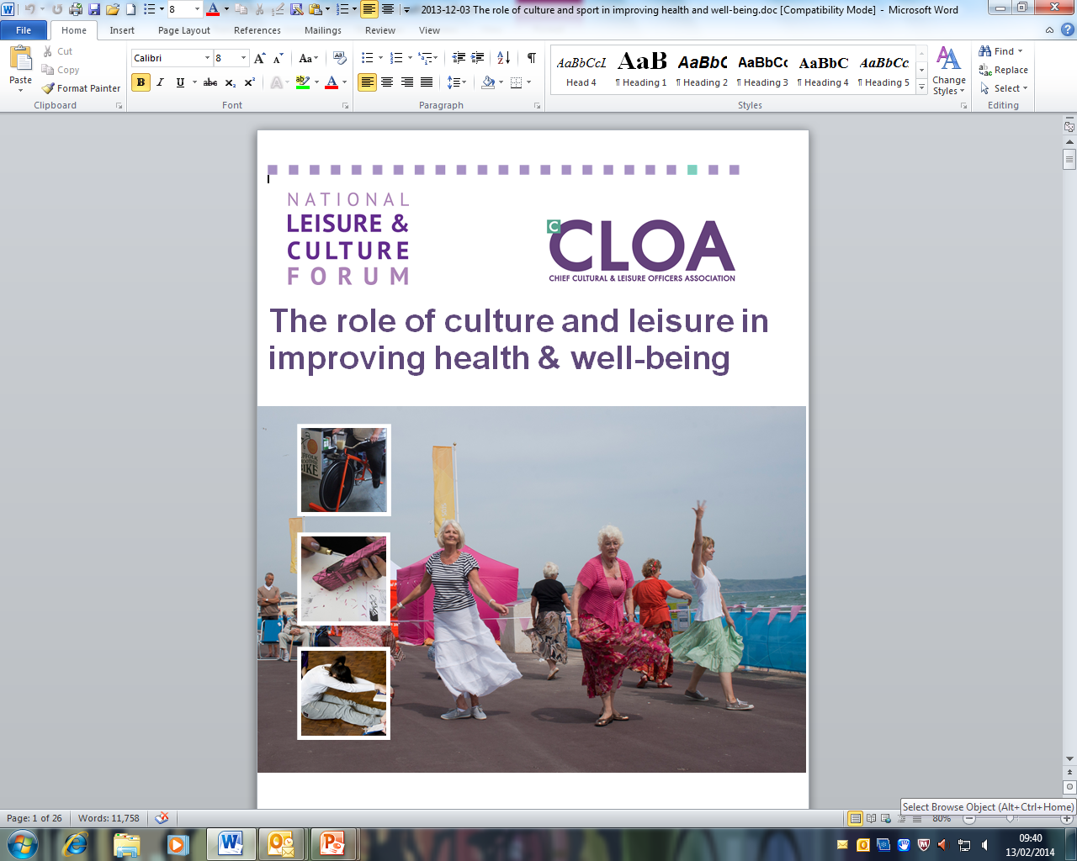
Building on existing guides produced by cCLOA
-Adult Social care
-Crime and anti social behaviour
Developed through wide stakeholder engagement across sport and cultural sectors

Slide 3
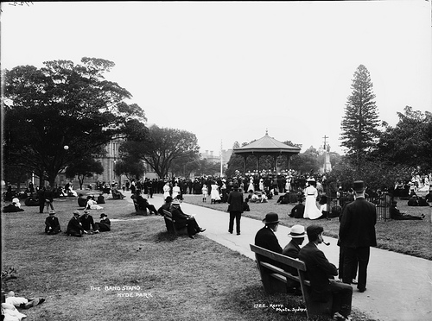
Post Industrial revolution
Allotments
Libraries
Museums
Parks
Public Baths
Adult Education
National Parks

Slide 4
Overview
Why it is important to engage
Understanding the policy context
How Culture and Leisure can engage locally
Demonstrating the contribution culture and leisure can make- the evidence base- case studies
Conclusions and taking action

Slide 5
Working smarter locally
Making links with Health and Well-being Boards
Working with CCGs
Working with Leisure Operators
Understand how funding is allocated
Lifestyle and behaviour change approaches
Skilled and talented workforces
Improve positioning through better data and championing

Slide 6

Engaging with Health and Well-being: Leeds City Council
Political support for culture and Sport
Budget cuts presenting opportunities as well as major challenges
Relationship building
Contributions include;
Service integration/Adult social care
Older people
Reminiscence
Cardiac rehab
School sport and healthy schools
Public health spend uplift

Slide 7
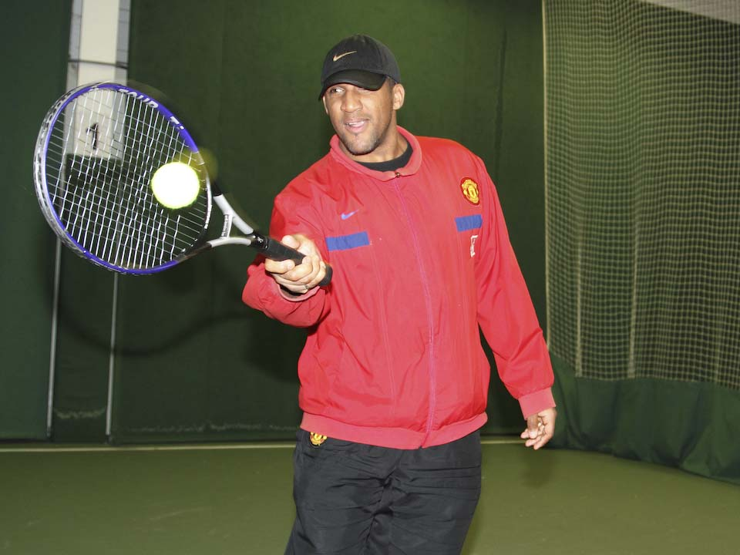

Culture and Sport contribution to Health and Well-being
Day Care Integration

Slide 8
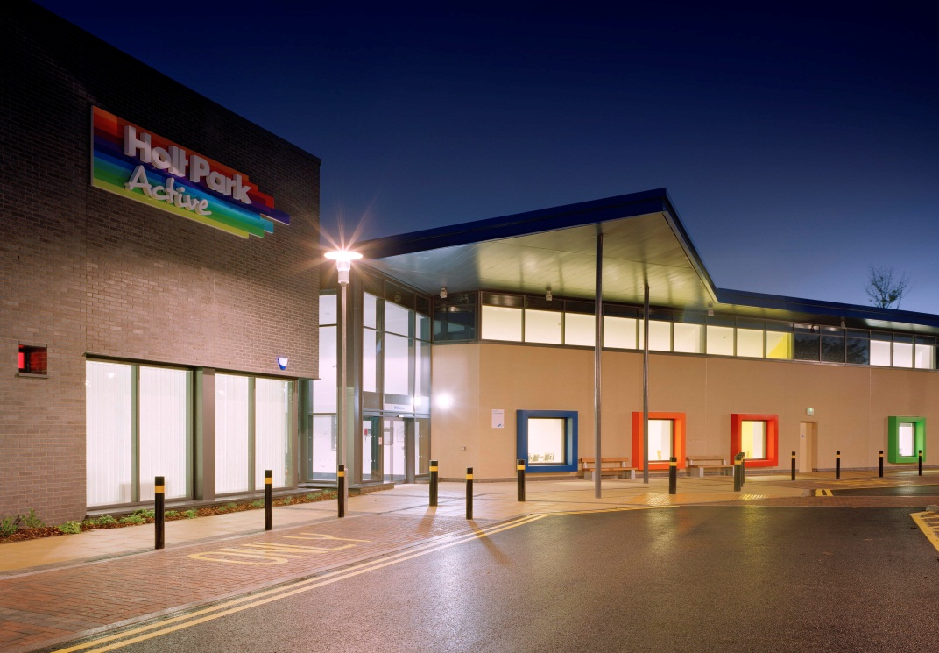
Holt Park Active
£28m DoH PFI project
A partnership
Fully integrated services for the provision of combined social care, wellbeing
and leisure services
Day care rooms
Pool/Gym/Studio
Hydro pool

Slide 9
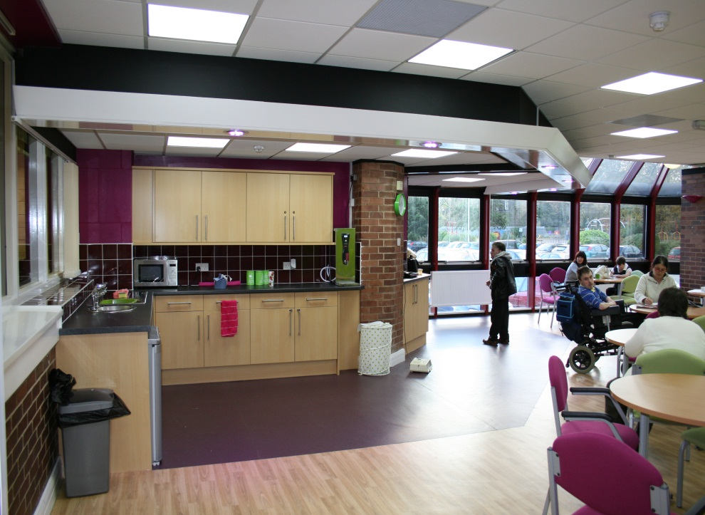
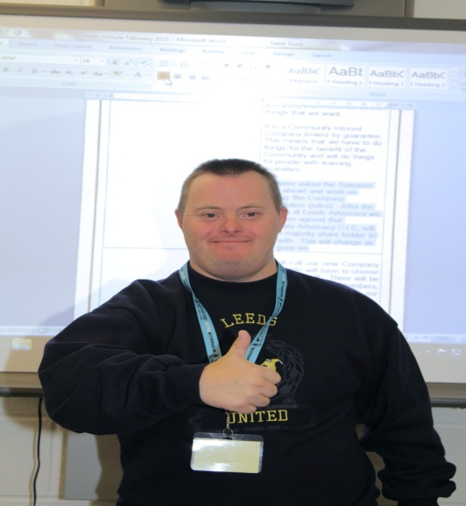
Other day care centres integrated into Leisure centres city wide
More Choice
Better Environments
Co-located facilities
More integrated activities
Improved co-working
Positive feedback from customers, staff and carers
Staff sickness rates down

Slide 10

Leeds Let’s Get Active
Reducing Health Inequalities in Leeds
Breaking Down Barriers to Physical Activity

Slide 11
Notes:
There are significant health and life expectancy inequalities which exist between the different areas of Leeds. This pilot project has the aim of reducing these inequalities by increasing participation in physical activity, targeted at those who are presently inactive and doing less than 1 x 30 minutes of physical activity per week, and whilst providing a universal free offer, the offer is greatest in those areas with the highest need. Sport England have joint funded the pilot with the City Council, as they estimate the cost of physical inactivity to the city at £10.4m every year.

Slide 12
Sport England Health Pilot
“Get healthy get into Sport grant programme”.
The “Leeds Let’s Get Active” LLGA project is one of 14 national pilots
Sport England award of £500k was matched by £500k from Public Health plus Health funding of £60k, continued from the previous Bodyline Access Scheme project, making total funding for this pilot project £1,060k.

Slide 13
Scheme Outline
Free, universal access to all City Council leisure centres (which includes gym, swim and exercise class provision)
Free physical activity opportunities in local parks and community settings.
A continuation of the Bodyline access scheme ( Exercise on referral)

Slide 14
What are we trying to achieve?
To increase the activity levels and participation in sport of those inactive in Leeds especially in areas of highest health inequalities
To establish better links with health partners
Create greater understanding (through evidence) of the role that sport and active lifestyles can play in delivering health outcomes,( protect and grow services).
Use of digital platforms to market to and sign up participants
Targets include
270,000 new visits
16,500 new card members
1350 previously inactive new participants completing 1x30 minutes physical activity per week

Slide 15
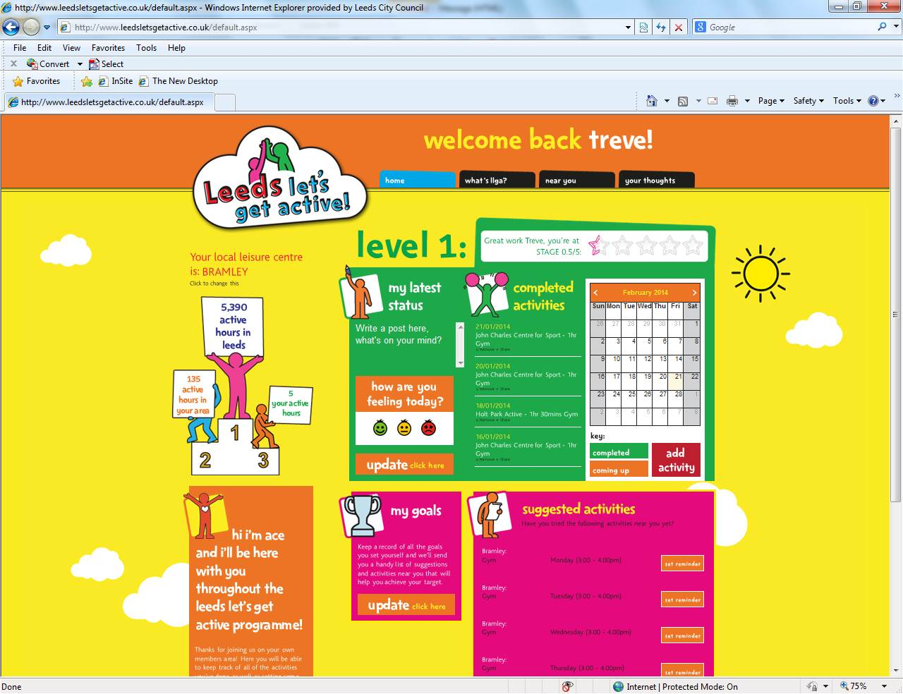

Slide 16
Notes:
Current Offer – 17 sites
All sessions have been carefully chosen as they have the capacity to incorporate new users with support from qualified staff, however, the scheme is continuously being developed as so times may change throughout the duration of the scheme.
We have worked with each site to find the most suitable times that we can offer – each centre has identified the times where they have capacity for this.
Community Offer - The community element will fund a total of 102 free community programmes across the 18 months of the pilot scheme. This equates to:
9 programmes running consecutively between October 2013 - December 2013 and January 2014 - March 2014
rising to a total of 18 consecutive programmes in April 2014 – June 2014 and July 2014 - September 2014 and;
then to a maximum of 24 consecutive programmes in Oct 2014 – December 2014 and January 2015 - March 2015.

Slide 17
Since Launching on 30th September….
Over 16,000 LLGA members signed up (microsite and automatic communication)
27,000 visits to LLGA sessions
745 members inactive at baseline had attended at least one LLGA session.
A further 177 inactive LLGA members had attended LLGA sessions at least once a week for at least four weeks.
Notes:
Figures are as of 6.2.14

Slide 18
“I just wanted to feedback a really positive story regarding the gym cards. We have a client who has been on an ATR and in and out of alcohol treatment for many years. He feels that the Gym card has been the single most helpful thing to help him stop drinking and stay stopped in all that time.
He has a history of mental health problems and feels that he is really aware of how exercise can improve his mental health now and has found it better than any mental health treatment. Since getting a gym card he has been going daily and has benefited and now intends to keep accessing the gym through Leeds Lets Get Active”
Service Manager
ADS Leeds

Slide 19
Learning points
Understand the landscape
Develop strong partnerships
Learn a new language ( and teach yours)
Win hearts and minds, but you still need evidence and more evidence
Public health now accountable politically- service alignment opportunities
Long term conditions
Don’t just think public health

Slide 20

Keeping in touch with ^{c}CLOA
Join and benefit from information and networking
Visit our website - www.cloa.org.uk
Follow us on Twitter @cCLOAssociation
Join the debate on Linkedin™
Subscribe to the blog
Mark Allman, Vice Chair mark.allman@leeds.gov.uk

