Slide 1


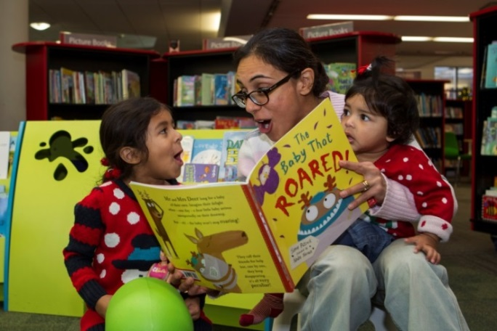
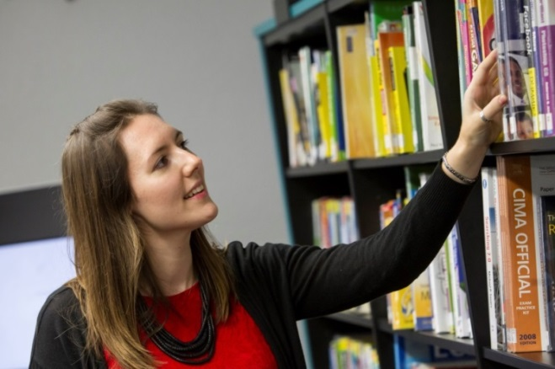

Innovation & Transformation
Iain Varah Chief Executive
Vision – Redbridge Culture & Leisure

Slide 2

Background to Vision RCL
Established in 2007 as a Sport & Leisure Trust; expanded in 2011
Currently operating in the London Borough of Redbridge
Approx 650 staff; turnover of £18m per annum
Parks & Opens Spaces
Sport & Leisure
Culture & Libraries
Formal Parks
Nature Conservation
Allotments
Country Parks
Outdoor Events
Leisure Centres
Swimming Pools
Cycling Centre
Outdoor Education
Indoor Play
High Ropes
Public and School Libraries
Museum & Heritage
Hospitality & Function Venues
Arts/Culture Development
Community Centres

Slide 3
Our Challenges
Responding to Local Authority pressures; financial and demographic
Seek opportunities for investment to grow our business
Generate income rather than make cuts and closures

Slide 4
Transformation & Innovation
Customer consultation and engagement
Building refurbishment and modernisation
Staff training and culture change
Greater use of technology
Flexibility and freedom operating outside the local authority environment
Low cost versus high performance

Slide 5
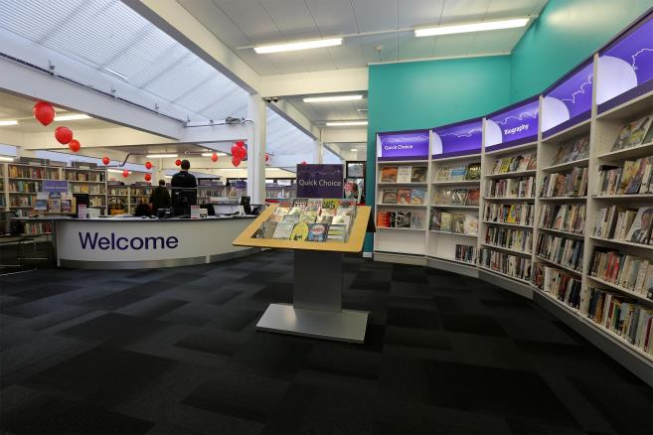
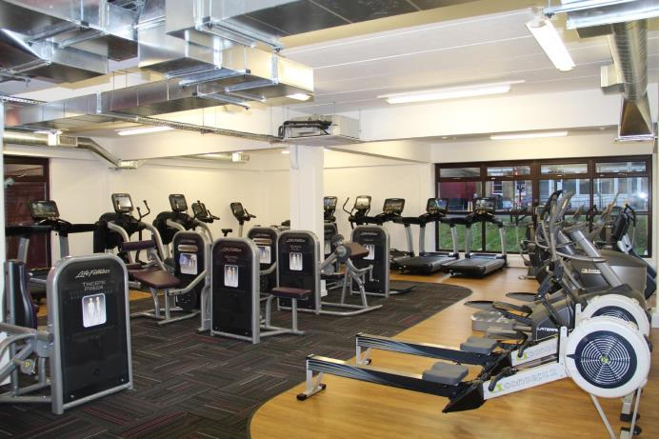



South Woodford Library & Gym
Opened January 2015
300 members + concessions and PAYG
Library hours increased from 55 to 100 per week at no additional cost
Integrated staffing and facility

Slide 6
Transformation… what next?
Continue the trend of income generation as opposed to savings
Currently quite reactive -
Pause; take stock
Develop a longer term view for Leisure, Culture & Libraries as well as responding to current challenges
Further review the broader potential of our buildings and assets; general rationalisation and co-location
Will the Library service be less about the physical?
Don’t lose sight of what we want to achieve and our strengths

Slide 7
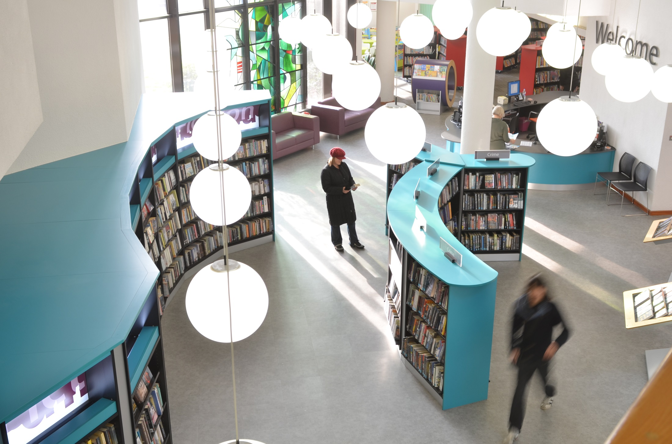
Iain Varah
Chief Executive
iain.varah@visionrcl.org.uk

