Slide 1
Environmental Responsibility and the Cultural Sector
Arts Council England
Andrew Ellerby, Senior Manager Combined Arts & Environmental Responsibility
#culturematters

Slide 2
Arts Council England has been working in partnership with Julie’s Bicycle to inspire environmental action across the arts and cultural sector for over a decade. This collaboration led to a pioneering policy intervention in 2012. Arts Council became the first cultural body to make environmental reporting and planning part of its funding agreements for National Portfolio Organisations.
Collectively, these organisations have reduced energy consumption by 23% and avoided costs of £16.5 million.

Slide 3
Creative Green Tools (Environmental Data collection and Beyond Carbon)
1 on 1 support
Webinars & Briefings
Events
  We Make Tomorrow
  Uncommon Ground
  Creative Climate Chats
Programmes:
- Spotlight
- Accelerator
- The Colour Green / The Colour Green Lab
Arts Council Support (Policy development, Roadshows)

Slide 4
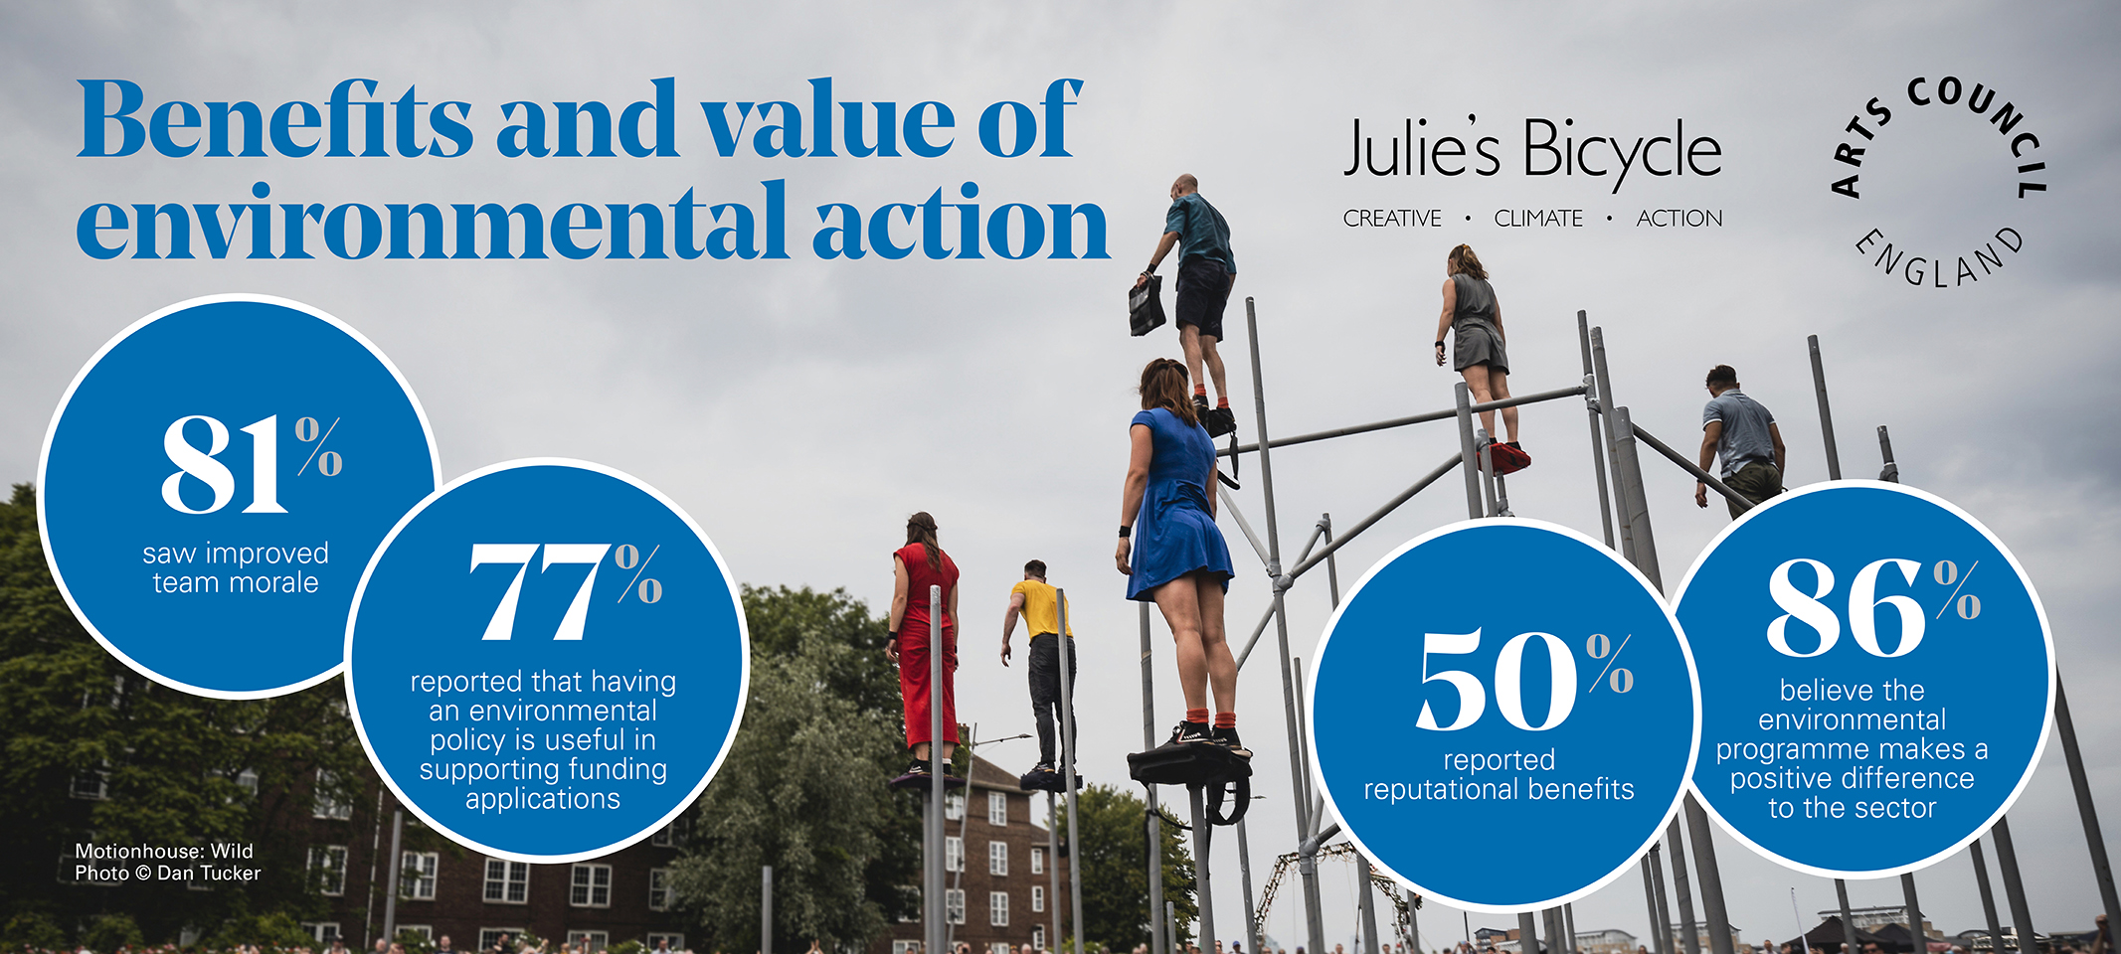

Slide 5
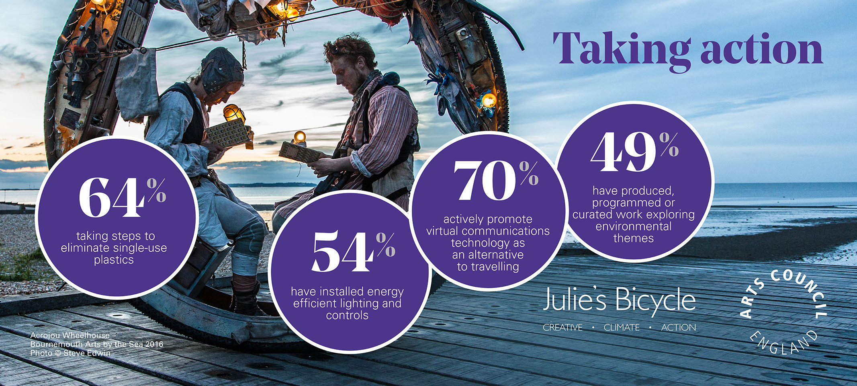

Slide 6
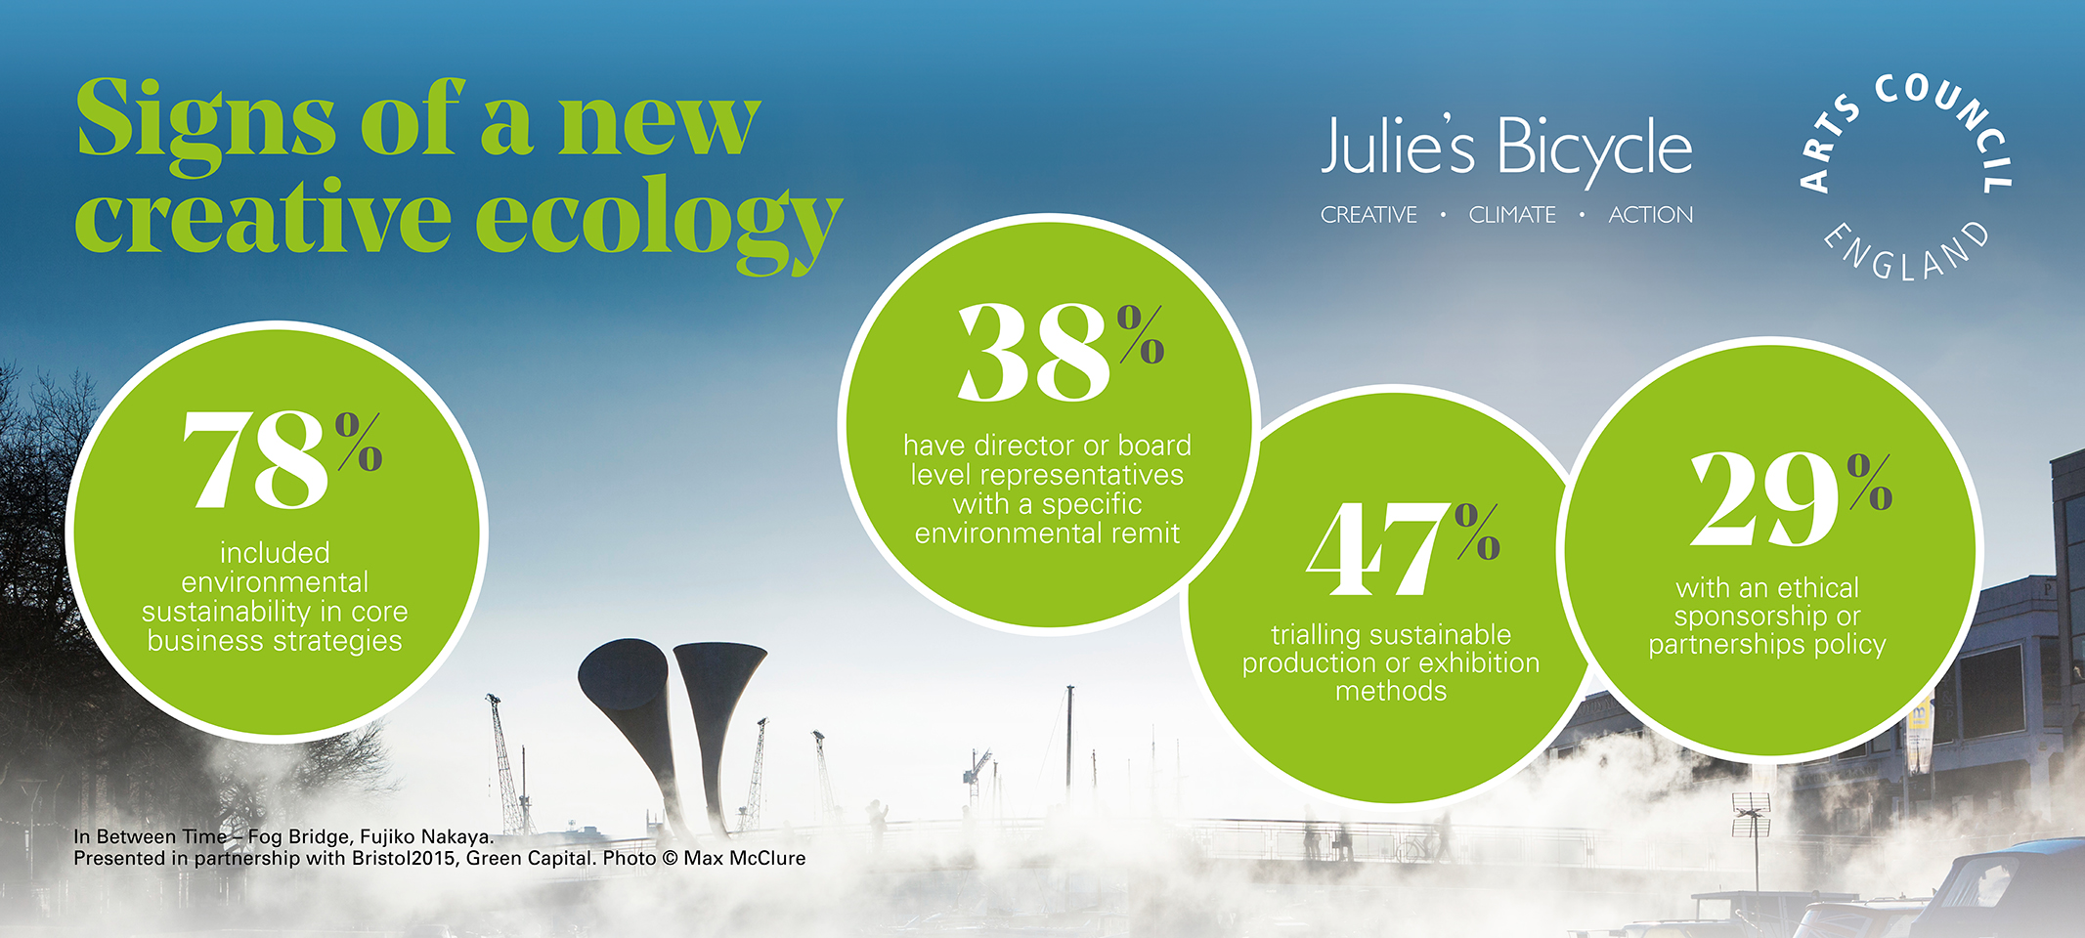

Slide 7
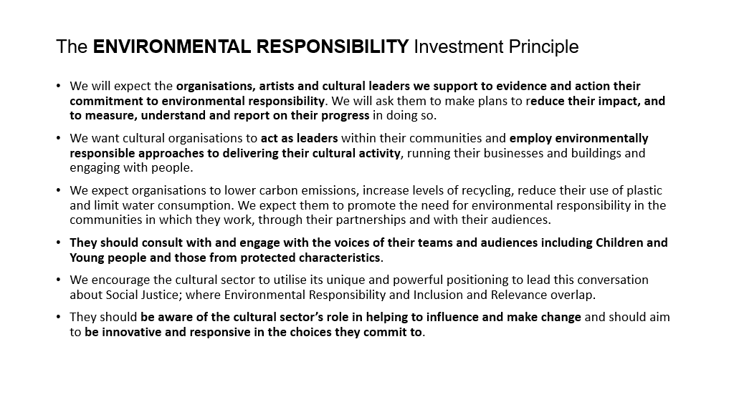

Slide 8

Understand the Data​
​You collect and use good quality data to understand and inform your environmental strategies.
​
Influence, Educate and Advocate
​You consider how your own environmental journey can contribute to discussion and provoke debate. You share the experiences and outcomes of your environmental strategy with your team, partners, stakeholders and the public as part of your advocacy.​
Plan, Action and Change​
Your environmental strategy is a core part of your business planning. It is supported by an action plan with relevant actions and targets that reflect your commitment to Environmental Responsibility. You are able to demonstrate positive change via the actions in your strategy.

Slide 9



Slide 10
1%

Slide 11


Theatres
Galleries
Museums
Libraries
Arts Centres
Studios
Creative Industries
Independent Cinemas
Festivals
Outdoor Arts
Touring
Participatory Practice

Slide 12
What is the potential?

Slide 13
andrew.ellerby@artscouncil.org.uk

