Slide 1
London Councils Climate Change Programme
Wednesday 27th January
Kate Hand
Notes:
Thank you for inviting me
I will be providing an overview of the London Councils climate change programme, including the seven themes of work, our training and data projects, and our advocacy work.
INFO: The Chief Cultural & Leisure Officers Association (CLOA) is the professional association for strategic leaders managing public sector Culture, Arts, Heritage, Tourism, Libraries, Parks, Sport and Leisure services.

Slide 2

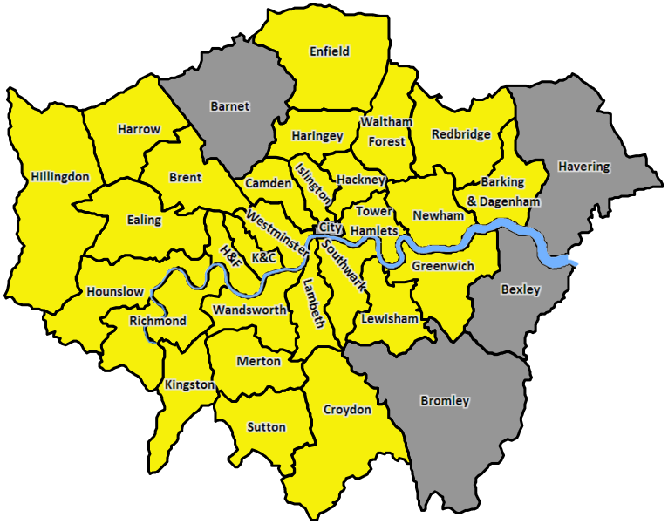
Climate emergency declarations
Notes:
28 boroughs now declared

Slide 3
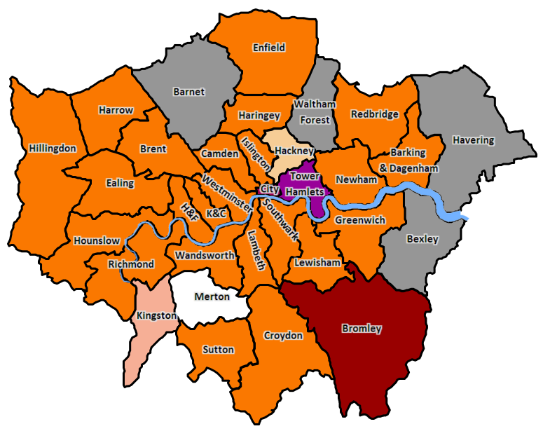
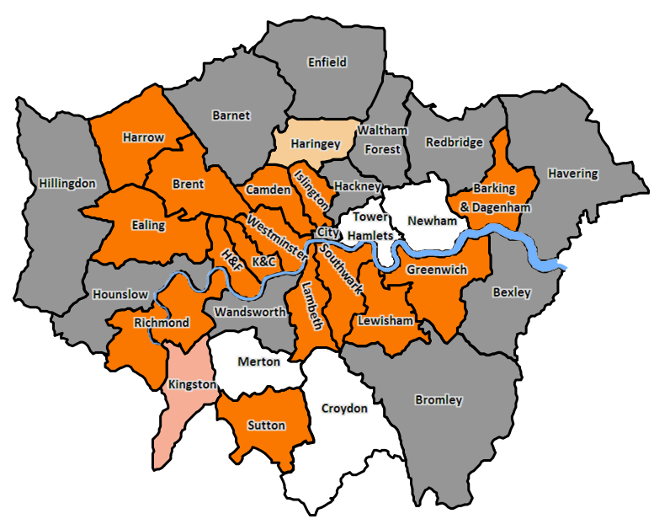
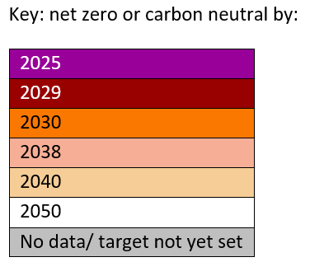
Boroughs’ targets
Council emissions
Borough-wide emissions
Notes:
Variety of targets
Similarity of ambition
And sticking with that ambition through Covid

Slide 4
Joint Statement on Climate Change
Retrofit London: retrofit everything to average EPC B
Low carbon development: buildings and infrastructure
Low carbon transport: Halve petrol and diesel road journeys
Renewable power for London: 100% renewable energy for London’s public sector now and in the future
Reduce consumption emissions: two thirds reduction, focusing on food, clothing, electronics and aviation
Build the green economy
Create a resilient and green London
Notes:
LEDNet and London Councils’ Transport and Environment Committee – portfolio holders – came together at the end of 2019 to agree a joint statement of ambition on climate emergency, a set of principles around governance, resourcing and citizen engagement, and these seven ambitions.
For the CLOA portfolio, I think the key engagement would be around ‘create a resilient and green London’, in respect of parks and leisure services, in terms of creating green (and blue) spaces, but also places that support adaptation to more extreme weather – e.g. libraries as cool spaces in heatwaves.
Beyond the programmes, there is perhaps something around the cultural dimensions of climate change, that we haven’t really addressed – on the culture and arts side. Is there something here about how we reimagine public spaces and a changing city, but also coping with the impacts of change – a role for arts and culture to explore, express and interrogate how we’re doing that? Allowing us to be more inclusive than just through standard consultations?

Slide 5
2021/22 priorities
Executive paper on 2021/22 climate change strategy
Significant process against the odds in 2020
Priorities for 2021:
  Projects to deliver ‘clear and robust evidence and data, shared understanding of emerging best practice, understanding of/ access to green finance’
  Programmes support to ‘ensure that our 7 programmes become an effective backbone for borough collaboration on climate action’
  Advocacy and comms to ‘secure a strong voice for LC on climate backed up by clear, evidence-based asks’

Slide 6
Projects
Climate Action Plans review delivery March/ April
Climate evidence review delivery April/ May
Consumption emissions data delivery April/ May
Emissions accounting delivery July/ August
Green finance
Community engagement
Low carbon procurement

Slide 7
Programmes
 | Lead borough | Action Plan
#1 Retrofit London | LB Enfield and LB Waltham Forest | Expected June (consultant recruited)
#2 Low carbon development | LB Hackney and LB Tower Hamlets | In draft
#3 Low carbon transport | RB Kingston | Pending
#4 Renewable power | LB Islington | Pending
#5 Consumption emissions | LB Harrow | In draft
#6 Green economy | LB Hounslow | Pending
#7 Resilient and green | LB Southwark | In draft
Notes:
The key things London Councils will be helping lead boroughs with are:
Securing an effective process for action plan development, if they don’t have one
Supporting the development of governance that involves other boroughs, and others as appropriate
Securing resources to support lead boroughs
Helping shepherd action plans through sign off
Supporting reporting

Slide 8
#7 Resilient and Green: key themes
Six main climate adaptation risks, to which London must become resilient – heat stress, drought, flooding and loss of natural capital
Can create significant co-benefits – inc. public health, and avoided costs to people and infrastructure
Interventions often small but numerous, scaling up distributed measures
Longer-term planning horizons
Requires an integrated approach within, across and beyond each borough, inc. to join up benefits and budgets
Will need to be reflected in each other action plan

Slide 9
#7 Resilient and Green: actions
Broad groupings:
  Mapping social vulnerability to heat, drought, access to green space
  Mapping opportunities to connect and enhance natural environment assets – rainwater gardens, attenuation basins, tree canopy
  Increasing evidence base and planning for multiple, cascading threats
  Developing collective tools e.g. early warning for surface water flooding, natural capital accounting
  Enabling planning and building control to address heat risk, water and flood risk in new build, and through retrofit
  Using green and blue infrastructure as solutions to resilience threats

Slide 10
#7 Resilient and Green: actions
  New and agile funding models, with persuasive modelling of avoided costs – e.g. financial catastrophe modelling or natural capital accounts
  Training and capacity, inc. possible pan-London teams
  Community engagement, on public health risks, water saving etc.
  Lobbying and advocacy, e.g. for building standards, area-based water charging, green infrastructure benchmarks etc.

Slide 11

HELPING LONDONERS INTO GOOD WORK
Mission Leads, Organisations and Approach
Mission
Approach
We will support Londoners into good jobs with a focus on sectors key to London’s recovery.
We propose to achieve this mission by developing easy to access support for Londoners so they can find training and rewarding employment opportunities. This includes four project strands:
Supporting Londoners hardest hit by the pandemic into good work, while ensuring that Londoners with the most complex needs are not left behind.
Coordinating skills, careers and employment support so there is ‘no wrong door’ for Londoners seeking assistance.
Establishing sector specific London 'Academies' to support Londoners to gain relevant skills and move into good work in sectors key to London’s recovery.
Close working with employers and job creation initiatives to promote good work.
Mission Co-leads:
Michelle Cuomo-Boorer (Assistant Director – Skills & Employment, GLA) and Dianna Neal (Strategic Lead: Enterprise, Economy and Skills, London Councils).
Lead Organisations & Partners:
GLA and London Councils, boroughs, Jobcentre Plus, skills and employment support providers, employers, unions and VCS.

Slide 12

HIGH STREETS FOR ALL
Mission Leads, Organisations and Approach
Mission
Approach
Deliver enhanced public spaces and exciting new uses for underused high street buildings in every Borough by 2025, working with London’s diverse communities.
We propose to achieve the mission by fostering local engagement, partnership formation and a culture of ideas, experimentation and invention across the city to deliver inclusive, exemplar High Street projects in every borough.
This will be supported by enabling funds, expert advice and best practice sharing. We will develop tools that respond to recent planning and licensing changes and plan for, safeguard and directly deliver a diverse, resilient and thriving mix of High street and town centre activity within easy reach of all Londoners and at all times of day and night.
All the while, we will be making the case for London's receipt of a fair share of Government resources available for high streets and town centres. Major Mayoral investments especially Housing and Transport will be harnessed to support local economic recovery objectives.
Mission Co-leads:
Sarah Cary (LB Enfield)
Patrick Dubeck (GLA)
Lead by locally defined partnerships - involving property interests, businesses, diverse community groups and local anchor institutions, supported by London Boroughs, London Councils and the GLA group and a newly formed multi sector / diverse interest advocates group.

Slide 13

A GREEN NEW DEAL
Mission Leads, Organisations and Approach
Mission
Approach
Tackle the climate and ecological emergencies and improve air quality by doubling the size of London's green economy by 2030 to accelerate job creation for all.
We propose to achieve the mission through large scale transformation by 2030, requiring new approaches, greater coordination, faster action, citizen buy-in, the devolution of powers and funding from national government, and substantial flows of private sector capital.
Three key themes to deliver projects
1) decarbonise and transform the built environment;
2) green London’s transport and public realm;
3) mobilise new finance and support green jobs, skills and lifestyles.
Lead Organisations & Partners:
Convening a Green New Deal Advisory Panel and co-designing action plans with delivery partners through 'deep dive' workshops.
  Three aimed for Winter 2021: Retrofit, Zero Emission Zones and Enhance green spaces and resilience.

Slide 14
Advocacy and comms
Key moments:
‘London Local Government Climate Leaders’ Roundtable’ March
Joint interventions on Net Zero Strategy – TBC Mar-Jun
London Climate Action Week 26 June – 4 July
‘London Climate Leaders’ pre-COP’ Jun – Oct
Engagement with departments on Spending Review May – Oct
Joint interventions on Spending Review May – Oct
COP26 1 – 11 Nov

Slide 15
Programmes – governance
Key:
Climate programme
Officer group
Member group
London Climate Emergency Board
Membership
Un-confirmed
CELC Environment lead (Chair)
Self-selecting CELC members (currently Hounslow, W’minster, H&F, Ealing, Bromley, Camden, Enfield, Tower Hamlets, Haringey, SLP)
Lead CX Advisors – Environment
Leaders Committee
Formal reporting
Informal reporting
London Environment Directors’ Network
London Housing Directors’ Group
Association of Directors of Public Health
Society of London Treasurers
Lead boroughs
London Councils
Cross-Director climate coordination group
Transport and Environment Committee
Working level lead officers per programme
Sub-regional p’ships
London Councils (Chair)
Lead borough climate coordination group
#1 Retrofit London
#2 Low carbon development
#3 Low carbon transport
#4 Renewable energy for London
#5 Reducing consumption emissions
#6 Building the green economy
#7 Creating a resilient and green London
LB Enfield + Waltham Forest
Steering Group (Boroughs, Partners)
LB Hackney and Tower Hamlets
Steering Group (Boroughs, Partners)
RB Kingston
Steering Group (Boroughs, Partners)
LB Islington
Steering Group (Boroughs, Partners)
LB Harrow
Steering Group (Boroughs, Partners)
LB Hounslow
Steering Group (Boroughs, Partners)
LB Southwark
Steering Group (Boroughs, Partners)
Notes:
To support the programmes more widely, we have developed this governance structure, which I’m hoping is now familiar.
The cross-director climate group will oversee strategic coordination
The borough leads group will bring together working leads – so Francis and colleagues to work through some of the nitty gritty.
The borough recovery missions coordination group will coordinate all that with the recovery missions… which we will also continue to co-lead with GLA

